Slide 1

DIVERSITY
Lesson Created by Christine Braun

Slide 2
Slide 1
DIVERSITY
Artist Statement:
Race, culture, religion or political party; each one of us is different and we think and see the world in different ways. We are able to take our thoughts and views and share them with one another to learn, to gain and to become one—to help our community, our country, and our world.

Slide 3

Slide 2
Diversity Makes
America Great
by: Andres Castano, Miami, Florida

Slide 4
Slide 3
A nation is only as strong as its people;
a people divided is a nation conquered.
quote by:
Jadesola Popoola,
Ikeja, Nigeria

Slide 5
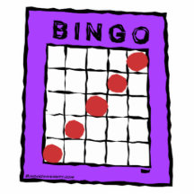
Slide 4
DIVERSITY BINGO
Walk around the room and gather signatures from students who
match the qualifications within the squares.
Fellow students may only sign ONE square per card.
Once you have a BINGO – across, down or diagonally in a row –
shout BINGO!
Get a prize for your BINGO

Slide 6
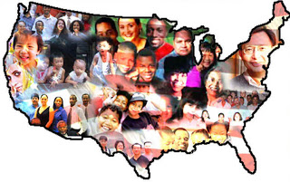
Slide 5
How diverse is our classroom? What are the benefits and challenges of a diverse classroom? City? State? Country?

