Slide 1

INCLUSION
Lesson Created by Christine Braun

Slide 2
Slide 1
INCLUSION
Definition – The act or practice of including and accommodating people who have historically been excluded (as because of their race, gender, sexuality or ability). The act of including; the state of being included.

Slide 3
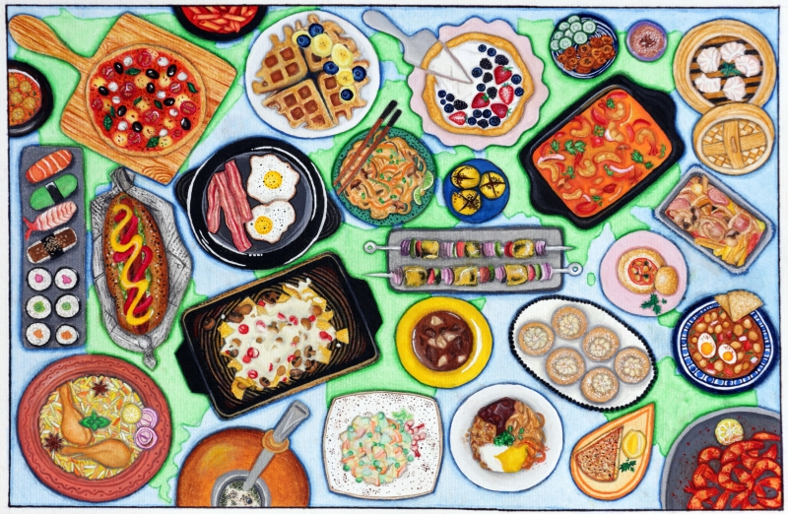
Slide 2
The World on Your Platter
by: Prerna Lulia,
11th Grade,
Narsee Monjee College of Commerce & Economics,
Mumbai, India

Slide 4
Slide 3
True inclusion is when everyone is not only invited to the table,
but encouraged to contribute to the meal.
quote by: Anne Russ,
New York, New York

Slide 5

Slide 4
ACTIVITY
Questions to ask during interview:
1. What is your favorite ethnic food?
2. How often do you eat this?
3. Is this food part of your family’s heritage? Cultural background?
Or was this food introduced to you through social circles/peer groups?

Slide 6
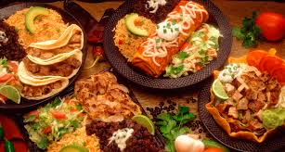
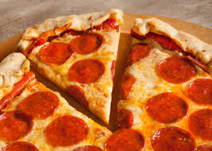
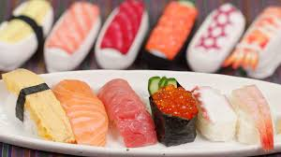
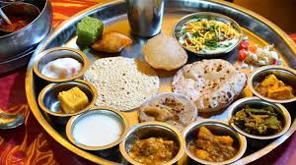
Slide 5
What can we learn about our diverse cultures
and inclusion through the foods we eat?

