Slide 1

INTEGRITY
Lesson Created by Christine Braun

Slide 2

Slide 1
INTEGRITY?
What is a trait, behavior or attitude that demonstrates integrity/honesty/morality ?
Write this on a post-it note.
Stick all notes on the board.
You have 5 minutes.
We will develop a definition of integrity based on your responses.

Slide 3

Slide 2

Slide 4

Slide 3
Taunting & Bullying
by: Irina Petukhova, Moscow, Russia

Slide 5
Slide 4
Crushing another's spirit doesn't make you stronger; it makes us all weaker.
Quote by:
Shashanna Prince,
New Ellenton,
South Carolina

Slide 6
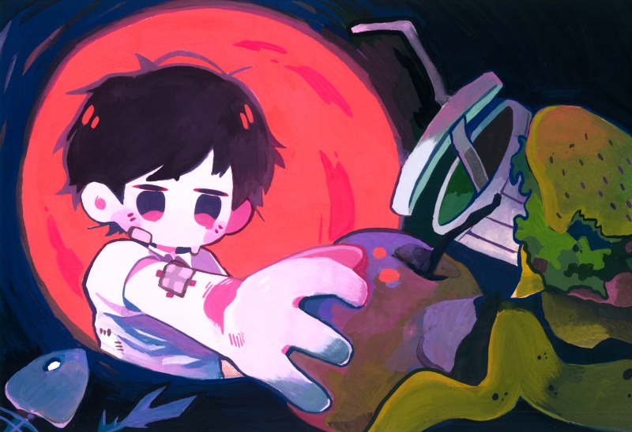
Slide 5
What Are You Looking For?
by: Pei Shuen Liew, The One Academy, Petaling Jaya, Malaysia
teacher: Christopher Reis

Slide 7
Slide 6
Your track in life should not be determined by what side of the tracks you come from.
quote by: Seth Morano, Sarasota, Florida

Slide 8
Slide 7
What does the word INTEGRITY mean to you?

