Slide 1

RESPECT
Lesson Created by Christine Braun

Slide 2
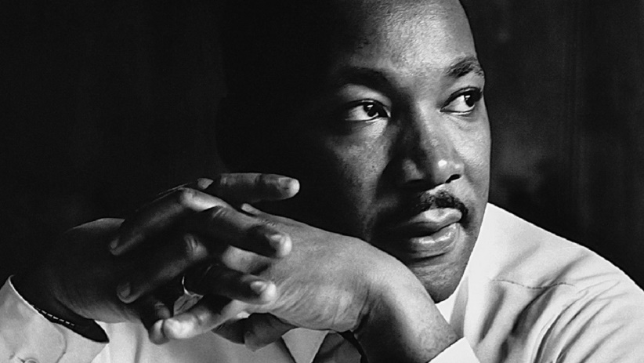
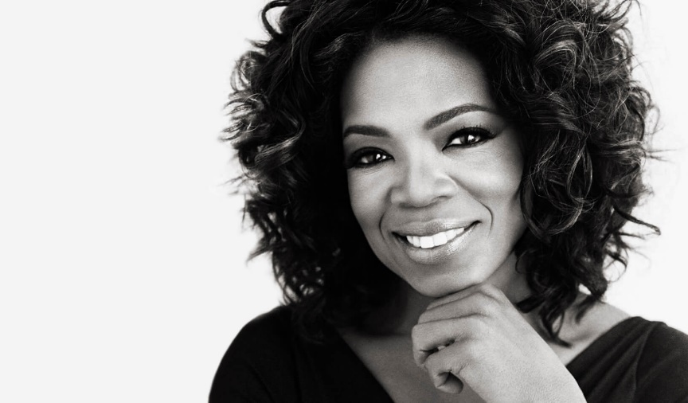
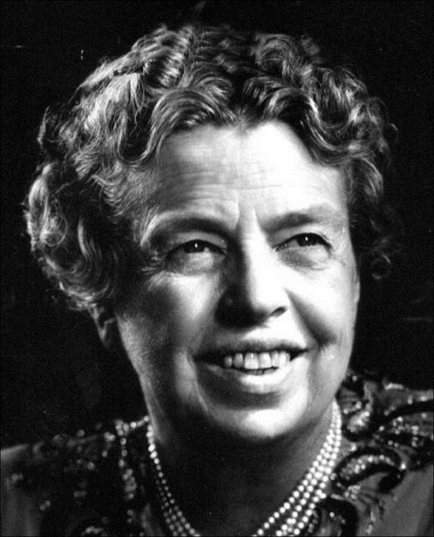
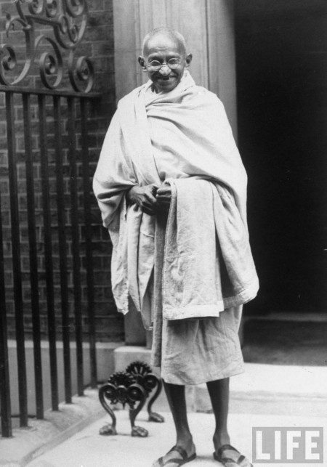
Slide 1
RESPECT
Brainstorm - Who is worthy of respect?

Slide 3
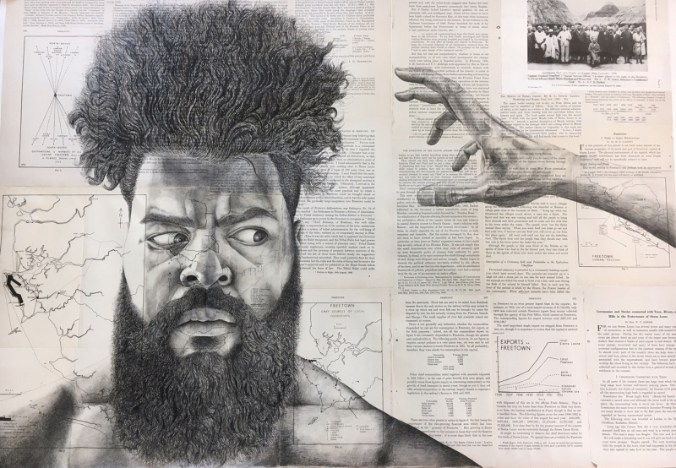
Slide 2
Can I Touch Your Hair?
Best in Show Adult
by: Habib Hajallie, Dartford, United Kingdom

Slide 4
Slide 3
One can be present, but not feel included. True inclusion is when you're seen, heard and respected.
Quote by:
Jana Quismundo,
Berlin, Germany

Slide 5
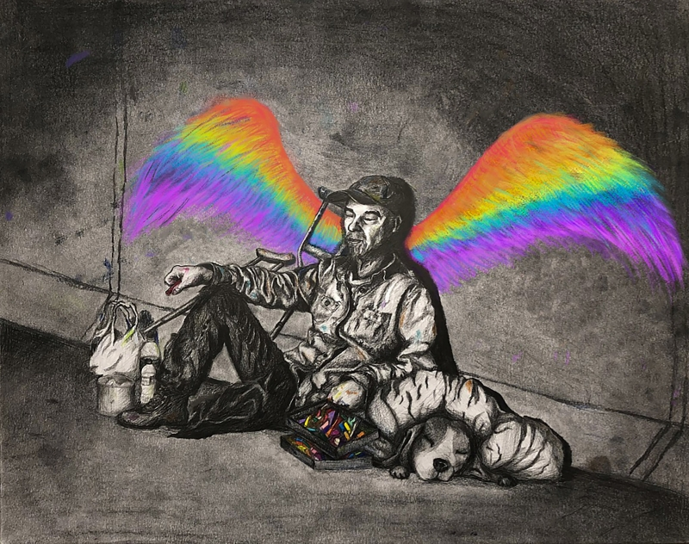
Slide 4
I Have a Dream
Best in Show Student
by: Shangxi Wu,
11th Grade,
Pleasanton, California

Slide 6
Slide 5
Living life as an amputee is the ability to stand tall like a mountain, even when you have no feet.
quote by:
Marsha Danzig,
Dayton, Ohio

Slide 7
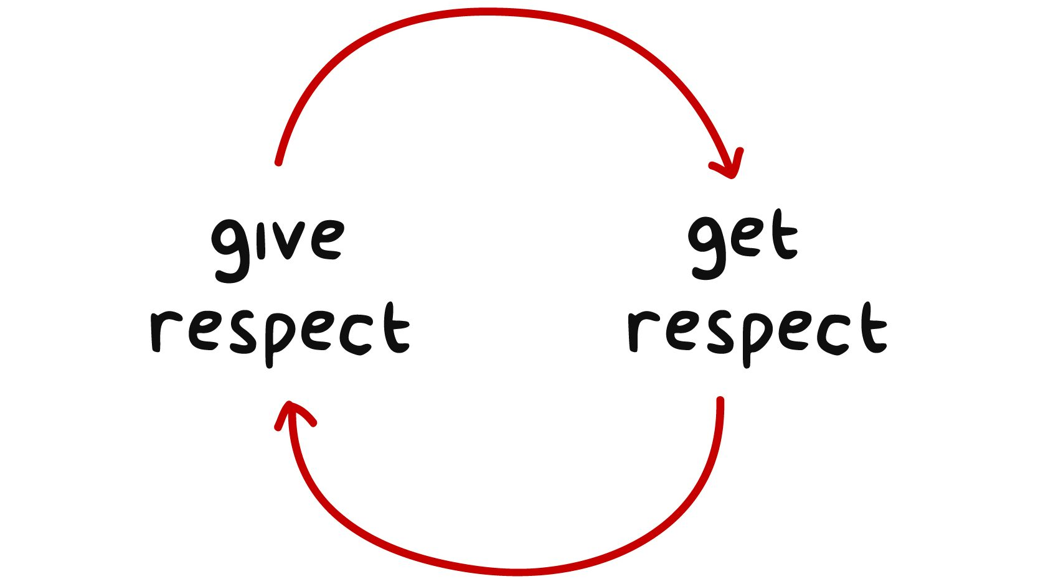
Slide 6
How can a person show dignity and respect for all people,
no matter who they are?

