Slide 1

Our Connections
Lesson Created by Carol LaVallee

Slide 2
Slide A
How do you see or understand yourself, what part of your identity is most important to you?
Think about (but do not answer) the following question: How can we all be connected if we are so different from one another?

Slide 3
Slide B
“Across many studies of mammals, from the smallest rodents all the way to us humans, the data suggests that we are profoundly shaped by our social environment and that we suffer greatly when our social bonds are threatened or severed.“ by Matthew Lieberman
What do you feel the author is trying to say? Is the quote talking about differences or similarities among people, or both? Explain your answer.

Slide 4
Slide C
“That was why Martin Luther King called on people to be judged not by the colour of their skin but the content of their character. And in the same way, people should not be judged by their last name, or their religious faith, but by the content of their character and how they behave. Are they good citizens? Are they good people? …. In the United States, we embrace the motto: E Pluribus Unum. In Latin, that means, ‘out of many, one.’” by Barak Obama
What do you feel the author is trying to say? Is the quote talking about differences or similarities among people, or both? Explain your answer.

Slide 5
Slide D
“…I am saddened by how people treat one another and how we are so shut off from one another and how we judge one another, when the truth is, we are all one connected thing. We are all from the same exact molecules.” By Ellen Degeneres
What do you feel the author is trying to say? Is the quote talking about differences or similarities among people, or both? Explain your answer.

Slide 6
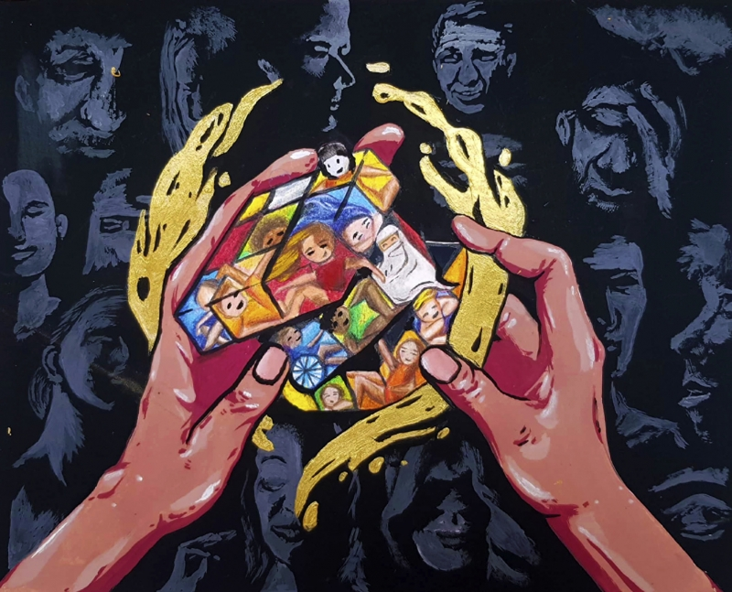
Slide E
What differences do you see?
What similarities do you see?
What is ONE word to describe this artwork?

Slide 7
Slide F
The Diversity Cube
by: Siti Rhaudah F., 11th Grade, SMA Plus Negeri 17 Palembang, Palembang, Indonesia
teacher: Widya Grantina
Why do you feel the artist used this title?

Slide 8
Slide G
A difference isn't a challenge; it's an opportunity.
quote by: Cutter J., 7th Grade, Sarasota Middle School, Sarasota, Florida
teacher: Kim Farrell
A difference isn't a challenge; it's an opportunity to _____________.
People who have similarities have an opportunity to _____________.

Slide 9
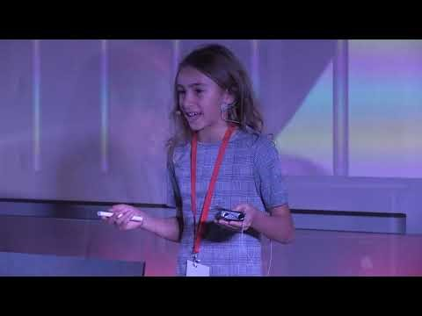
Slide H
Essential Question: How can we all be connected if we are so different from one another?
A difference isn't a challenge; it's an opportunity.
quote by: Cutter J., 7th Grade, Sarasota Middle School, Sarasota, Florida
teacher: Kim Farrell
The Diversity Cube
by: Siti Rhaudah F., 11th Grade, SMA Plus Negeri 17 Palembang, Palembang, Indonesia
teacher: Widya Grantina
Ted Talk: Being the Same and Being Different

