Slide 1

Comic Book Heroes
Lesson Created by Carol LaVallee

Slide 2
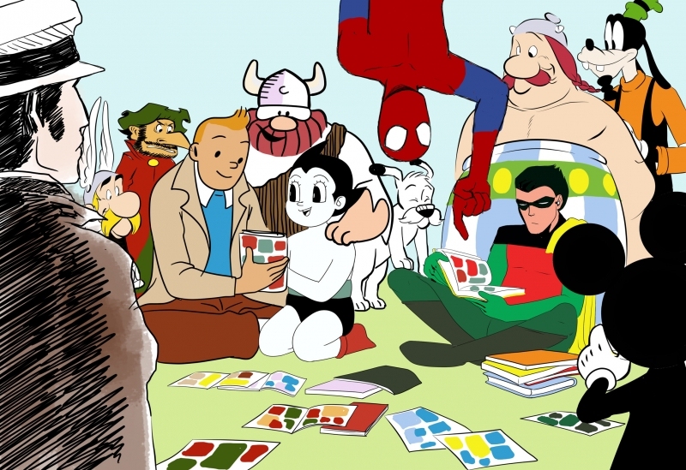
Slide A
Can you name any of the comic book characters?
Comic Heroes
by: Ana Perić, Bukovac/Novi Sad, Serbia

Slide 3
Slide B
Pretenders say the right things. Heroes do the right things.
by: Suresh Jayan, Bengaluru, India
What do you think this quote means?

Slide 4
Slide C
What defines a Hero?
1.
2.
3.
4.
5.
6.
7.
8.

Slide 5
Slide D
Why do you think the artist sees these characters as “Comic Heroes”?
Comic Heroes
by: Ana Perić, Bukovac/Novi Sad, Serbia

Slide 6
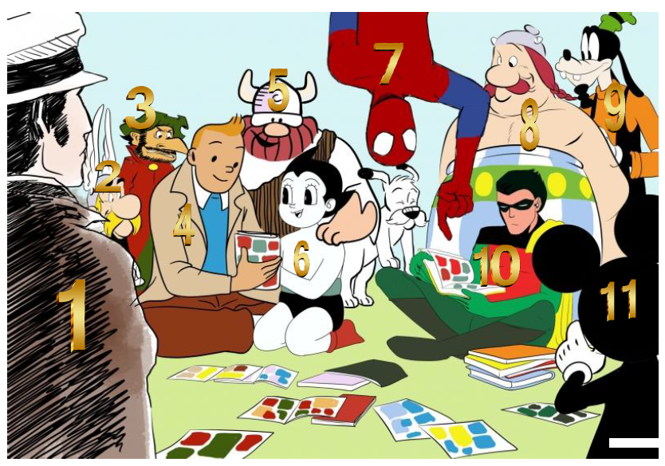
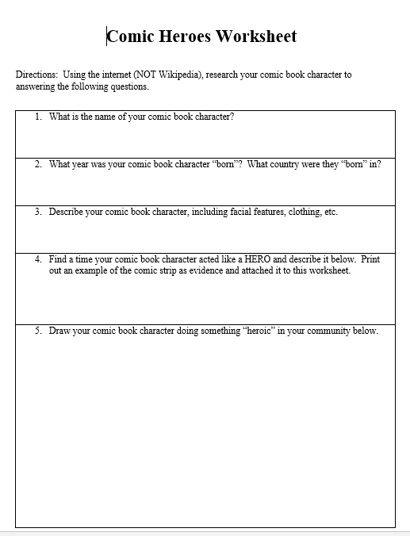
Slide E

Slide 7

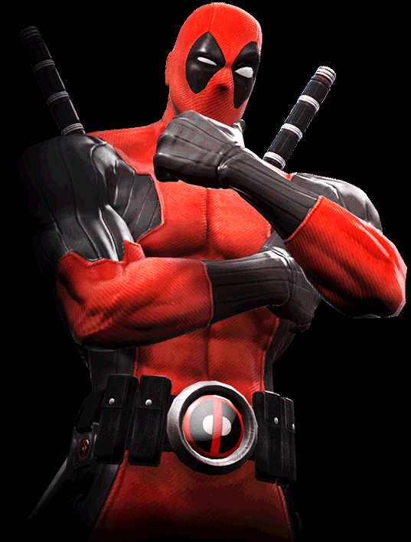
Slide F
What have we learned so far….
Essential Question:
What defines a Hero?

Slide 8
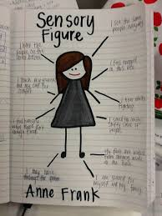
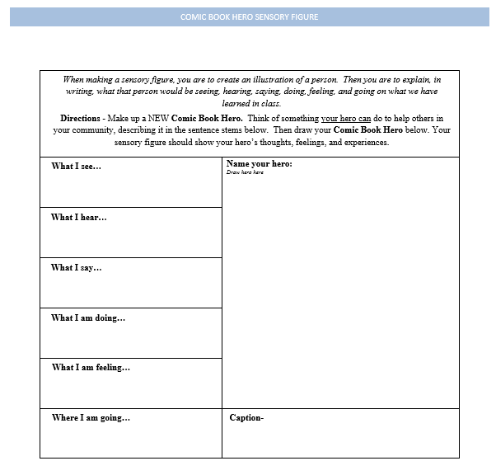
Slide G
Comic Hero Sensory Figure

