Slide 1

Social Media & Society
Lesson Created by Carol LaVallee

Slide 2
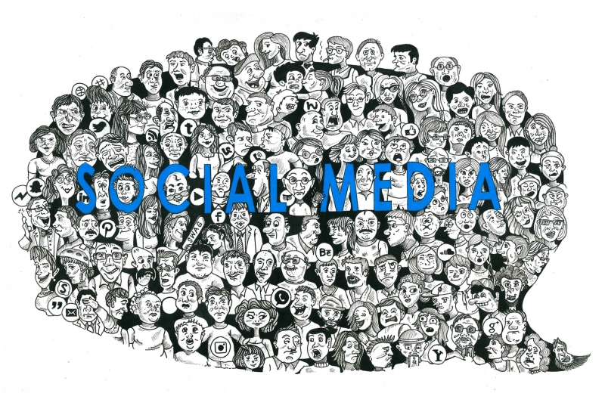
Slide A
We see a lot of faces, describe one.
What object do you see?
Write a one sentence summary under the artwork.
Social Web
by: Kajol Shah, Delhi, India

Slide 3
Slide B
What in the artwork speaks to you?
How does it connect to your life?
Social Web
by: Kajol Shah, Delhi, India

Slide 4
Slide C
In your opinion…
What EXACTLY IS social media?
Is social media a positive or negative for society? Or both?

Slide 5
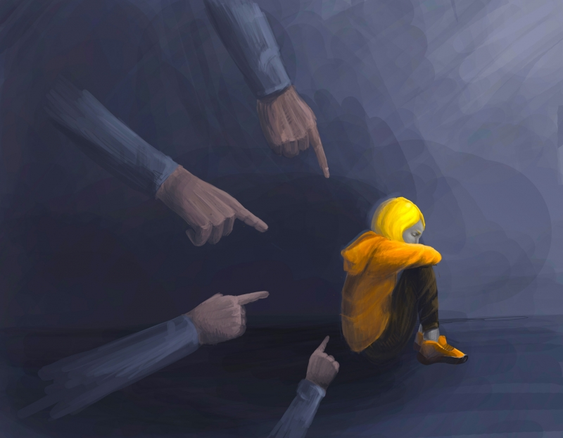
Slide D
What do you see?
Why do you think the artists used the colors they did?
How is this artwork related to our discussion on social media?
Write a caption describing what you think might be going on in this artwork.
Alienation
by: Maryana Oliynyk, Lviv College of Civil Engineering, Architecture & Design, Lviv, Ukraine
teacher: Alina Mulyk

Slide 6
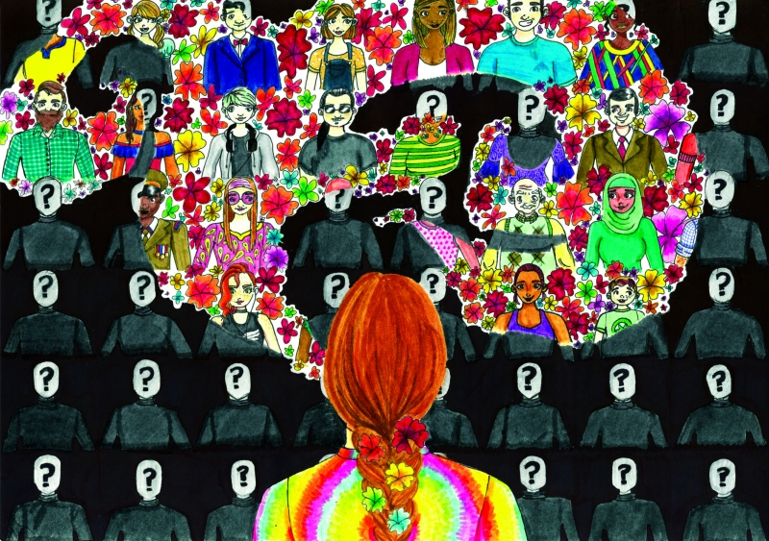
Slide E
What do you see?
Why do you think the artist used the colors she did?
How is this artwork related to our discussion on social media?
Write a caption describing what you think might be going on in this artwork.
Be a Voice, Not an Echo by: Mackenzie A., 9th Grade, Saint Kentigern College, Auckland, New Zealand

Slide 7
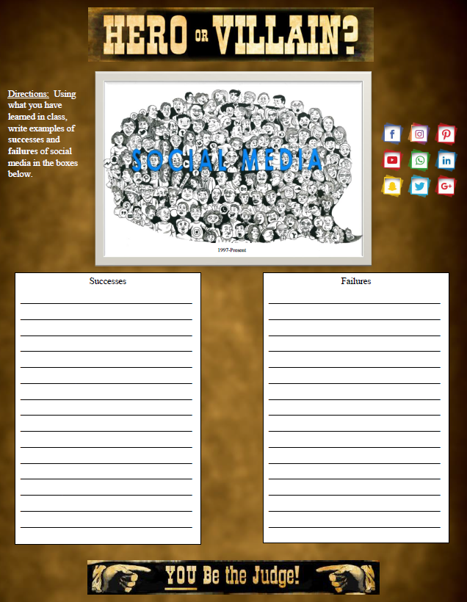
Slide G
Hero or Villain
Is the impact of social media positive or negative for society?

Slide 8

Extention:
Matching
When you find your voice, use it to be a force for change.
by: Fran Squires, M.Ed., Osprey, Florida
If you are given the choice of "being cool" or "being kind," choose kind.
by: Amanda L., 8th Grade, Sarasota Middle School, Sarasota, Florida
teacher: Laura Segreto
Destroying someone else's sparkle doesn't make you shine brighter.
by: Maddox V., 6th Grade, Pine View School, Osprey, Florida
teacher: Linda Lyons

