Slide 1
Diversity Fingerprint
Lesson Created by Carol LaVallee

Slide 2
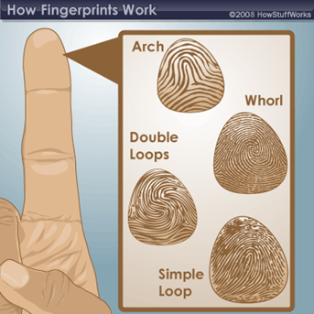
Slide A
What is a fingerprint?

Slide 3
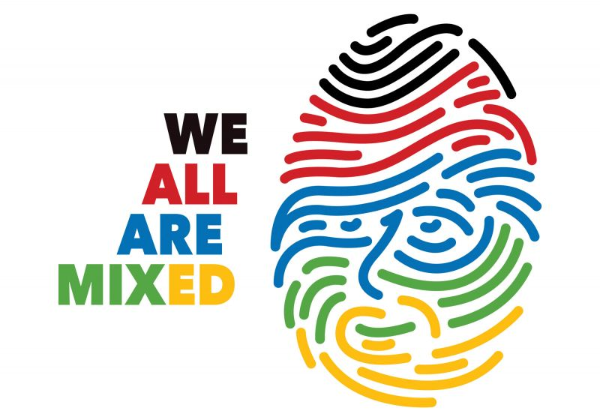
Slide B
Look at this piece of artwork.
What do you see?
Diversity Fingerprint by Sergio Naranjo Segura, Benicarlo, Spain

Slide 4
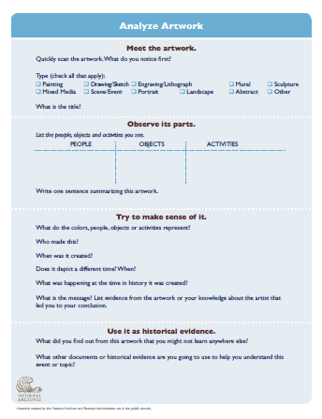
Slide C
Complete the Artwork Analysis Sheet
Diversity Fingerprint by Sergio Naranjo Segura, Benicarlo, Spain

Slide 5
Slide D
What does this artwork mean to you?
What does the artist mean by “WE ALL ARE MIXED”?
Diversity Fingerprint by Sergio Naranjo Segura, Benicarlo, Spain

Slide 6
Slide E
Artist Statement
“Recent research on DNA reveals that human beings have an extremely varied genetic inheritance; even in some very isolated populations, the genetic variation is remarkable. A person from Haiti can have DNA that is shared with people from France, Tunisia, Poland, Vietnam and Argentina. This insight led me to think that each one of us carries a good part of the world’s genetic diversity. In this way, our fingerprint, which identifies us
as unique individuals, could be visualized as a symbol of this diversity.”
Sergio Naranjo Segura, Benicarlo, Spain

Slide 7
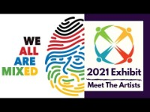
Slide F
Click on Image to Play Video (Internet Connection Required)

Slide 8
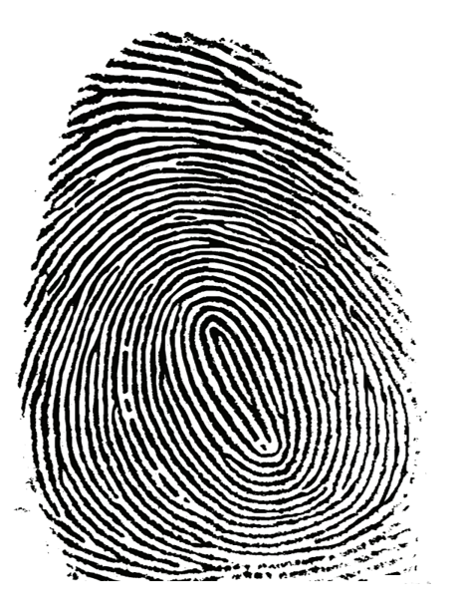
Slide G
What does diversity look like?
Make your own Diversity Fingerprint!
Diversity Fingerprint by Sergio Naranjo Segura, Benicarlo, Spain

Slide 9

Slide H
Diversity
EXTENTION
EXTENTION
How is this quote related to the Diversity Fingerprint artwork?
"The fact that everybody has a unique fingerprint proves that each person is meant to be different.“
quote by Natalie Lubich, San Francisco, California

Slide 10
Slide I
EXTENTION
Create a quote!
Have student brainstorm words/phrases/ideas that the phrase ‘Embracing Our Differences’ reminds them of.
Have them raise their hand to come to the board to write down their ideas.
Use these ideas to create a quote!
Diversity Fingerprint by Sergio Naranjo Segura, Benicarlo, Spain

Slide 11
Slide J
EXTENTION
Create a quote!
Some advice when creating a quote:
Write like real people talk.
Use phrasing that is memorable
Create a picture in the reader's mind.
Not to long, not to short
Then submit the quote to EOD!
https://www.prnewsonline.com/tips-writing-quotes
Diversity Fingerprint by Sergio Naranjo Segura, Benicarlo, Spain

Slide 12
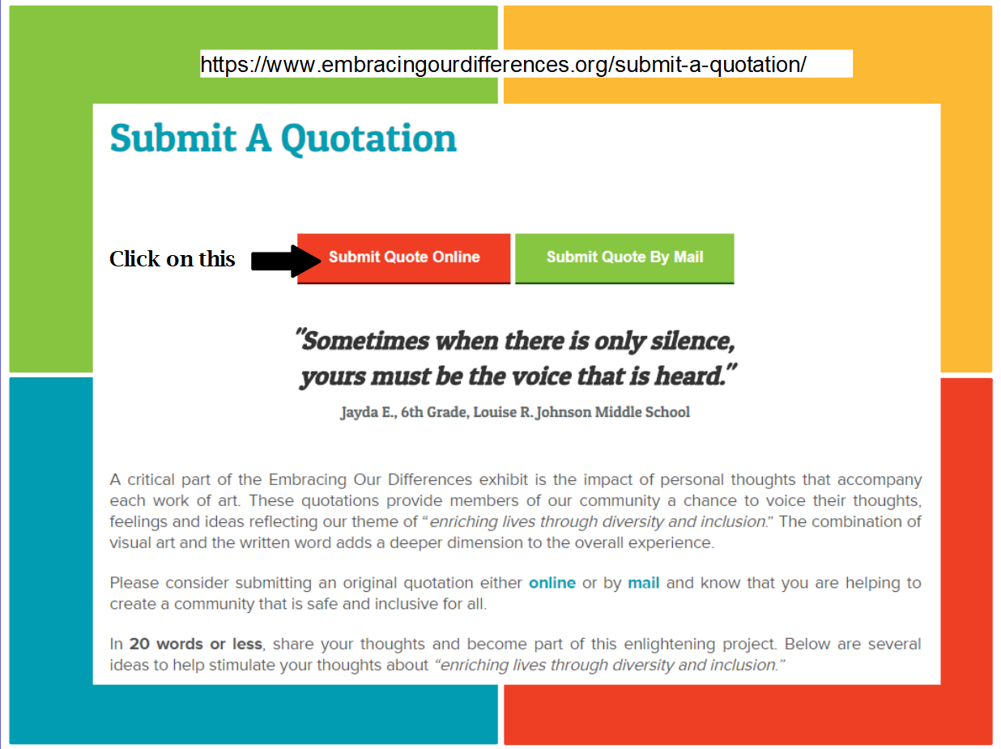
Slide K
EXTENTION

Slide 13
Slide L
EXTENTION
Make your own piece of artwork showing Diversity in your community.

