Slide 1
Friendship
Lesson Created by Carol LaVallee

Slide 2
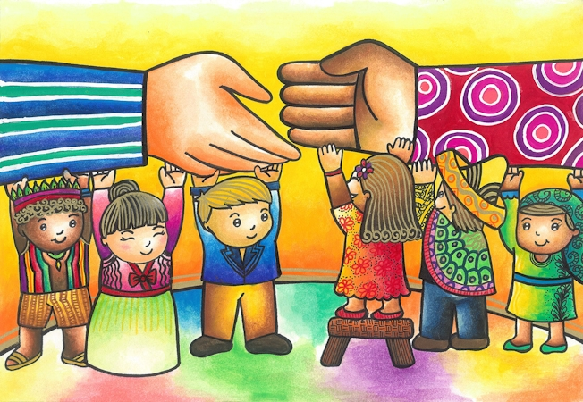
Slide A
What qualities would you find in a friend?
Bringing Hands Together, Bridging Gaps Forever (2012)
by Jamia M, 7th Grade, St. Stephen's High School - Valenzuela City, Philippines

Slide 3
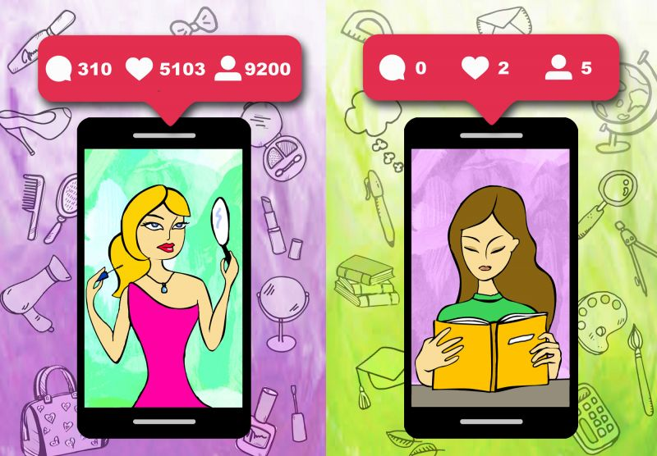
Slide B
What do you see?
Girl on Left
Girl on Right
Real Values by Maryam Seifollahi Bazarjani, Tehran, Iran

Slide 4
Slide C
What are these girls thinking? Fill out the thinking bubbles.
Real Values by Maryam Seifollahi Bazarjani, Tehran, Iran

Slide 5
Slide D
Girl On Left
Girl On Right
Real Values by Maryam Seifollahi Bazarjani, Tehran, Iran

Slide 6
Slide E
Would these two girls be friends or enemies? Why?
Real Values by Maryam Seifollahi Bazarjani, Tehran, Iran

Slide 7
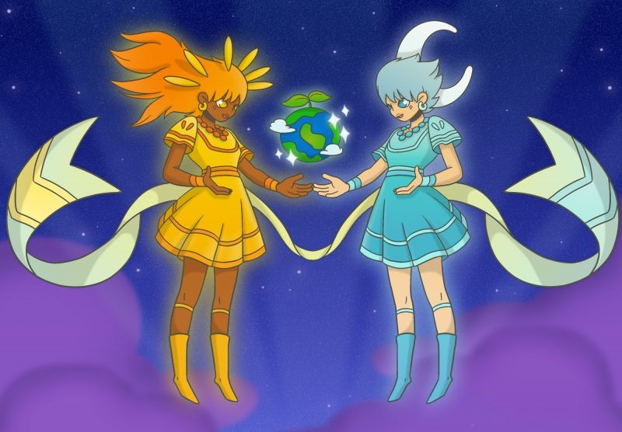
Slide F
What do you see?
Sun Sister
Moon Sister
The Sun & Moon Sisters by Allanson Ace Mangulabnan, Parañaque City, Philippines

Slide 8

Slide G
If they were talking, what would they be saying. Fill in the talking bubbles.
The Sun & Moon Sisters by Allanson Ace Mangulabnan, Parañaque City, Philippines

Slide 9
Slide H
z
Sun Sister
Moon Sister

Slide 10
Slide I
Are these two people friends or enemies? Why?
The Sun & Moon Sisters by Allanson Ace Mangulabnan, Parañaque City, Philippines

Slide 11

Slide J
Write a quote about the characteristics of a friend and post a photo of your friend(s) next to your quote.
https://padlet.com/

Slide 12
Slide K
Extension
EXTENTION
"A best friend is someone who appreciates our strengths and accepts our flaws.“
quote by Sanika Chatterjee, Dhanbad, India
What are the characteristics of a best friend?
Read this quote: Do you agree or disagree with this quote? Why?

Slide 13


Slide L
Extension
EXTENTION
Choose a piece of artwork from the following website that you feel shows friendship.
Write a caption for the piece.
Be prepared to explain how your piece related to friendship.

Slide 14
Slide M
What is friendship?
EXTENTION
Make your own piece of artwork showing your friendship.

