Slide 1
Helping Hand
Lesson Created by Carol LaVallee

Slide 2
Slide A
Have you helped someone? Why?
By helping people does it help your community? How?

Slide 3
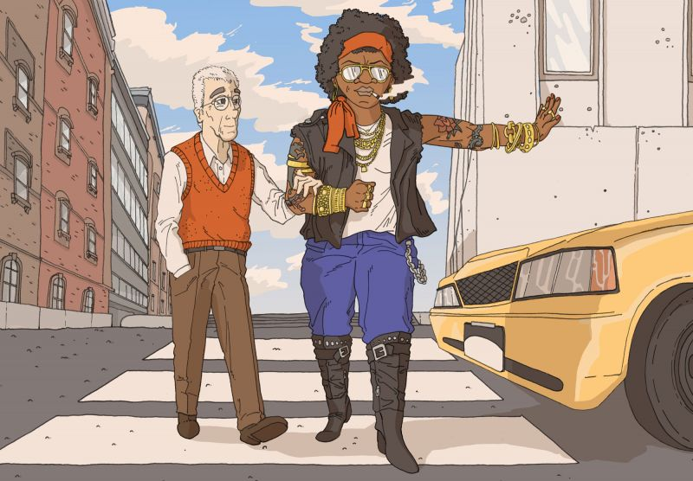
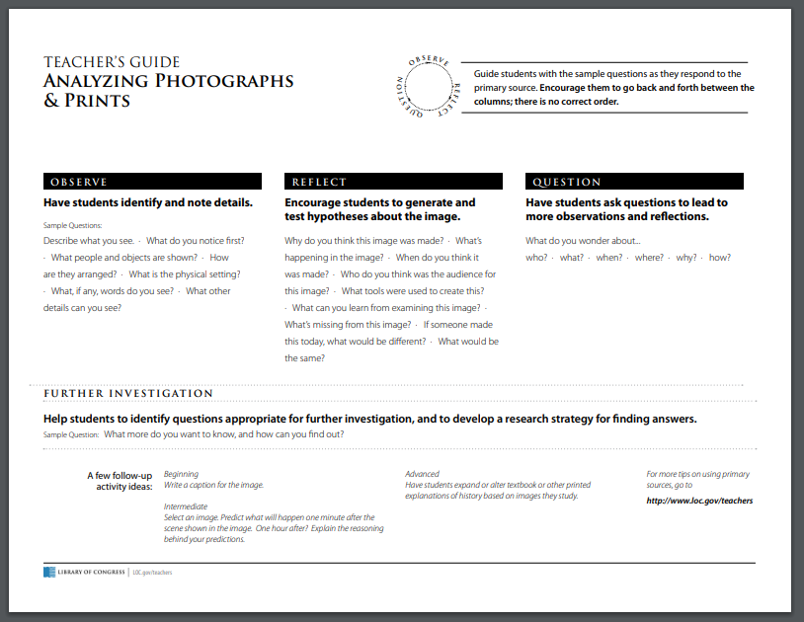
Slide B
Helping Hand by Clayton Southard, University of Kansas, Lawrence, Kansas

Slide 4
Slide C
Describe what you see.
What do you notice first?
What people are shown?
What objects are shown?
How are they arranged?
What is the physical setting?
What, if any, words do you see?
What other details can you see?
Helping Hand by Clayton Southard, University of Kansas, Lawrence, Kansas

Slide 5
Slide D
Why do you think this image was made?
What’s happening in the image?
Who do you think was the audience for this image?
What tools were used to create this?
What can you learn from examining this image?
What’s missing from this image?
Helping Hand by Clayton Southard, University of Kansas, Lawrence, Kansas
Helping Hand by: Clayton Southard, University of Kansas, Lawrence, Kansas

Slide 6
Slide E
What do you wonder about...
who?
what?
when?
where?
why?
how?
Helping Hand by Clayton Southard, University of Kansas, Lawrence, Kansas
Helping Hand by: Clayton Southard, University of Kansas, Lawrence, Kansas

Slide 7
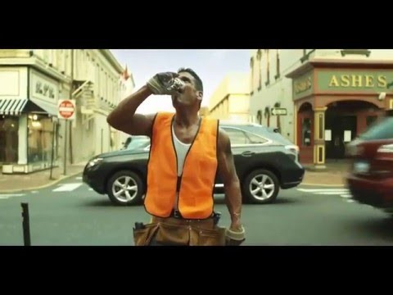
Slide F
Click on Image to Play Video (Internet Connection Required)

Slide 8
Slide G
Have you seen kindness happen in your community?
Which person would you be in this artwork? Why?
Why is it important to help the citizens in your community?
Helping Hand by Clayton Southard, University of Kansas, Lawrence, Kansas

Slide 9

Slide H
How can helping others make a difference?
Make your own piece of artwork about helping your community.

Slide 10
Slide I
Extension
EXTENTION
Do first impressions matter?
Read this quote: Do you agree or disagree with this quote? Why?
"The way you make others feel is how they will remember you."
quote by Sarah S., 11th Grade, Pine View School, Osprey, Florida

Slide 11


Slide J
Extension
EXTENTION
Choose a piece of artwork from the follow website that you feel shows kindness.
Write a caption for the piece.
Be prepared to explain how your piece related to kindness.

