Slide 1
What is Ethnicity?
Lesson Created by Carol LaVallee

Slide 2
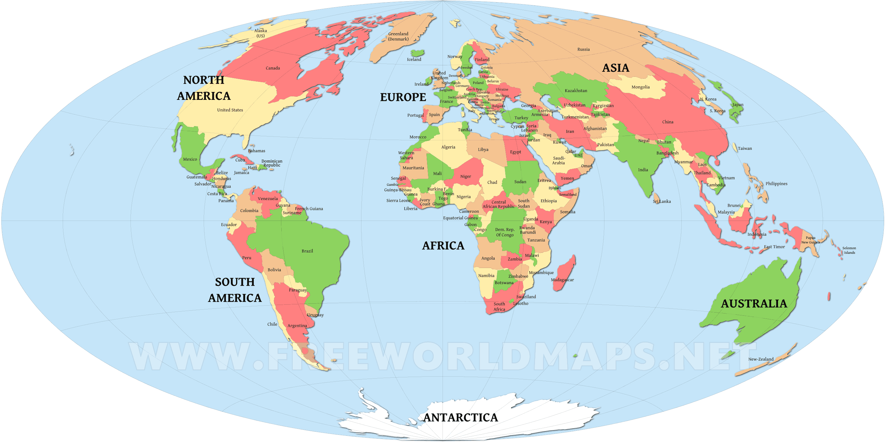
Slide A
Find your ancestral home the world map and mark it with a star.
Have your peers mark your map with their ancestral home with a plus sign.

Slide 3
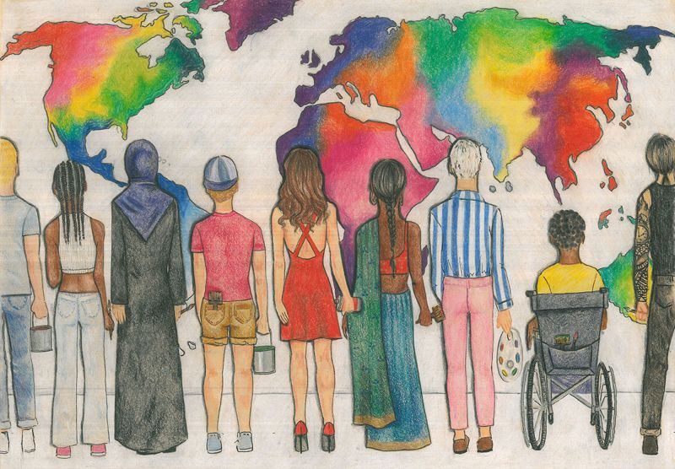
Slide B
Draw a line from each person to where you think their ancestral home might be.
Why did you choose that part of the world?
Our Colorful World by: Yasmina Akhavan Kharazi, Tehran, Iran

Slide 4
Slide C
Is it possible you might find a person’s ancestry in a different part of the world?
If so, draw another line, using a different color, to that part of the world.
Why did you choose that place?
Our Colorful World by: Yasmina Akhavan Kharazi, Tehran, Iran

Slide 5
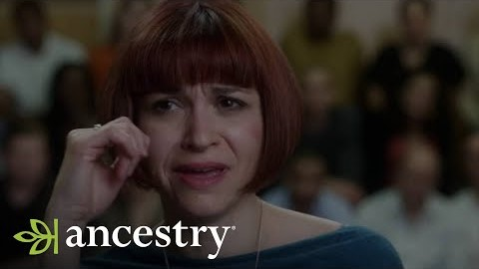
Slide D
Slide D
Click on Image to Play Video (Internet Connection Required)
Our Colorful World by: Yasmina Akhavan Kharazi, Tehran, Iran

Slide 6
Slide E
ETHNICITY means…
the fact or state of belonging to a social group that has a common national or cultural tradition.
Our Colorful World by: Yasmina Akhavan Kharazi, Tehran, Iran

Slide 7
Slide F
RECAP:
Can you tell by looking at someone what ethnicity they are?
Can you guess?
Could you be wrong?
Our Colorful World by: Yasmina Akhavan Kharazi, Tehran, Iran

Slide 8
Slide G
How do you find out someone’s ethnicity?
Our Colorful World by: Yasmina Akhavan Kharazi, Tehran, Iran

Slide 9
Slide H
Ask them!
Our Colorful World by: Yasmina Akhavan Kharazi, Tehran, Iran

Slide 10
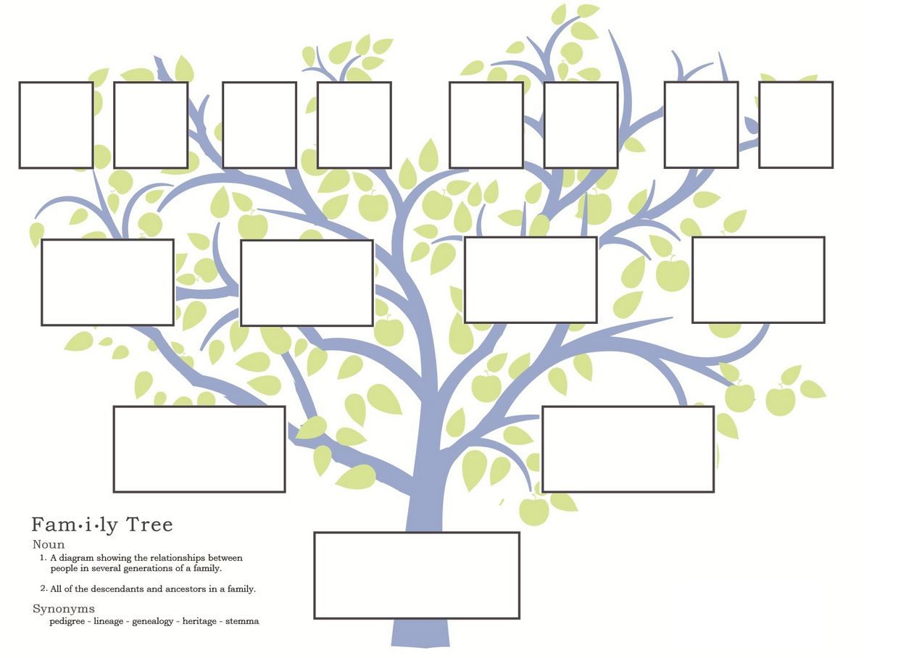
Slide I-EXTENTION
Interview your family to discover your ethnicity and complete this family tree.
Our Colorful World by: Yasmina Akhavan Kharazi, Tehran, Iran

Slide 11
Slide J-EXTENTION
What did you discover?
What did you learn that you did not know?
Our Colorful World by: Yasmina Akhavan Kharazi, Tehran, Iran

Slide 12
Slide K-EXTENTION
What is Ethnicity?
Make your own piece of artwork showing your ethnicity.

