Slide 1
Embracing Our Differences Bright future
Diversity and Social Emotional Learning: Self-Awareness

Slide 2

“A world with no differences would be like a library with copies of the same book.”
Quote by: Kelly Z., 10th Grade, Pine View School, Osprey Florida
Imagine walking into a library like this…
1. How would you feel?
2. What would you miss?

Slide 3

Words to think about: Diversity
Diversity - differences and variety.
3. What things in your life are much better because of diversity?
4. What makes your different and unique?

Slide 4
Birds of a Feather
by: Michael O'Connell, Clearwater, Florida
Words to think about…
5. How does the artist show Diversity in this artwork?
Notes:
CLICK on the artwork to Listen to the artist Michael O’Connell, of Clearwater, Florida discuss Birds of a Feather.
(Hyperlink - https://youtu.be/E15hvPUJhoA)

Slide 5
Udderly Unique
by: Brooks Tracey, Sarasota, Florida
Words to think about…
6. How does the artist show Diversity in this artwork?
Notes:
CLICK on the artwork to Listen to the artist Brooks Tracey, of Sarasota Florida, discuss Udderly Unique.
(Hyperlink: https://youtu.be/bNkmen9Cp7Q)

Slide 6
7. How are Birds of a Feather and Udderly Unique the same?
8. How are Birds of a Feather and Udderly Unique different?
Birds of a Feather
by: Michael O'Connell, Clearwater, Florida
Udderly Unique
by: Brooks Tracey, Sarasota, Florida

Slide 7
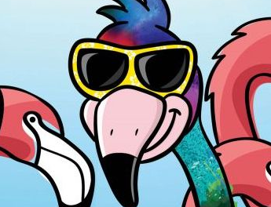
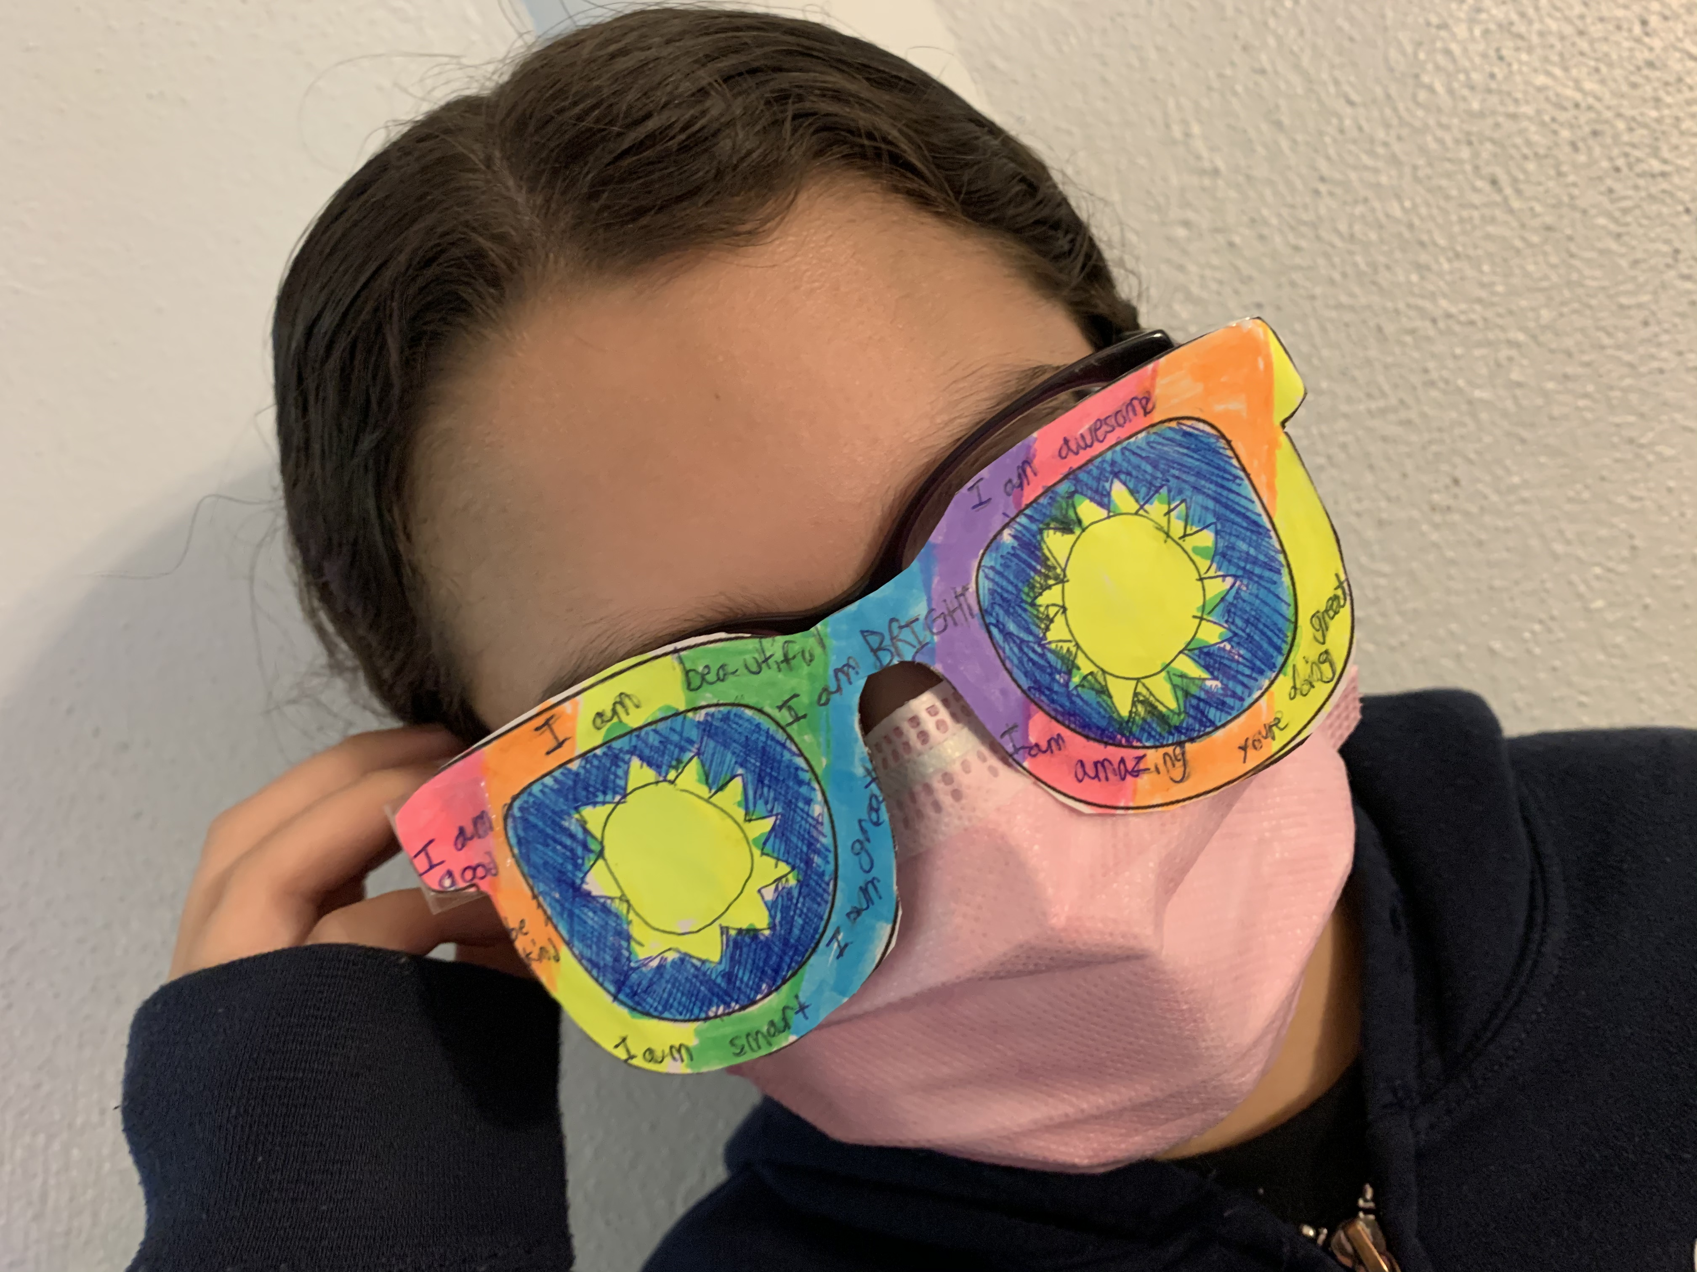
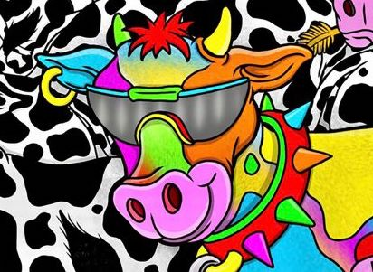
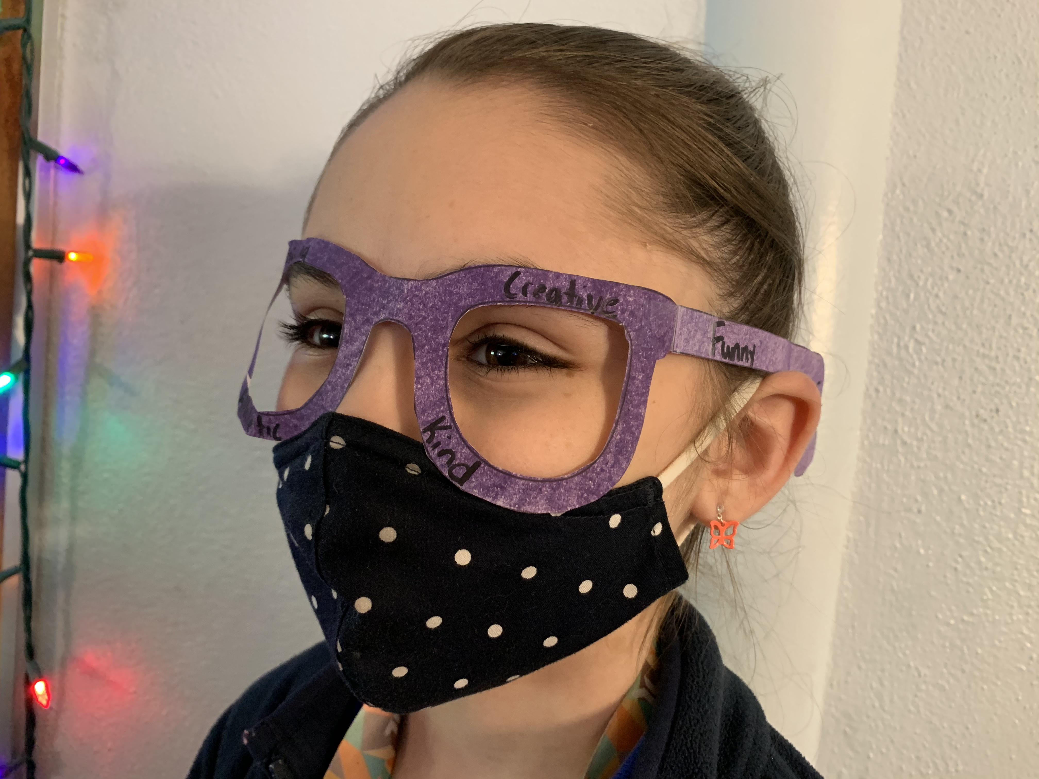
”Your Future Is so Bright you’ve got to wear shades”
Activity: Let’s Make Shades!
*First, think of all the amazing things that make you, AWESOME!
*Then, write and draw these things on your shades Worksheet!
*Have fun designing your own shades! Share a picture in your shades with pride!
Notes:
Website for instructions to making glasses: https://picklebums.com/free-printable-crazy-glasses/
Listen to “Your Future is so Bright You’ve got to Wear Shades”: https://www.youtube.com/watch?v=TPP4oNzIspM

