Slide 1
Embracing Our Differences
Carry your own weather
Perseverance & Social Emotional Learning: Self-Management

Slide 2
“Hate is a strong word. So is Love.”
Quote by: Malachi B., 10th Grade, Braden River High School, Bradenton, Florida
1. Do you think that love is stronger than hate?
Why or why not?
2. Who makes you feel loved?
3. What do people do to make you feel loved?

Slide 3
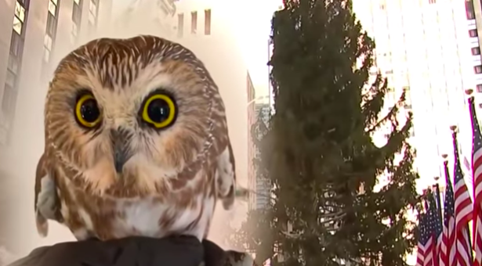
Words to think about: perseverance
Perseverance- persistence in doing something despite difficulty or delay in achieving success
4. Why is it important to persevere when
something is difficult?
5. How did the owl persevere in the video?
Notes:
CLICK on the Owl to watch the video (https://youtu.be/knbQsU7dNgQ)

Slide 4
Love Protects
by: Pamela Kok, Sarasota, Florida
Words to think about…
6. How is perseverance shown in this artwork?
7. Why are these words important during stressful times?
Notes:
CLICK on the artwork to Listen to the artist Pamela Kok, Sarasota, Florida discuss Love Protects.
(Hyperlink: https://youtu.be/f6NzcaTOV9k)

Slide 5
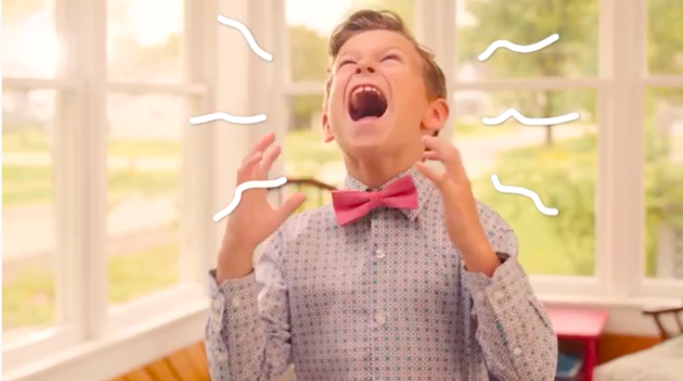
Let’s talk about stress!
8. What things make you stressed?
9. What worries do you have in your life?
(Acknowledge each individually by writing them on separate sheets of paper)
10. What do you do to cope with stress and worry?
Notes:
CLICK on the Heart2HeartKid photo and watch the video
(Hyperlink: https://www.youtube.com/watch?v=qmfUhxVIOxQ)

Slide 6
Activity:
Snowball Toss
Get your worry and stress papers
Crumble each of them up individually
Give them a Toss!
Notes:
Snowball Toss Activity Video Explanation: click here.
Additional Movement: Get Moving & Grooving with this fun Trolls GoNoodle Dance: click here.
(Snowball Toss Activity Video Explanation hyperlink: https://www.edutopia.org/video/60-second-strategy-snowball-toss)
(Get Moving and Grooving with this fun Trolls GoNoodle Dance hyperlink: https://www.youtube.com/watch?v=KhfkYzUwYFk)

Slide 7
Enjoy Becoming Mindful
Pause
Breath
Smile
You’ve got this!
Notes:
Slide 7 (Wind Down):
Wind down from all the tossing fun with a Guided Meditation for Anxiety and Stress Relief
*Remind students to: Pause, Breath, and Smile
Video Link: click here (length: 5:28 min.)
(Hyperlink: https://www.youtube.com/watch?v=SCuzh8SQ9ZA)
Additional video of Kids Explaining Mindfulness (3:06)
https://www.youtube.com/watch?v=awo8jUxIm0c&feature=emb_logo
Additional information on SEL
https://www.kickboardforschools.com/blog/post/sel-social-emotional-learning/8-key-social-emotional-learning-sel-skills-to-develop/

