Slide 1
Embracing Our Differences equality for all
Respect & Social Emotional Learning: Social Awareness

Slide 2
“A garden looks most beautiful when it has flowers of all colors, all sizes, all fragrances.”
quote by: Shreya N., 12th Grade, Kendriya Vidyalaya, Kharagpur, India
1. What does this quote make you think, feel, or wonder?
2. What does the artwork make you think, feel, or wonder?
What do you see that makes you say that?

Slide 3
Words to think about Respect and equality
Respect- Treating people in a way that makes them feel cared for and important.
Equality- Having equal opportunities and rights.
3. How do you treat others with respect? What are some things you do and say?
4. Why is equality important?

Slide 4
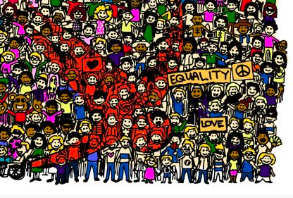
Check out this small piece of the next artwork.
All of these tiny characters make up a bigger picture…
5. What do you think the bigger picture is? What do you see that makes you think that?

Slide 5
Equality
by: Nuera Wencesa, Davao City, Philippines
6. How does this artwork show respect? What do you see that makes you say that?
7. How does this art represent equality? What do you see that makes you say that?
Notes:
CLICK on the artwork to Listen to the artist Nuera Wencesa talk about her artwork Equality.
(Hyperlink: https://youtu.be/gdKUMHkzshI)

Slide 6
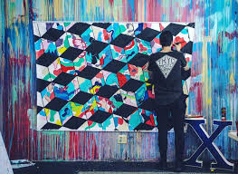
In the artwork, Equality, a variety of characters make up a bigger picture.
*Let’s learn about the artist Thank You X and his cube murals.
9. What is a similarity between Thank You X and the Equality artwork?
Notes:
(CLICK on the first picture for the Hyperlink) (Hyperlink https://www.youtube.com/watch?v=1j2ntwVUstI&feature=emb_logo)

Slide 7
Activity: Putting it all together Learning about the artist Thank you x
*Watch the video on how to complete your own cube and be a piece of the larger picture in our own cube mural (click on cube for link)!
10. What is your large symbol?
11. What is your symbol pattern?
12. What color is your solid top (or bottom)?
Notes:
Slide 7 (Activity - Putting It All Together):
CLICK on the cube to watch the video on how to complete your own cube.
Cube Template PDF
file:///Users/branigerb/Downloads/cube%20template%20pdf.pdf

Slide 8
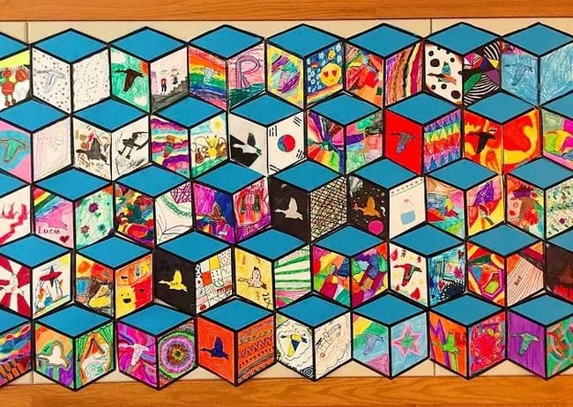
Classroom example:
*Enjoy being a part of the bigger picture!

