Slide 1
Embracing Our Differences Play together
Inclusion & Social Emotional Learning: Relationship Skills

Slide 2
"A simple sincere smile can dry up all our tears, a friendly little hug can wipe out all our fears" quote by Leyi S. Shanghai, China.
Think of a time when you were in need of a friend.
1. How did it feel to have someone on your side?
2. How did your friend make you feel better?

Slide 3
Words to think about: Teamwork and inclusion
Teamwork- Working together and taking action as a group
Inclusion- the action or state of including or of being included within a group
3. What things do you need to be a good team member?
4. How does it feel when you are not included in a game?

Slide 4
Words to think about…
5. Would the kids in this artwork make a good Team? Why or why not?
6. Is Inclusion shown in this artwork? What do you see that makes you say that?
Play Together
by: Leow Yong Jun
2nd Grade, Bukit Panjang Primary School, Singapore
Notes:
CLICK on the artwork to Listen to the artist, Leow Yong Jun.
(Hyperlink: https://youtu.be/S98YvIR-Ewc)

Slide 5
Sezer's Diary
by: Leyla Emektar, Erdek, Turkey
Words to think about…
7. How is the artist showing Teamwork?
8. How is the artist showing Inclusion?
Notes:
CLICK the artwork to watch the video (this video is subtitled so the translation is below)
(Hyperlink: https://youtu.be/AoKoOLcjBJg)
Artist Statement
The boy in the photograph is my student; his name is Sezer. Sezer was born in 2012 with spina bifida. He has had six operations in eight years. With the help of his parents, he can maintain many of his basic living activities, but Sezer is a smart, hardworking and determined child. He wants to play basketball in the Paralympics when he grows up. I hope he achieves everything he wants in his life and is very happy.

Slide 6
9. How are Play Together and Sezer’s Diary the same?
10. How are Play Together and Sezer’s Diary different?
Play Together
by: Leow Yong Jun, 2nd Grade, Bukit Panjang Primary School, Singapore
Sezer's Diary
by: Leyla Emektar, Erdek, Turkey

Slide 7
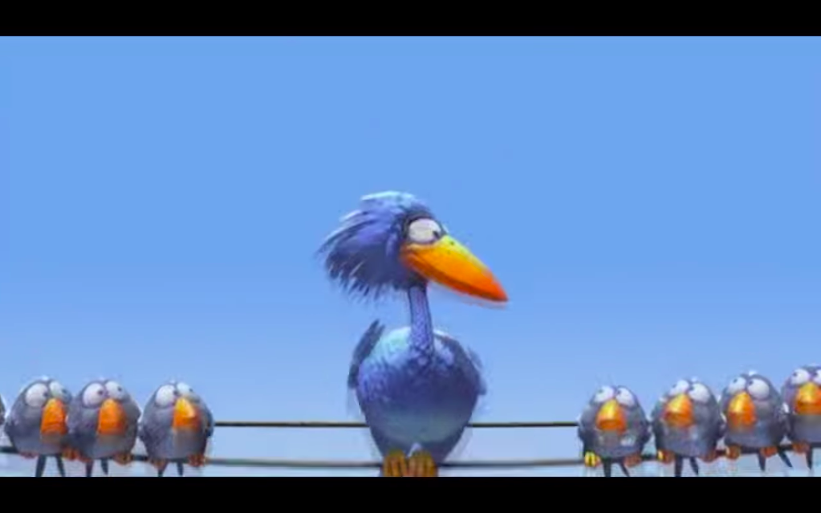
Activity:
Inclusion and Teamwork:
*First, watch the video.
*Then, think about how video shows teamwork and inclusion.
*Finally, think of some advice you could give the characters in the video about how to become a better teammate.
Notes:
CLICK on the picture to watch the video then discuss the topics
(Hyperlink: https://youtu.be/fUXdrl9ch_Q)

