Slide 1

DIVERSITY
Lesson Created by Christine Braun

Slide 2
Slide 1
DIVERSITY
Artist Statement:
“I created this piece to encourage kids (especially teenagers) to just be themselves. Embrace all of your differences, from your background, to your appearance, to where you come from. It’s what makes you who you are, and what makes you unique. The piece should inspire people to be comfortable with themselves and just be different, whatever that means to them.”

Slide 3
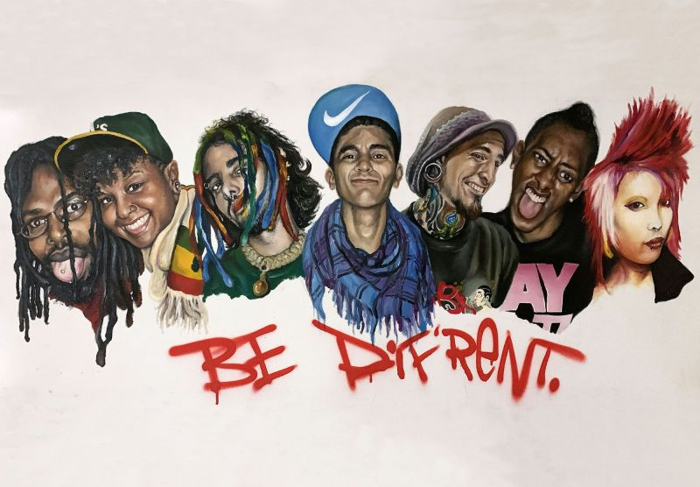
Slide 2
Be Dif’rent
by: Corey Payne,
West Hartford, Connecticut
“Anyone can fit in, but it takes true courage to stand out.”
quote by: Emilia M., 7th Grade, Sarasota School of Arts & Sciences, Sarasota, Florida Teacher: Brian Hubbard

Slide 4
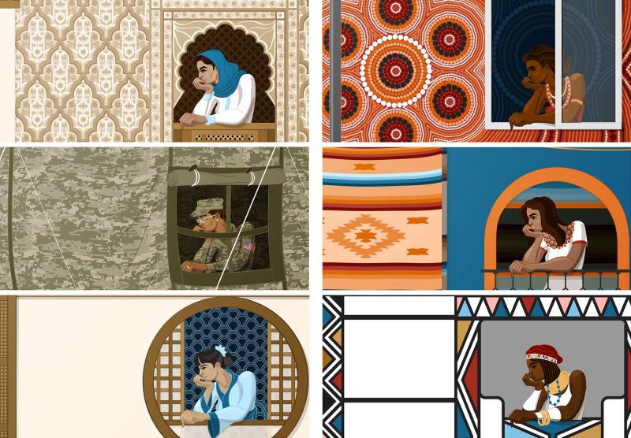
Slide 3
Patterns & Possibilities 1-6
by: Donavon Brutus, San Francisco, California
“Each of us is a vibrant thread in humanity’s tapestry.”
quote by: Sowmya S., 11th Grade, Flower Mound High School, Flower Mound, Texas

Slide 5
Slide 4
DIVERSITY
Artist Statement:
“No matter where we come from, we all have something in common: we all have hopes and dreams. Visually I represented not only diverse women, but also the patterns and art of their respective cultures.”
https://youtu.be/0CkXZRvU16Y

Slide 6
Slide 5
ACTIVITY – Personal Identity Wheel
Take 10 minutes to fill out the wheel. We will come together as a
class to see what we have in common and what may be some
of our differences.

Slide 7



Slide 6
How diverse is our classroom?
How do your personal identities influence your sense of belonging in the classroom? City? State? Country?

