Slide 1

INCLUSION
Lesson Created by Christine Braun

Slide 2
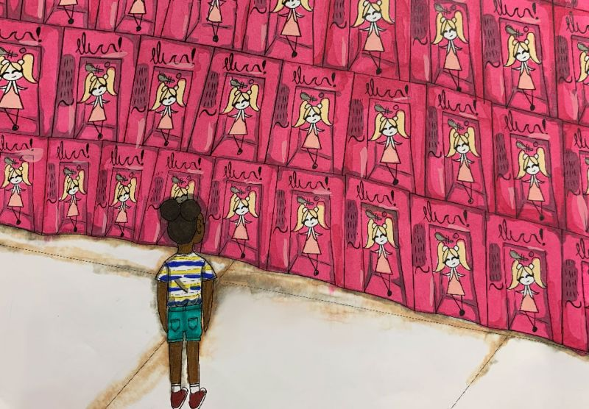
Slide 1
Small Struggles
Best in Show Student
by: Emily N., 7th Grade,
Sarasota Middle School,
Sarasota, Florida
Teacher: Brooks Tracey
"Social equality cannot be achieved if the folks making the decisions all look alike."
quote by: Kimberly Boyd, Tyrone, Georgia

Slide 3
Slide 2
INCLUSION
Artist Statement:
“To me, the concept of “embracing our differences” means showing off what’s unique about yourself. My piece depicts a little girl standing in front of an aisle of dolls advertised to look like the person buying them. Through my work, I attempt to highlight the little struggles people of color go through every day.”

Slide 4

Slide 3
ACTIVITY –Hair Love –
an Oscar winning animated
short film by: Matthew A. Cherry

Slide 5
Slide 4
INCLUSION
Artist Statement:
“In this work, Lady Liberty is a Black woman who stands before the millions of Black lives that have been lost to slavery and injustice in this country. She is lighting the way and leading us forward. The piece also reflects the recent official acknowledgement that the original Statue of Liberty was made to honor the emancipation of the slaves. In fact, the original statue was supposed to be holding chains in her left hand. These chains were instead placed at her feet. This piece honors that history.”

Slide 6
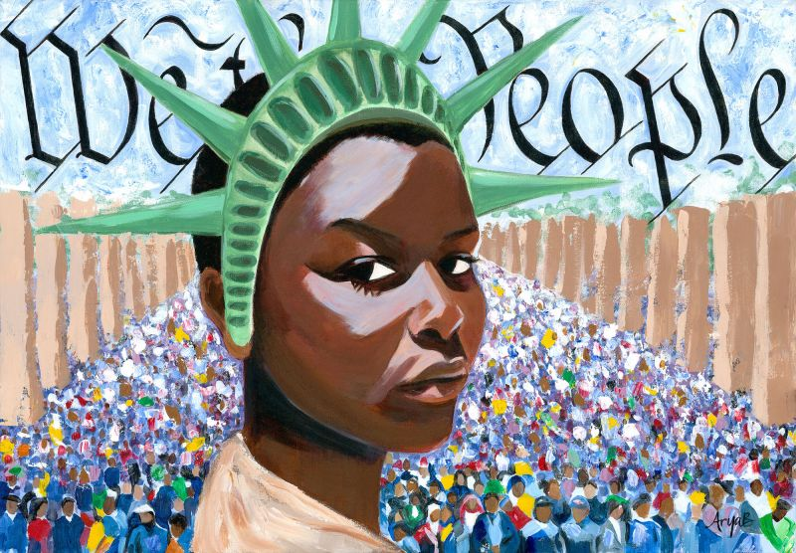
Slide 5
Liberty Enlightening the World
Best in Show Adult
by: Arya Badiyan, Lake Oswego, Oregon
Don't wait for better leaders, become one."
quote by: Seth Morano, Sarasota, Florida

Slide 7



Slide 6
What differences do you see when you compare the YOUNGER PERSON’S art to the adult's art?
Do you see strength in one ?
Do you see frustration in another? Or POSSIBLY both IN EACH?
DOES AGE HAVE ANY CONNECTION TO THE ART OR HOW IT IS EXPRESSED?

