Slide 1

INTEGRITY
Lesson Created by Christine Braun

Slide 2
Slide 1
INTEGRITY
What does integrity mean to you?
How would you DEFINE integrity?

Slide 3
Slide 2
ACTIVITY – Quotes and Integrity
Take 10 minutes with your group to discuss and analyze your
quote. Be prepared to come together as a class and share
your group’s thoughts on your quote.

Slide 4
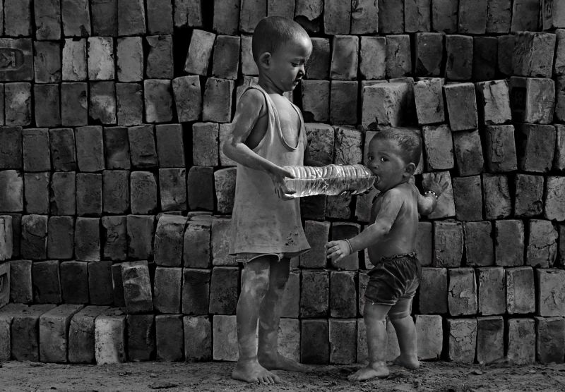
Slide 3
Tiny Guardian
by: Chinmoy Biswas, Kolkata, India
"A single act of kindness can be an action that saves someone's life."
quote by: Ya S., 9th Grade, Lynbrook High School, Cupertino, California
Teacher: Hannah Su

Slide 5
Slide 4
INTEGRITY
Artist Statement:
“My image shows the older brother trying to help his younger brother drink water in a brick field while their parents are busy at work. These children have lost their childhood as they are missing their parents' guidance.”

Slide 6
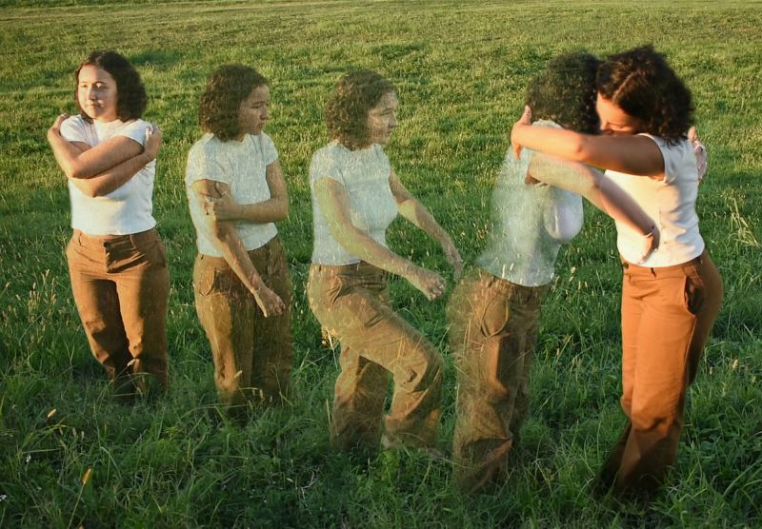
Slide 5
Journey to Self Love
by: Ella M., 12th Grade, Booker High School, Sarasota, Florida
Teacher: Jeffery Cornwell
"Do not let the pain of your past limit the hope that lies in your future."
quote by: Hadley D., 12th Grade, NewGate Montessori IB School, Sarasota, Florida Teacher: Amy Kremer-Treibly

Slide 7
Slide 6
INTEGRITY
Artist Statement:
“The phrase “I love myself” is one coated with terror and discomfort. In a society that profits off people (especially women) by picking apart all of their insecurities, engaging in acts of self-acceptance is an unspeakable rebellion. It shouldn’t be! We must wholeheartedly embrace ourselves before being able to unconditionally love all others. We must embrace our own differences, first and foremost. The journey begins there!”

Slide 8


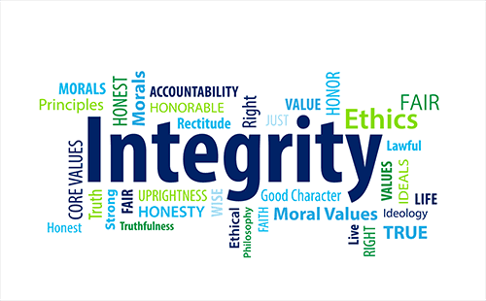
Slide 7
How can you keep your integrity?
Who is a person you know who displays integrity?
how important is integrity to you?

