Slide 1


RESPECT
Lesson Created by Christine Braun

Slide 2
Slide 1
RESPECT
A feeling of deep admiration for someone or something elicited by their abilities, qualities or achievements.
Due regard for the feelings, wishes, rights or traditions of others.
Caring enough to consider how words and actions impact others.

Slide 3
Slide 2
ACTIVITY – Video and Reflection
We will watch the video – The Danger of a Single Story
Be prepared to share your reflections and how Chimamanda Ngozi Adichie approaches respect for all peoples
and cultures.
https://www.ted.com/talks/chimamanda_ngozi_adichie_the_danger_of_a_single_story?language=en

Slide 4
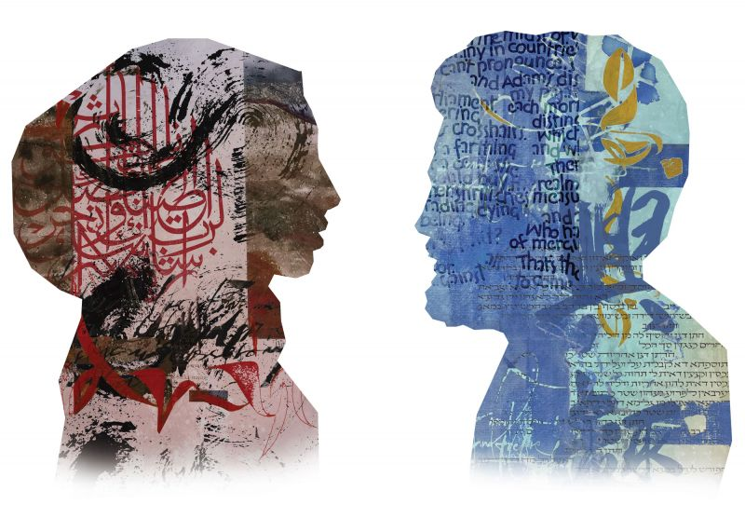
Slide 3
Conversation
by: Arash Shirinbab,
Albany, California
“A person who can admit that they don't know, is smart enough to learn anything."
quote by: Ethan Booth, Sedgley, United Kingdom

Slide 5
Slide 4
RESPECT
Artist Statement:
“Now and throughout history, people have created physical, social, political and religious boundaries intended to separate and divide. This is why it’s vitally important to raise awareness of the many instances of people crossing these boundaries to engage with each other and celebrate a shared humanity. Today, there are more and more people seeking to explore the way other cultures think, speak, pray, read and write. If we think an intercultural conversation is worthwhile, quite often we must create special circumstances in which two or more members of the human family, who have remained largely ignorant about the other or others, cross cultural boundaries and find themselves in the same room, with a mediating voice encouraging them to speak. “Conversation” juxtaposes different calligraphic styles, languages and scripts on faces with various ethnic and cultural backgrounds. This diversity of identity and expression encourages us to find common ground in spite of our differences. As Saadi Shirazi puts it “Adam's sons are body limbs, to say; for they’re created of the same clay. Should one organ be troubled by pain, others would suffer severe strain.”

Slide 6
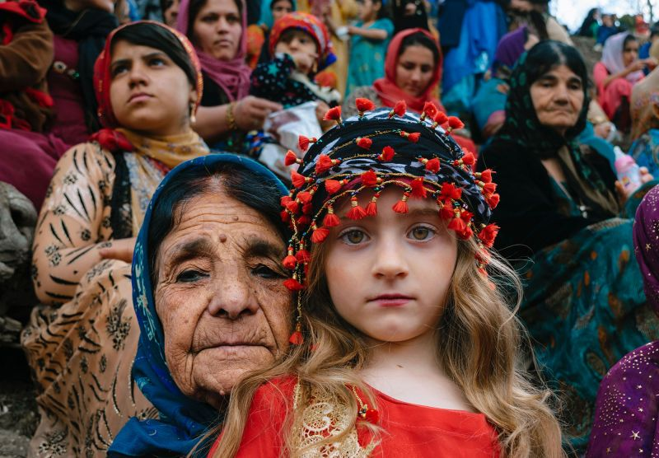
Slide 5
The Differences
by: Salar Arkan, Sanandaj, Iran
"Broaden your mind and open your ears because you never know whose story has the ability to change you."
quote by: Catelyn Meyer, Cary, North Carolina

Slide 7
Slide 6
RESPECT
Artist Statement:
“My photo depicts a grandmother and her granddaughter at a celebration of the Kurdish New Year in the village of Besaran in the Kurdistan Province of Iran. This piece is about the differences between a grandmother and her grandchild as they cross generations and watch the ceremony together.”

Slide 8
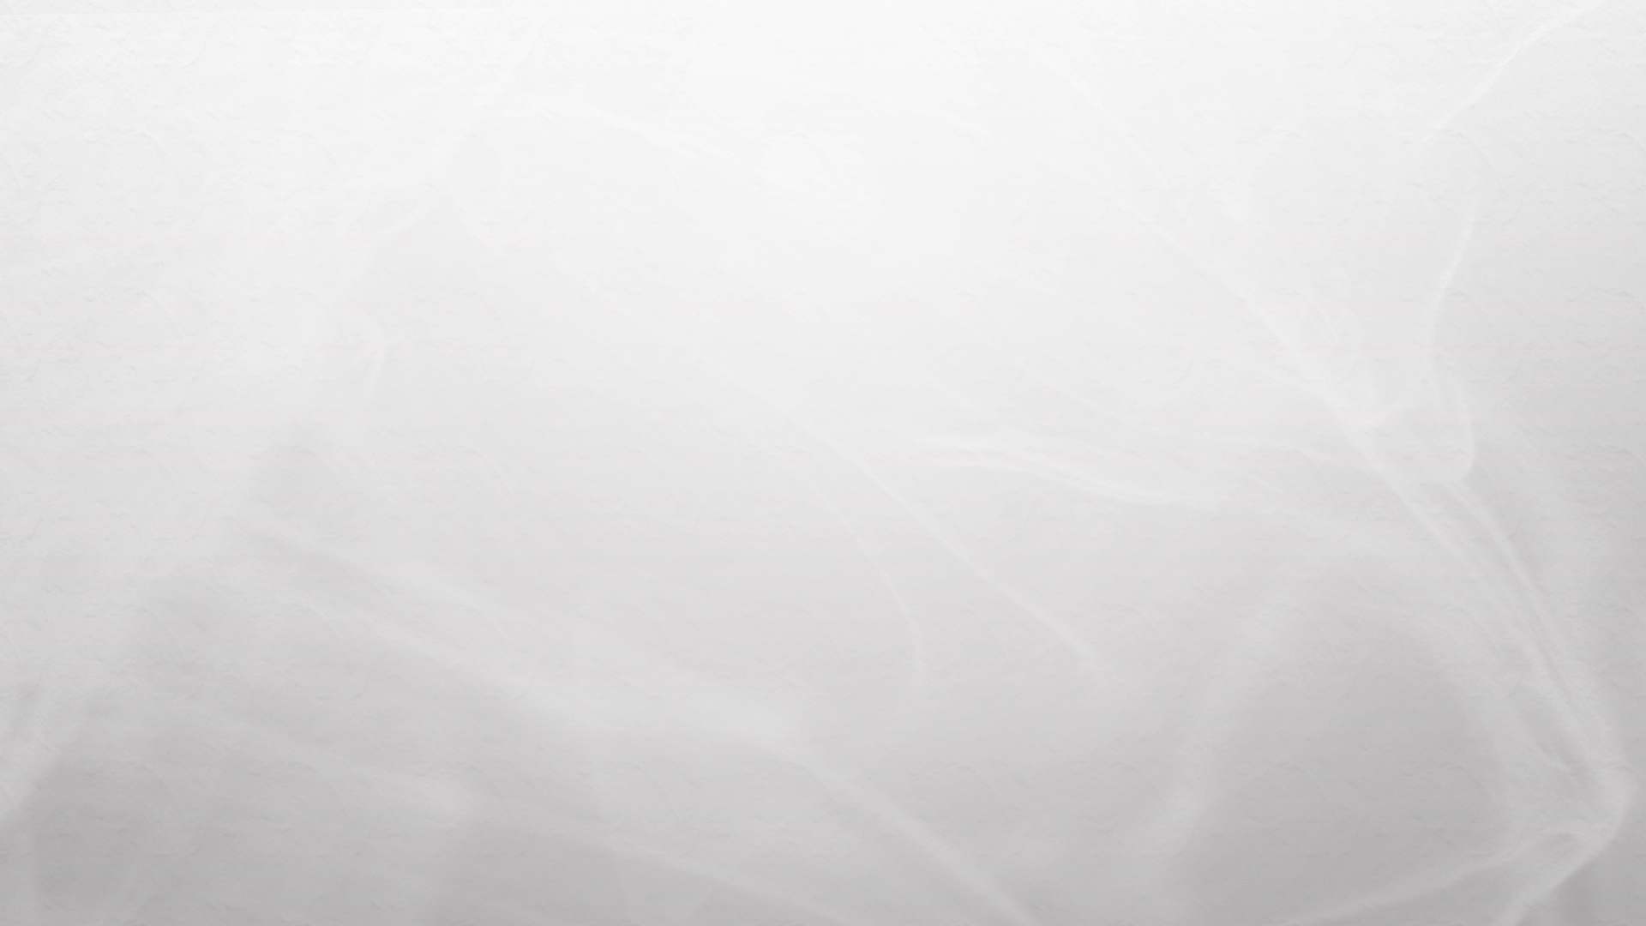


Slide 7
In what ways do “single stories” impact our own identities, how we view others, and the choices we make?
How can respecting others cancel out the “single stories” or misunderstandings?

