Slide 1
Know your worth

Slide 2
Think-write-talk
In your journal, respond to this prompt: Is there a common definition of beauty? Who decides what is beautiful?
‘Free write’ for 5 minutes
When finished, you will share with your partner.

Slide 3
At the end of this lesson, you will be able to…
Analyze the development of a complex character over the course of a text in order to understand how it advances a central theme.
Describe and explain the impact of self awareness and inclusion on our role as stakeholders in a community.

Slide 4
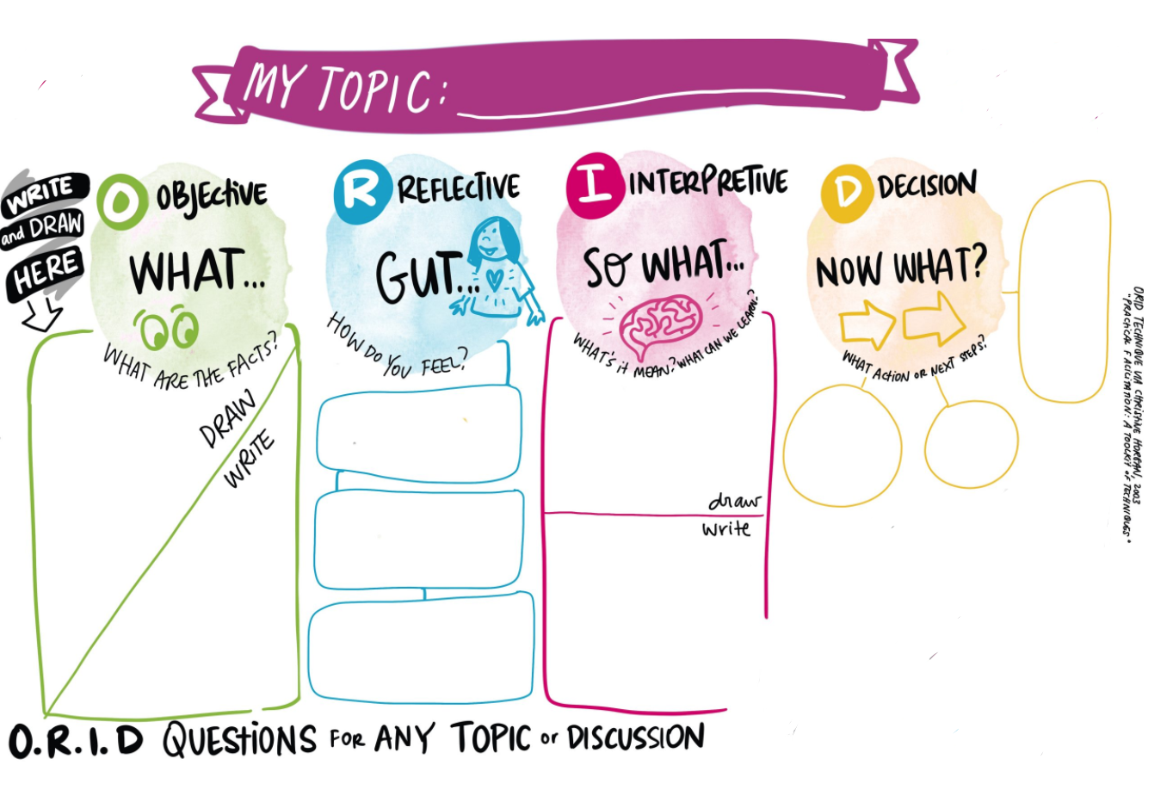

Slide 5
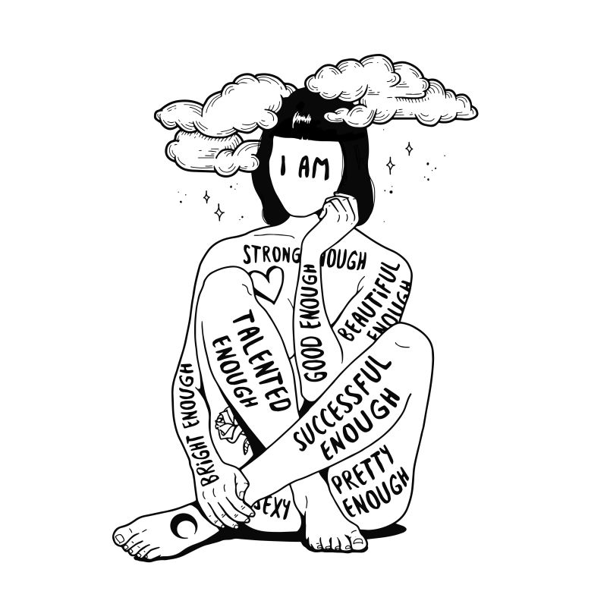
I Am Enough by: Sanda Bogdan, Čakovec, Croatia
Notice & note
Using the ‘what’ section, jot down two observations and infer the meaning.
Example: I see_____. This makes me think_______.
"You're perfectly you; there is no substitute.“ quote by: Ellie Goss, Waratah, Australia

Slide 6
Artist Statement
This artwork shows a girl covered in tattoos - phrases which describe how good you are. As long as you look for someone else to validate who you are by seeking their approval, you won't be good enough for yourself. Good enough means that you are okay just the way you are, and that you play your position in this world. In a world full of diversity, you need to be valued by yourself in order to be integrated into a society and accepted by others.

Slide 7
Discuss - turn & talk
What are your thoughts on the artist’s statement?
Could anyone relate to this artwork?
Why do you think it’s important to acknowledge one’s insecurity on the path to self acceptance?

Slide 8
Source 2
Now we will look at a short story by Amy Tan. Pay close attention to the ways Tan’s character development advances the plot of the story.
Consider? How does a character’s understanding of their personal and cultural assets help them to recognize their own value?

Slide 9
I fell in love with the minister’s son the winter I turned fourteen. He was not Chinese, but as white as Mary in the manger. For Christmas I prayed for this blond-haired boy, Robert, and a slim new American nose. When I found out that my parents had invited the minister’s family over for Christmas Eve dinner, I cried. What would Robert think of our shabby Chinese Christmas? What would he think of our noisy Chinese relatives who lacked proper American manners? What terrible disappointment would he feel upon seeing not a roasted turkey and sweet potatoes but Chinese food? On Christmas Eve I saw that my mother had outdone herself in creating a strange menu. She was pulling black veins out of the backs of fleshy prawns. The kitchen was littered with appalling mounds of raw food: A slimy rock cod with bulging eyes that pleaded not to be thrown into a pan of hot oil. Tofu, which looked like stacked wedges of rubbery white sponges. A bowl soaking dried fungus back to life. A plate of squid, their backs crisscrossed with knife markings, so they resembled bicycle tires. And then they arrived — the minister’s family and all my relatives in a clamor of doorbells and rumpled Christmas packages. Robert grunted hello, and I pretended he was not worthy of existence. Dinner threw me deeper into despair. My relatives licked the ends of their chopsticks and reached across the table, dipping them into the dozen or so plates of food. Robert and his family waited patiently for platters to be passed to them. My relatives murmured with pleasure when my mother brought out the whole steamed fish. Robert grimaced. Then my father poked his chopsticks just below the fish eye and plucked out the soft meat.

Slide 10
“Amy, your favorite,” he said, offering me the tender fish cheek. I wanted to disappear. At the end of the meal my father leaned back and belched loudly, thanking my mother for her fine cooking. “It’s a polite Chinese custom to show you are satisfied,” explained my father to our astonished guests. Robert was looking down at his plate with a reddened face. The minister managed to muster up a quiet burp. I was stunned into silence for the rest of the night. After everyone had gone, my mother said to me, “You want to be the same as American girls on the outside.” She handed me an early gift. It was a miniskirt in beige tweed. “But inside you must always be Chinese. You must be proud you are different. Your only shame is to have shame.” And even though I didn’t agree with her then, I knew that she understood how much I had suffered during the evening’s dinner. It wasn’t until many years later — long after I had gotten over my crush on Robert — that I was able to fully appreciate her lesson and the true purpose behind our particular menu. For Christmas Eve that year, she had chosen all my favorite foods.

Slide 11
Discuss & write-ORID
Using the ORID sheet: Sketch a depiction of the most impactful scene from Tan’s story (under the ‘what’ section).
**Remember-you’ve already filled in the ‘write’ section in response to I am Enough.

Slide 12
Discuss & write-ORID
Under the ‘Reflective’ section-
Write your thoughts on the artwork (1st box)
Write your thoughts on the short story (2nd box)
Connect to your past experiences (3rd box). This reminds me of…

Slide 13
Discuss & write-ORID
Interpretive-What can one learn from these two sources?
Explain why the lessons (we can glean from these sources) matter.

Slide 14
Enrichment activity: ORID-Now what?
Under the ‘now what?’ section, you and your peer will create a PSA
Definition and examples here
Your PSA will focus on the strength and beauty of diverse voices on your campus/at your school.
Points of focus: define the topic, Show the benefits, Draw on examples
Call to action: what others can do to ensure that ALL voices are valued?

