Slide 1
Fearless Integrity
and Responsible Decision Making
by Brittany Braniger
Notes:
Teacher Notes:
Get the conversation started by writing the title of this lesson on the board:
Fearless Integrity and Responsible Decision Making

Slide 2
What is Integrity?
Integrity - The quality of being honest and having strong
moral principles; moral uprightness
"A slight change of perspective can change the entire story." quote by: Jumshad Aisha , Tsing Yi, Hong Kong (2022 Exhibit)
Notes:
Teacher instructions:
Read aloud and discuss the definition of Integrity.
Think about the quote and come up with an agree or disagree statement.
I agree or disagree that “A slight change of perspective can change the entire story.”
Think of a personal example that backs up your opinion.

Slide 3
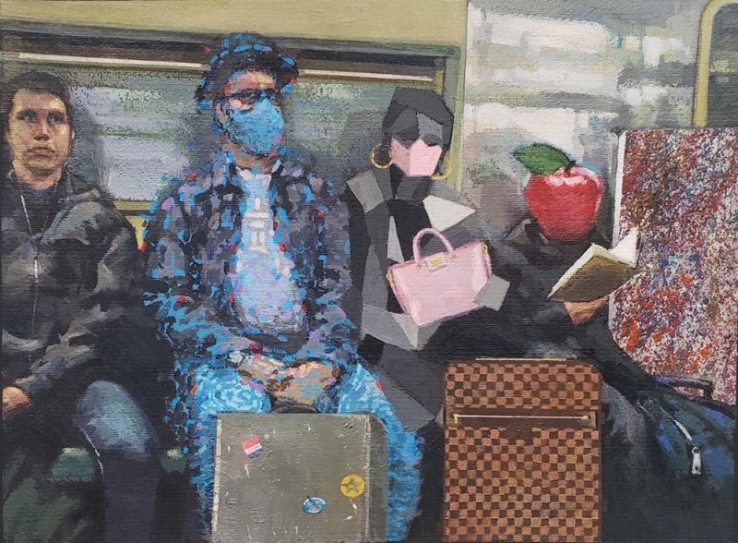
What do you think each of the individuals on the train represent? Why?
What artistic differences do you see in each of the train riders?
Which train rider do you represents these art genres: abstract, impressionism, cubism, representational and surrealism? Why?
Do your guesses match what the artist says in their video statement?
Different Strokes for Different Folks
by: Andrew McDermott, Vancouver, Canada (2022 Exhibit)
Notes:
Teacher instructions:
Look at “Different Strokes for Different Folks”, and answer the questions.
On number 4 click on the HERE to watch the artist explanation and continue the discussion and see how you did.

Slide 4
What is responsible decision making?
Responsible decision making is the ability to make choices that affect you positively in your physical, intellectual, social, and emotional bodies.
Responsible decisions are based on social morals, ethics, and safety.
Notes:
Teacher notes:
Read aloud the definition of responsible decision making according to https://www.infobase.com/blog/sel-beyond-responsible-decision-making/
*Extension Video and Discussion: https://www.youtube.com/watch?v=QXY5TyCUTlo
How does the little boy in the video show integrity and responsible decision making?
What was your take away from the video?
What surprised you the most about the video?

Slide 5
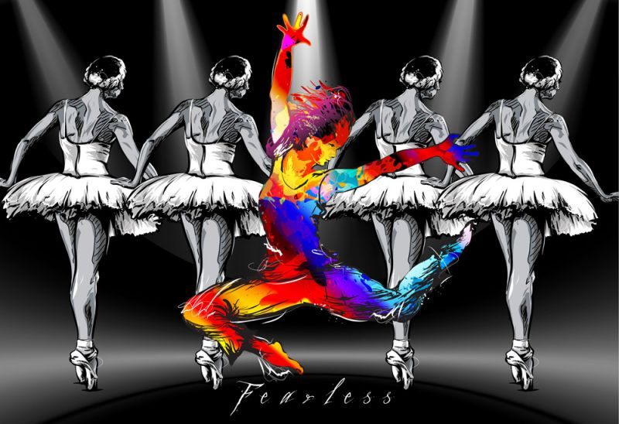
Fearless By Michael O'Connell, Clearwater, Florida (2022 Exhibit)
Observe the differences between the dancers in the background compared to the dancer in the foreground.
How does being fearless go along with responsible decision making and integrity?
How does this quote fit with the artwork?
"The problem isn't that I'm different. It is the expectation that I should be the same. "
quote by: Aakriti Kaushik, Solihull, United Kingdom
Click HERE to watch the artist statement
Notes:
Teacher Notes:
Observe “Fearless”. Discuss connections made and understood from the artwork.
Have students respond to the questions and then watch the artist statement by clicking “HERE”.
Think of a memory of when you were fearless (share out, journal entry, or extension activity).
*Extension activity: Recreate this moment in an artistic way. This could be depicting yourself in color and the rest of the artwork black and white, like Michael O’Connell created in “Fearless”.

Slide 6
Prompts that support responsible decision making
What kinds of things do you think about when you are making a decision?
Create a short story, poem, limerick or rap about a fictional character or historical figure you admire. How did their choices impact the people and world around them?
Write about a time that a decision you made was strongly guided by your ethics.
Notes:
Teacher Notes:
Students will choose to use their background knowledge and personal experiences to inspire their writing using the prompts available.
*Extension activities: These can be written and turned in for a grade, read aloud, or acted out, students could create a graphic novel or comic.
*Adapted from and additional prompts can be found at: https://casel.s3.us-east-2.amazonaws.com/SEL-Reflection-Prompts.pdf

