Slide 1
Inclusion and Gratitude
A lesson on perseverance and self-management
by Brittany Braniger
Notes:
Teacher notes:
Start the conversation by writing the title of the lesson on the board.

Slide 2
What are Inclusion and Gratitude?
Inclusion- The action or state of including or of being included within a group or structure.
Reflect: Think of a time in your life when you felt truly included. How did it feel?
Gratitude- the quality of being thankful; readiness to show appreciation for and to return kindness.
Reflect: Think of what you are most grateful for.
Notes:
Teacher notes:
Read aloud and discuss the vocabulary of Inclusion and Gratitude.
Think of a time in your life when you felt truly included. How did it feel?
Think of what you are most grateful for.
*Have students think of examples where they have been grateful for being included.
These can be shared out, written in a journal, or simply an intrinsic answer.

Slide 3
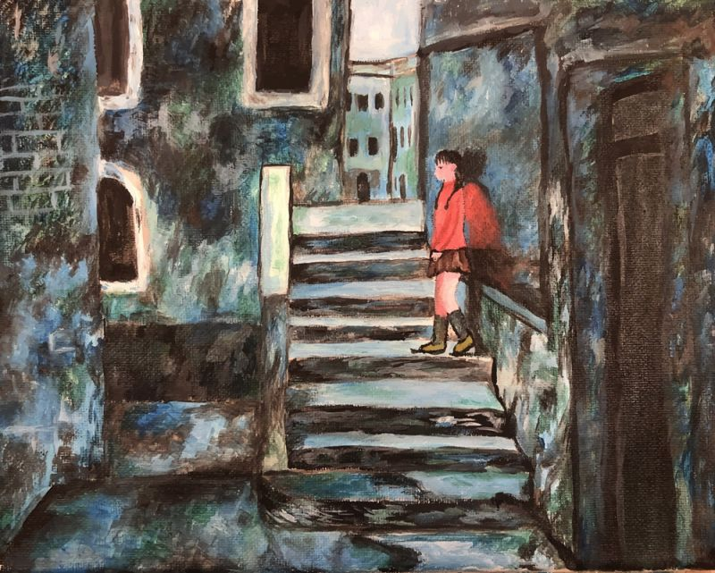
Alone by: Katherine Wei, 12th Grade, Chandler, AZ (2022 Exhibit)
Visually read this artwork by asking “what’s going on in this picture” and “what do you see that makes you say that?
What emotions do you think the artwork demonstrates?
Watch the artist’s statement . Did your thoughts on the meaning of this piece change or the same listening to the artist?
Notes:
Teacher notes:
Answer questions out loud in an open discussion.
Visually read this Artwork by asking “what’s going on in this picture” and “what do you see that makes you say that?”
What emotions do you think the artwork demonstrates?
Watch the artist statement. Did your thoughts on the meaning of this piece change or the same listening to the artist?

Slide 4
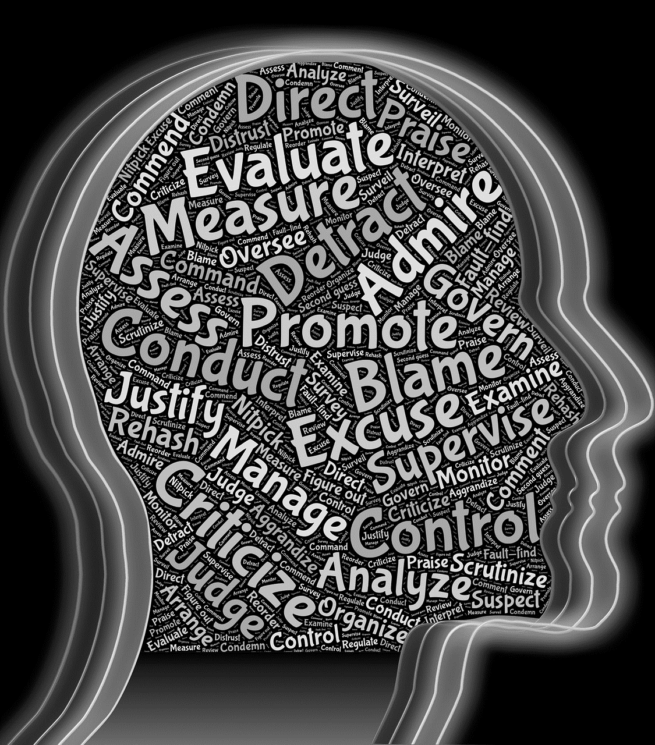
What is Self-Management?
The competency of self-management is the ability to harness one's emotions, thoughts and behaviors effectively in different situations and to achieve goals and aspirations.
Notes:
Teacher Notes: Read aloud the definition of self-management - The competency of self-management is the ability to harness one's emotions, thoughts, and behaviors effectively in different situations and to achieve goals and aspirations.
Ask students to connect the artwork “Alone” to the idea of Self-Management (you may want to go back to slide 3 so that students can look at the art while thinking of their response).

Slide 5
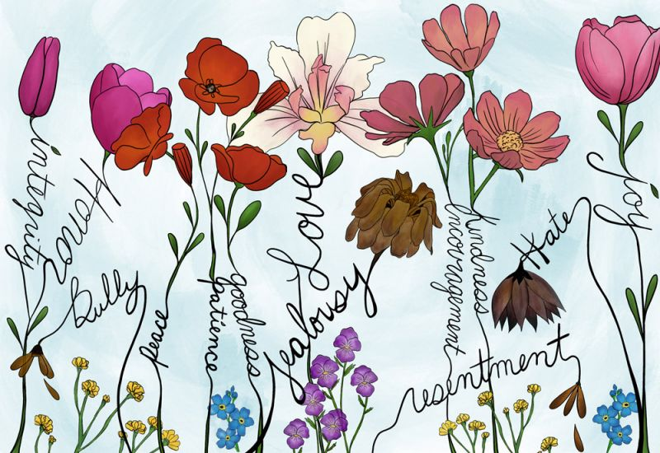
Cultivation by: Samantha Miller, Sarasota, FL (2022 Exhibit)
Cultivation- to grow and care for something (example – gardening).
connections between the flowers and the words connecting them. Why do you think that the artist chose to do this?
Why do you think that the name of this artwork is named “Cultivation”?
How do you think the quote relates to the artwork?
"The way you think can change how you act; the way you act can change how others think."
quote by: Yasser Mecate, San Juan, Philippines
Click HERE to watch the artist statement.
Notes:
Teacher Notes:
Discuss the definition of the word “Cultivation” and provide additional examples.
Work through the questions about “Cultivation”.
What connections do you see between the flowers and the words linking them? Why do you think that the artist chose to do this?
Why do you think that the name of this artwork is named “Cultivation”?
How do you think the quote relates to the artwork?
"The way you think can change how you act; the way you act can change how others think." quote by: Yasser Mecate, San Juan, Philippines
Watch the artist's statement.
*Extension Video: Use this short video to deepen your discussion of perseverance and cultivation.

Slide 6
Grateful Diamantes Poem Activity
A diamante is a seven-line, diamond-shaped poem that begins with a single word and ends with its opposite:
Line 1: One noun (or topic)
Line 2: Two adjectives about the noun
Line 3: Three gerunds (-ing verbs) that relate to the noun
Line 4: Four nouns
(the first two relate to the noun in Line 1, the last two relate to the noun in Line 7)
Line 5: Three gerunds (-ing verbs) that relate to the noun in Line 7
Line 6: Two adjectives that describe the noun in Line 7
Line 7: Renames the noun from Line 1 (its opposite)
Notes:
Teacher Notes:
A diamante poem is a great way to practice descriptive writing.
“A diamante – pronounced dee-uh-MAHN-tay – is an unrhymed seven-line poem. The beginning and ending lines are the shortest, while the lines in the middle are longer, giving diamante poems a diamond shape. “Diamante” is the Italian word for diamond, so this poetic form is named for this diamond shape.” For a video to learn more about these poems visit https://www.poetry4kids.com/lessons/how-to-write-a-diamante-poem/
*After sharing a few examples and writing a group diamante, invite students to write their own poem that represents something that they are grateful for. Display the poems on diamond-shaped pieces of paper. Students should decorate their diamonds around the poem that they created to enhance the personal connection.
Find examples here: Diamante Poems
Line one: Cat
Line two: Proud, Assured
Line three: Stalking, Sleeping, Watching
Line four: Feral, Tortoiseshell, Calico, Persian
Line five: Running, Jumping, Playing
Line six: Soft, Little
Line seven: Kitten

