Slide 1
Empathizing with others
A not-so-ancient artifact lesson

Slide 2
Please take out a piece of paper
Tear it in half “hamburger” style.
At the top of your paper please write down your definition of the word “empathy.”

Slide 3
Empathy
The ability to share someone else's feelings or experiences by imagining what it would be like to be in that person's situation
Notes:
https://dictionary.cambridge.org/us/dictionary/english/empathy

Slide 4
What are some examples of “Empathy in Action” ?

Slide 5
“Your struggle is different from mine, so let us learn together as we go.”
Linda Thorburn
Averill Park, New York,
United States

Slide 6
Create a numbered list of all the ways that people (adults and students) use their cell phones

Slide 7
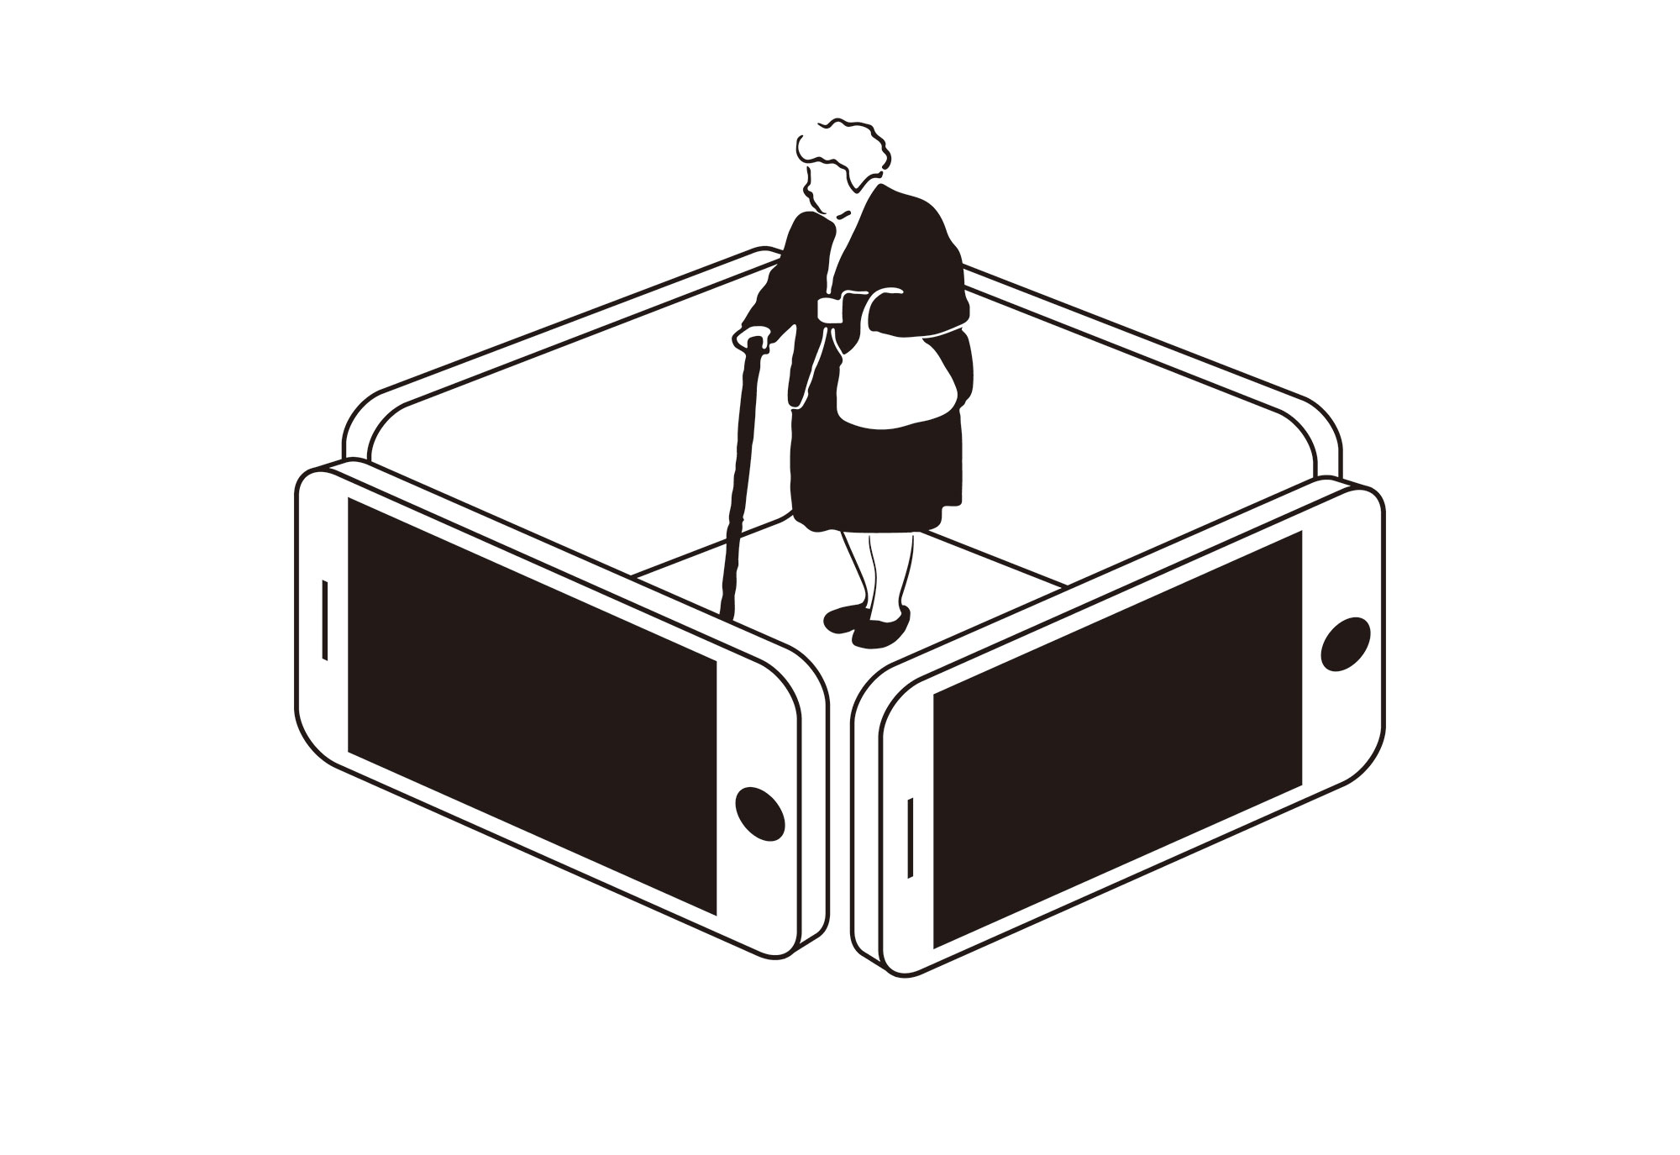
Smart Cage by Wenjie Huo Beijing, China

Slide 8
What do you see? (colors, objects)
What do you think the author is trying to tell you?

Slide 9
Accessibility: Knowledge or money?
Notes:
Why aren’t senior citizens using smartphones? For some it is a choice. For others it is a question of accessibility. They either lack the knowledge needed to use a smartphone or don’t have the money to purchase the phone and/or service.

Slide 10
Use Internet?
99% v. 75%
Notes:
According to Pewresearch.org, over 99% of Americans between the ages of 18 and 29 use the Internet. About 75% of Americans over the age of 65 use the internet.

Slide 11
Got Smartphone?
96% v. 61%
Notes:
According to Pewresearch.org, 96% of Americans between the ages of 18 and 29 have a smartphone, vs. only 61% of older Americans. Why do you think that so many more senior Americans use the Internet than own a smartphone? Is it possible that not knowing how to use them is to blame?

Slide 12
Got Smartphone?
89% v. 80%
Notes:
It’s not just senior citizens that are missing out on the usefulness of a cell phone. According to Pewresearch.org, 89% of Americans 18+ living in urban areas have a smartphone, while only 80% of Americans 18+ living in rural areas own one. Poverty and access to cell service are possible reasons for this difference.

Slide 13
What can you do?
Donate your old phones to a worthy organization.
Contact your Senator or Representative and encourage them to support infrastructure bills that invest in broadband for all.
Teach people you know how to use mobile technology, or volunteer to do so at a senior center.
Notes:
We can do something about the accessibility of cell phones.

Slide 14
Technology time machine
Maybe the older generation could teach you something, too!

Slide 15
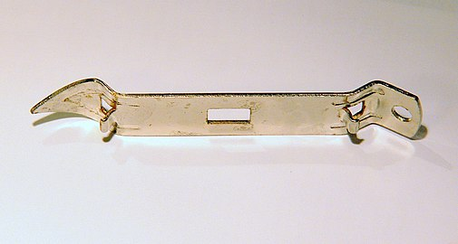
Notes:
“Church keys” were needed to open cans before pop tops were commonplace.
https://en.wikipedia.org/wiki/Church_key

Slide 16
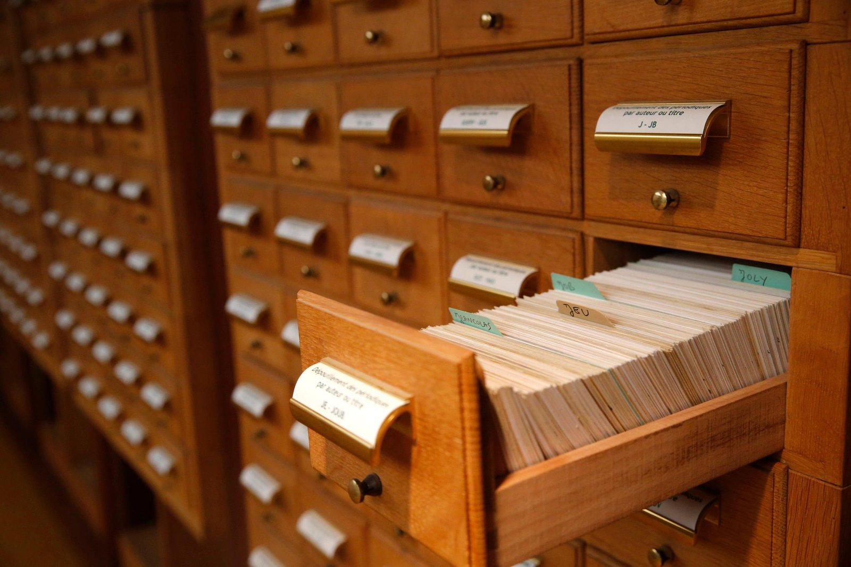
Notes:
The card catalog
Before computer databases your research began here. In most libraries you could look up information by author, book name, and subject using the catalog. The cards would have some basic information about the book and information about where to find it in the library.
https://www.smithsonianmag.com/smart-news/card-catalog-dead-180956823/

Slide 17
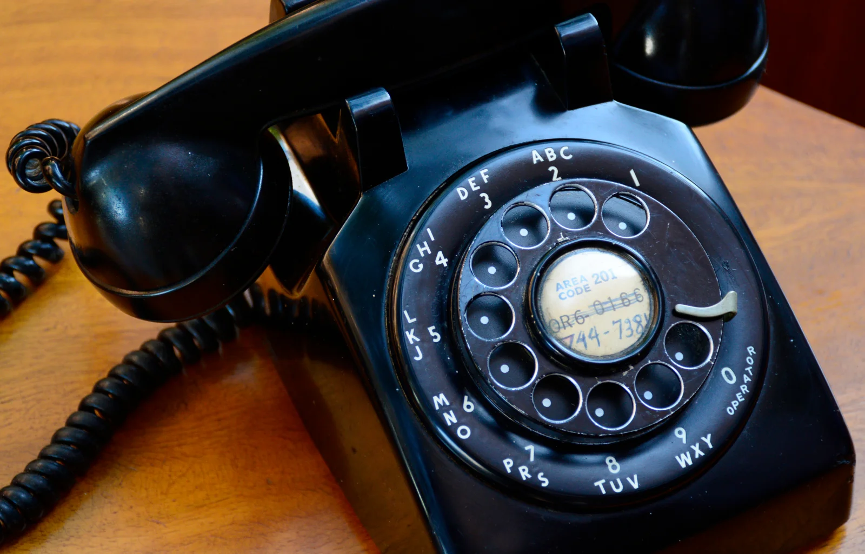
Notes:
Rotary phone
OK, so you know it’s a phone. How do you use it?
https://time.com/5503086/rotary-phone/

Slide 18
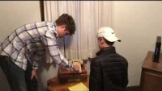
Two teens try to figure out how to use a rotary phone
Notes:
https://youtu.be/8HyyAlcoUXo

Slide 19
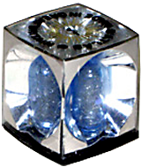
Notes:
Flash cube
In 1965 Eastman Kodak of Rochester, New York replaced the individual flashbulb technology used on early Instamatic cameras with the Flashcube developed by Sylvania Electric Products.^{[10][11]}
A flashcube was a module with four expendable flashbulbs, each mounted at 90° from the others in its own reflector. For use it was mounted atop the camera with an electrical connection to the shutter release and a battery inside the camera. After each flash exposure, the film advance mechanism also rotated the flashcube 90° to a fresh bulb. This arrangement allowed the user to take four images in rapid succession before inserting a new flashcube.
Description credit: https://en.wikipedia.org/wiki/Flash_(photography)#flashcube
Image credit: https://www.quora.com/Do-you-remember-the-Flashcube-camera-How-was-it-made-How-did-it-work

Slide 20
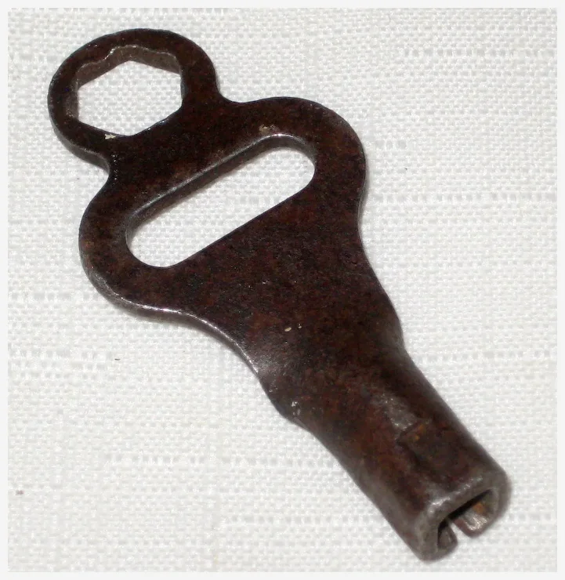
Notes:
Skate key
This tool was used on metal skates to adjust the size. You couldn’t get the skates on or off without one!
https://www.rubylane.com/item/34499-STx20-x202885/1940x27s-Roller-Skate-Key

Slide 21
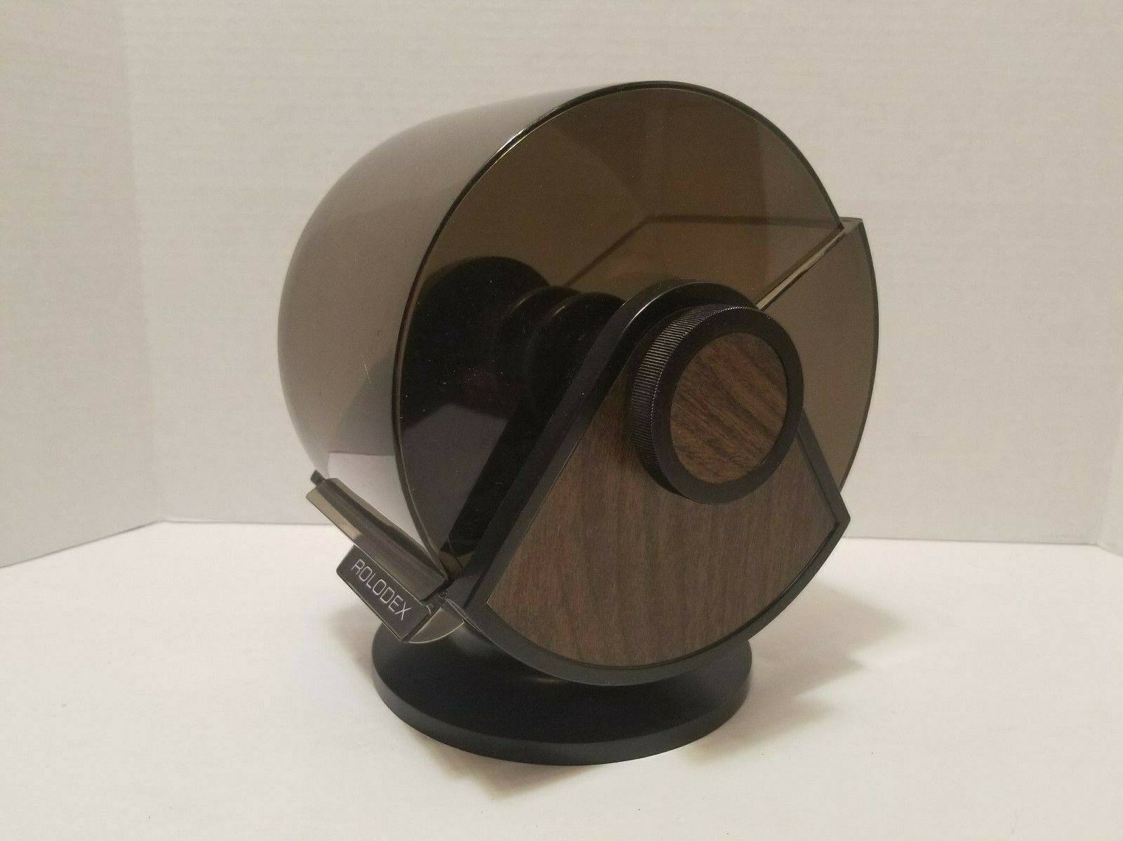
Notes:
The Rolodex
This is how people kept track of their contacts before the cell phone. It alphabetically stored a card for each one of your contacts that included all their information. You had to manually fill out and file a card for each person.
https://mavin.io/item/Vintage-ROLODEX-SW%3D24C-Swivel-Base-Faux-Wood-Grain-EUC%C2%A080%27s?itemId=113830076157&q=

Slide 22
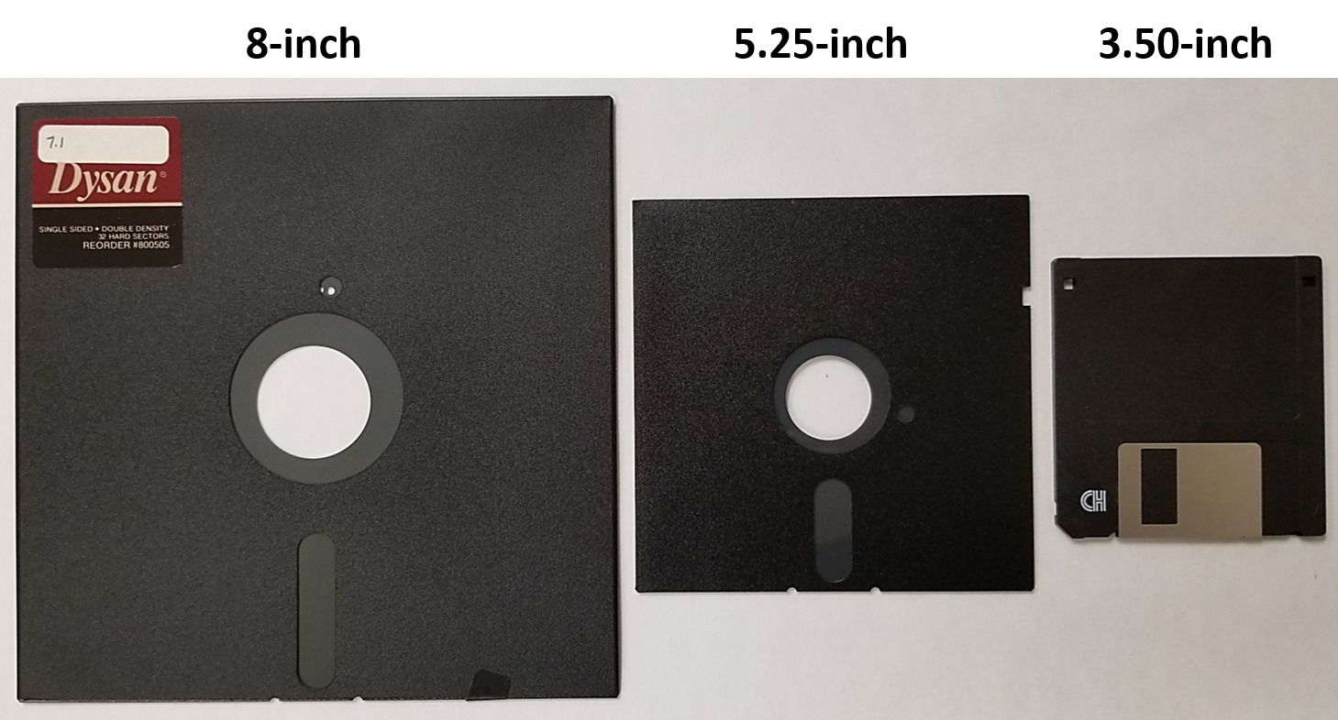
Notes:
Floppy disks
Before technology increased the capacities of internal storage the main way to store your files was on one of these devices. They worked like a modern memory card but were so much bigger!
https://www.digital-scrapbooking-storage.com/floppy-disk.html

Slide 23
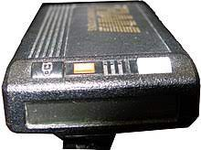
Notes:
The Pager
AKA a beeper, this small device would alert you when someone “beeped” you. Basic beepers would display a phone number that you would have to call back; more advanced models would allow you to send text messages to people who had a similar device.
https://www.silicon.co.uk/mobility/smartphones/tales-tech-history-pager-204285

Slide 24
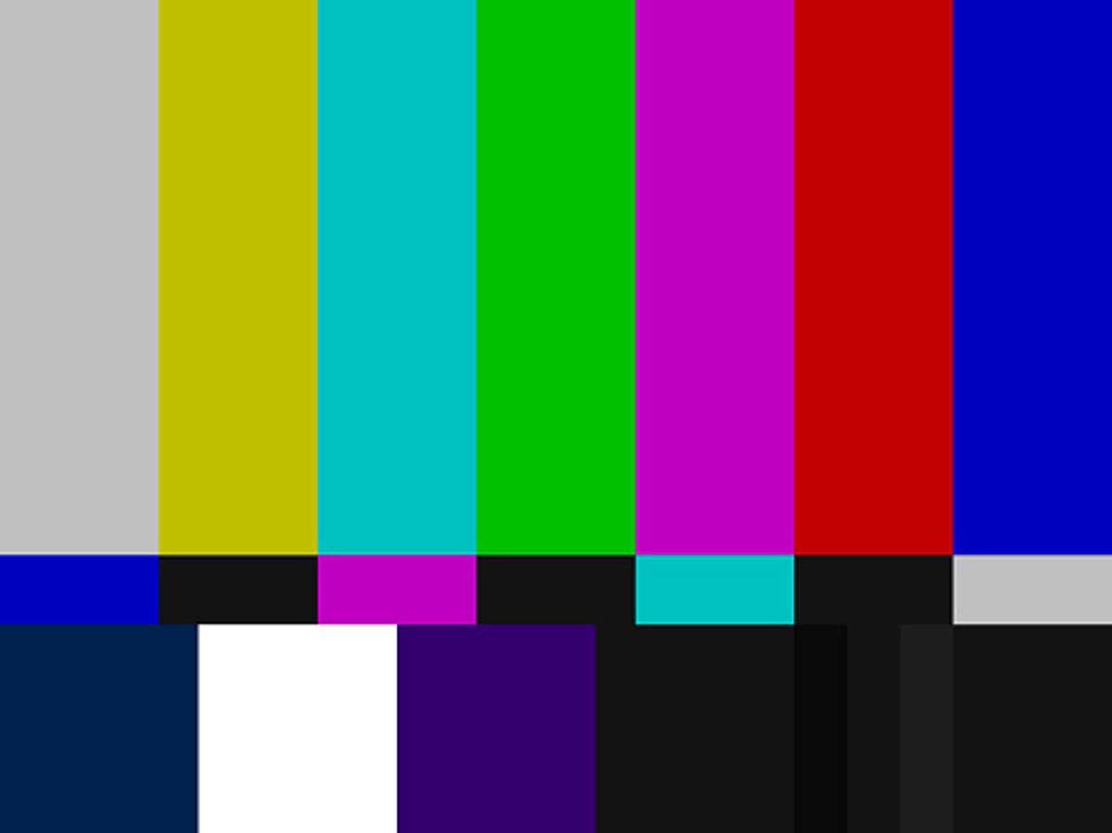
Notes:
TV Sign off image
TV hasn’t always been a 24 hour thing. Most stations ‘Signed off’ at the end of the day (often around midnight.) They would play the National Anthem and then display this test pattern.
https://wbckfm.com/old-michigan-television-sign-offs/

Slide 25
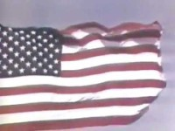
Notes:
Test pattern example

Slide 26
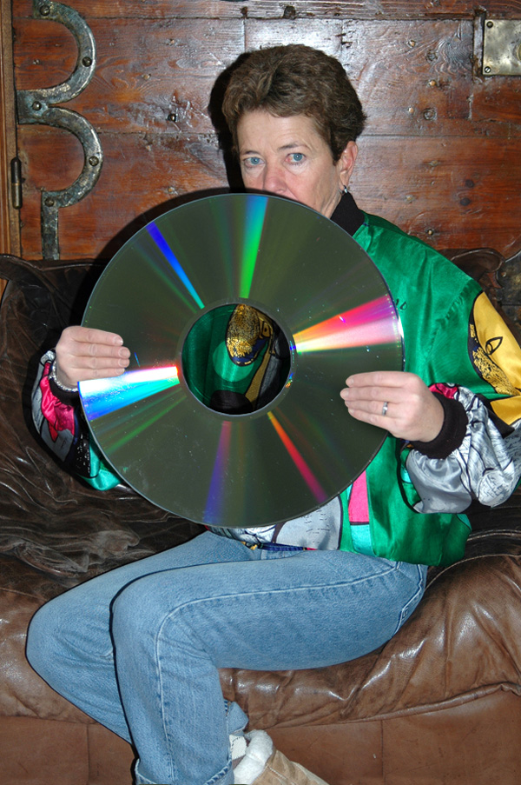
Notes:
The Laser Disc
These were sold mostly between 1980 and 2000. The 12 inch discs were most popular with people who took their movies seriously (as well as people in the Eastern Hemisphere.) They came out about the same time as the VHS VCR which was more popular because of its ability to record as well. The laser disc technology led to the development of the audio CD.
https://forum.lowyat.net/topic/4480357

