Slide 1
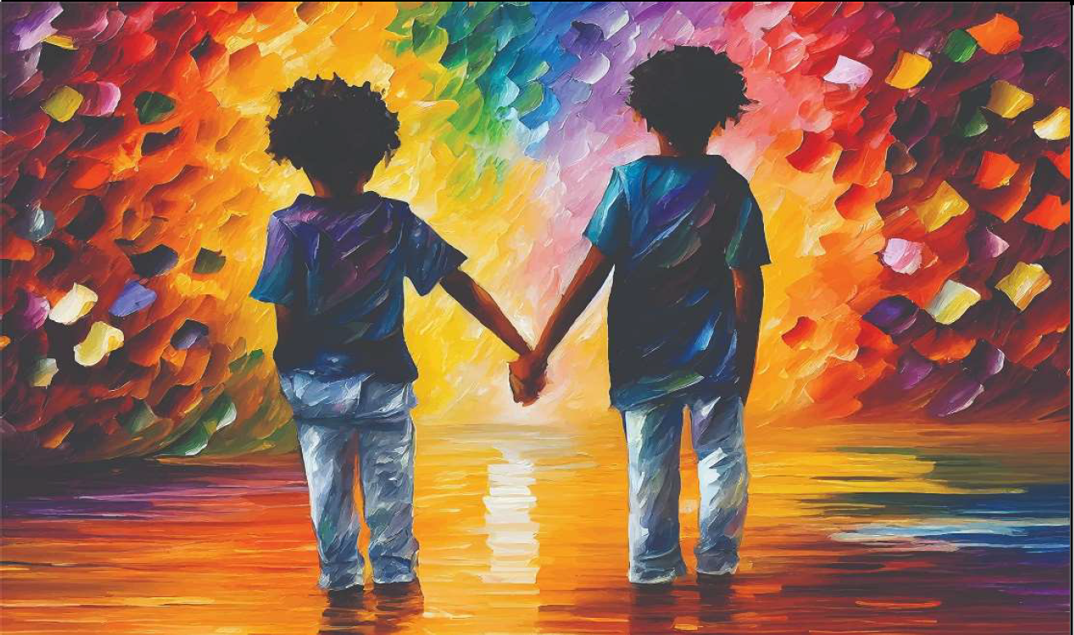
What do you notice and wonder about this painting?

Slide 2

Turn and Talk:
What emotions would you use to describe this painting?
If We All Held Hands (2023 Exhibit)
by: Eric Applequist, Moline, Illinois, United States

Slide 3
“A best friend is like a candle in the darkness.”
-Deepti Sapra
Ambala City, Haryana, India
What does that quote mean to you?
If We All Held Hands (2023 Exhibit)
by: Eric Applequist, Moline, Illinois, United States

Slide 4
Empathy
Empathy is the ability to share another person's feelings and emotions as if they were your own.
Turn and Talk:
Tell your partner about a time when someone showed you empathy.

Slide 5

Be Kind by Pat Zietlow Miller
Click on picture above to play

Slide 6

Interview Your Classmates
Interview your classmates on how they like to be shown empathy
(or comforted) when they are sad or upset.
Write down student responses. Discuss your findings.

Slide 7
What color stands out to you?
What emotions does it elicit?
How do the colors affect your thoughts?
If We All Held Hands (2023 Exhibit)
by: Eric Applequist, Moline, Illinois, United States

Slide 8
Discussion Questions
What do you think the relationship is between the two children?
What do you notice about the children?
Where do you think the children are and how did they get there?
Where do you think the children are going?
How do you think the children feeling?
Why do you think there aren’t any adults in the picture?
How would you feel if you were one of the children?
Why do you think the author titled his artwork, “If We All Held Hands”?
What questions would you ask the artist of this painting?

Slide 9
Author’s Statement
We’ve discussed your thoughts and feelings about this artwork.
Here’s a statement from the artist about his painting:
“We all possess great gifts enabling us to bring comfort to others. Whether it is just a smile when passing a stranger on the street, a casual wave or holding a hand to reassure or show affection. We can’t forget the things that make us so uniquely human. We are endowed with a great power to ease the suffering of others through the most simple human expressions. Use these wonderful gifts everyday!”

Slide 10
Write About It: What Happened?
If this was a photograph,
what do you think might have happened just BEFORE it was taken?
What do you think happens NEXT?
Write about it and explain your reasoning.

