Slide 1
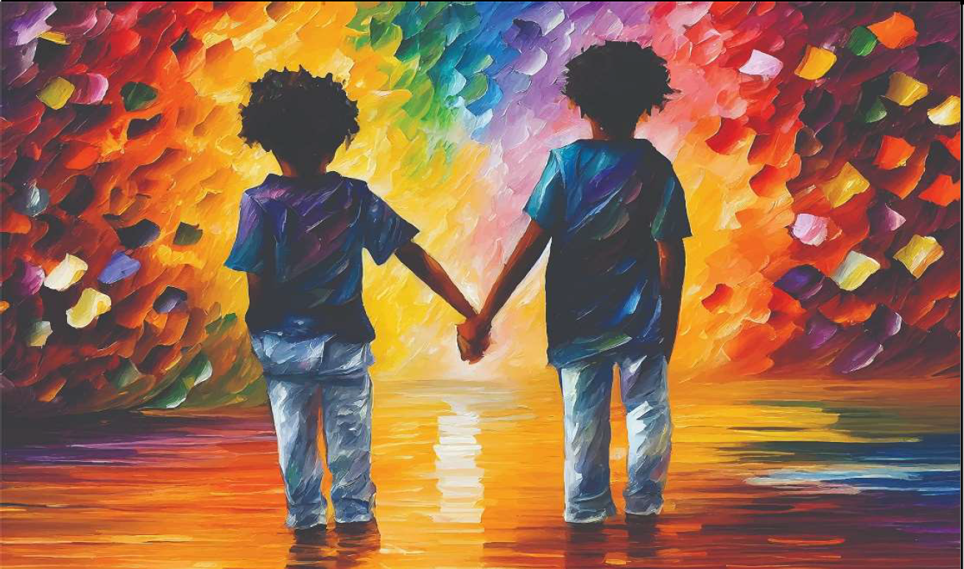
What do you notice and wonder about this painting?

Slide 2

Turn and Talk:
What feeling word or emotion would you use to describe this painting?
If We All Held Hands (2023 Exhibit)
by: Eric Applequist, Moline, Illinois, United States

Slide 3
“A best friend is like a candle in the darkness.”
-Deepti Sapra
Ambala City, Haryana, India
What does that quote mean to you?
If We All Held Hands (2023 Exhibit)
by: Eric Applequist, Moline, Illinois, United States

Slide 4
Comfort
Comfort is what you feel when worries or unhappiness stop.
Turn and Talk:
Tell your partner about a time when someone comforted you.

Slide 5

Kindness Starts With You
Click on picture above to play

Slide 6
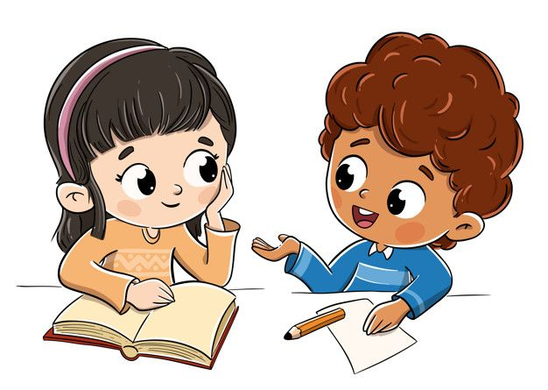
Interview Your Classmates
Interview your classmates on how they like to be comforted when they are sad or upset. Put a tally mark by their answer.

Slide 7
What color stands out to you?
What feeling word or emotion does that make you think of?
If We All Held Hands (2023 Exhibit)
by: Eric Applequist, Moline, Illinois, United States

Slide 8
What Happened?
If this was a photograph, what do you think might have happened just BEFORE it was taken?
What do you think happens NEXT?
If We All Held Hands (2023 Exhibit)
by: Eric Applequist, Moline, Illinois, United States

Slide 9
Author’s Statement
We’ve discussed your thoughts and feelings about this artwork.
Here’s a statement from the artist about his painting:
“We all possess great gifts enabling us to bring comfort to others. Whether it is just a smile when passing a stranger on the street, a casual wave or holding a hand to reassure or show affection. We can’t forget the things that make us so uniquely human. We are endowed with a great power to ease the suffering of others through the most simple human expressions. Use these wonderful gifts everyday!”

Slide 10
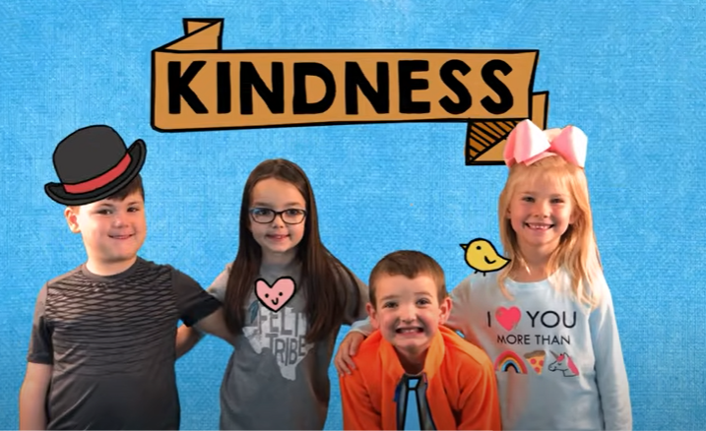
Kindness by The Juicebox Jukebox
Click on picture above to play

Slide 11
How to Show Kindness and Comfort?
Draw a picture and write about a time you showed kindness or comforted someone.
OR
Draw a picture and write about a time when someone showed you kindness or comforted you when you were sad or upset.

