Slide 1
Compare and Contrast
With Embracing Our Differences

Slide 2
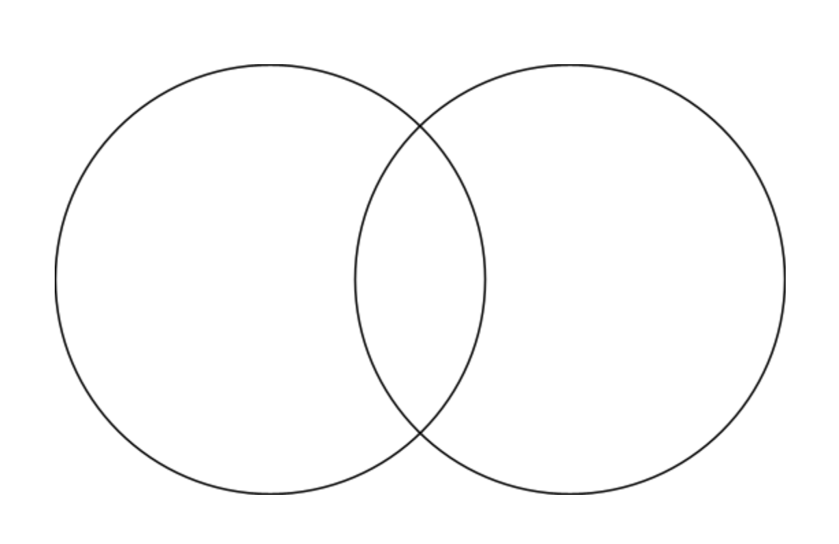
Compare and Contrast
You can use a Venn Diagram to help you compare and contrast.
What does it mean to compare and contrast?
It means to look at how two or more things are similar and different.
Key words that authors use when they compare and contrast include same, both, also, alike, like, different, in common, however, but and on the other hand.
Click here for definition video

Slide 3
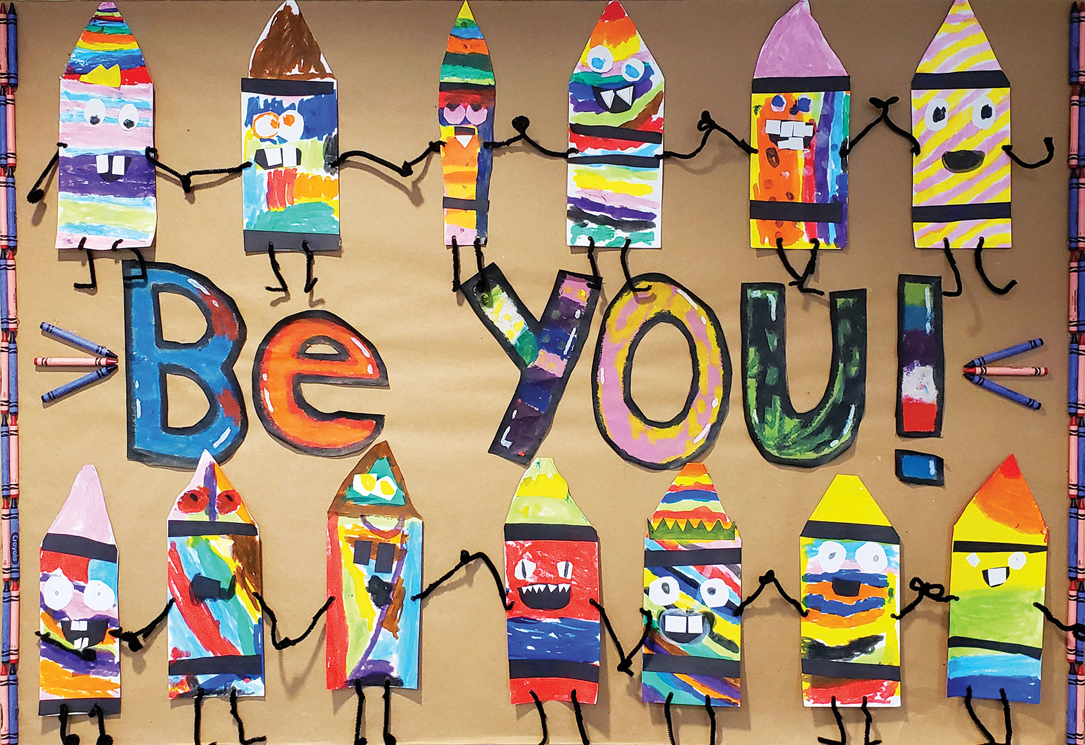
Be You
What the artist had to say about the piece:
“In this collaborative artwork, we wanted to portray the idea that all the things that make us different should be celebrated because our uniqueness makes the world a more colorful place. The students represented this idea as crayons, but instead of making their characters one solid color, they reflected their uniqueness with a variety of colors, facial features, and design elements. While we were positioning the crayons on the poster, the students joined the crayons together so that they were holding hands.”
What do you think about when you look at this piece of art?
How does this piece of art make you feel?
What is the theme of this piece?
Be You
by: Ms. Motta’s First Grade Class (Emma E. Booker Elementary in Sarasota, Fl)

Slide 4
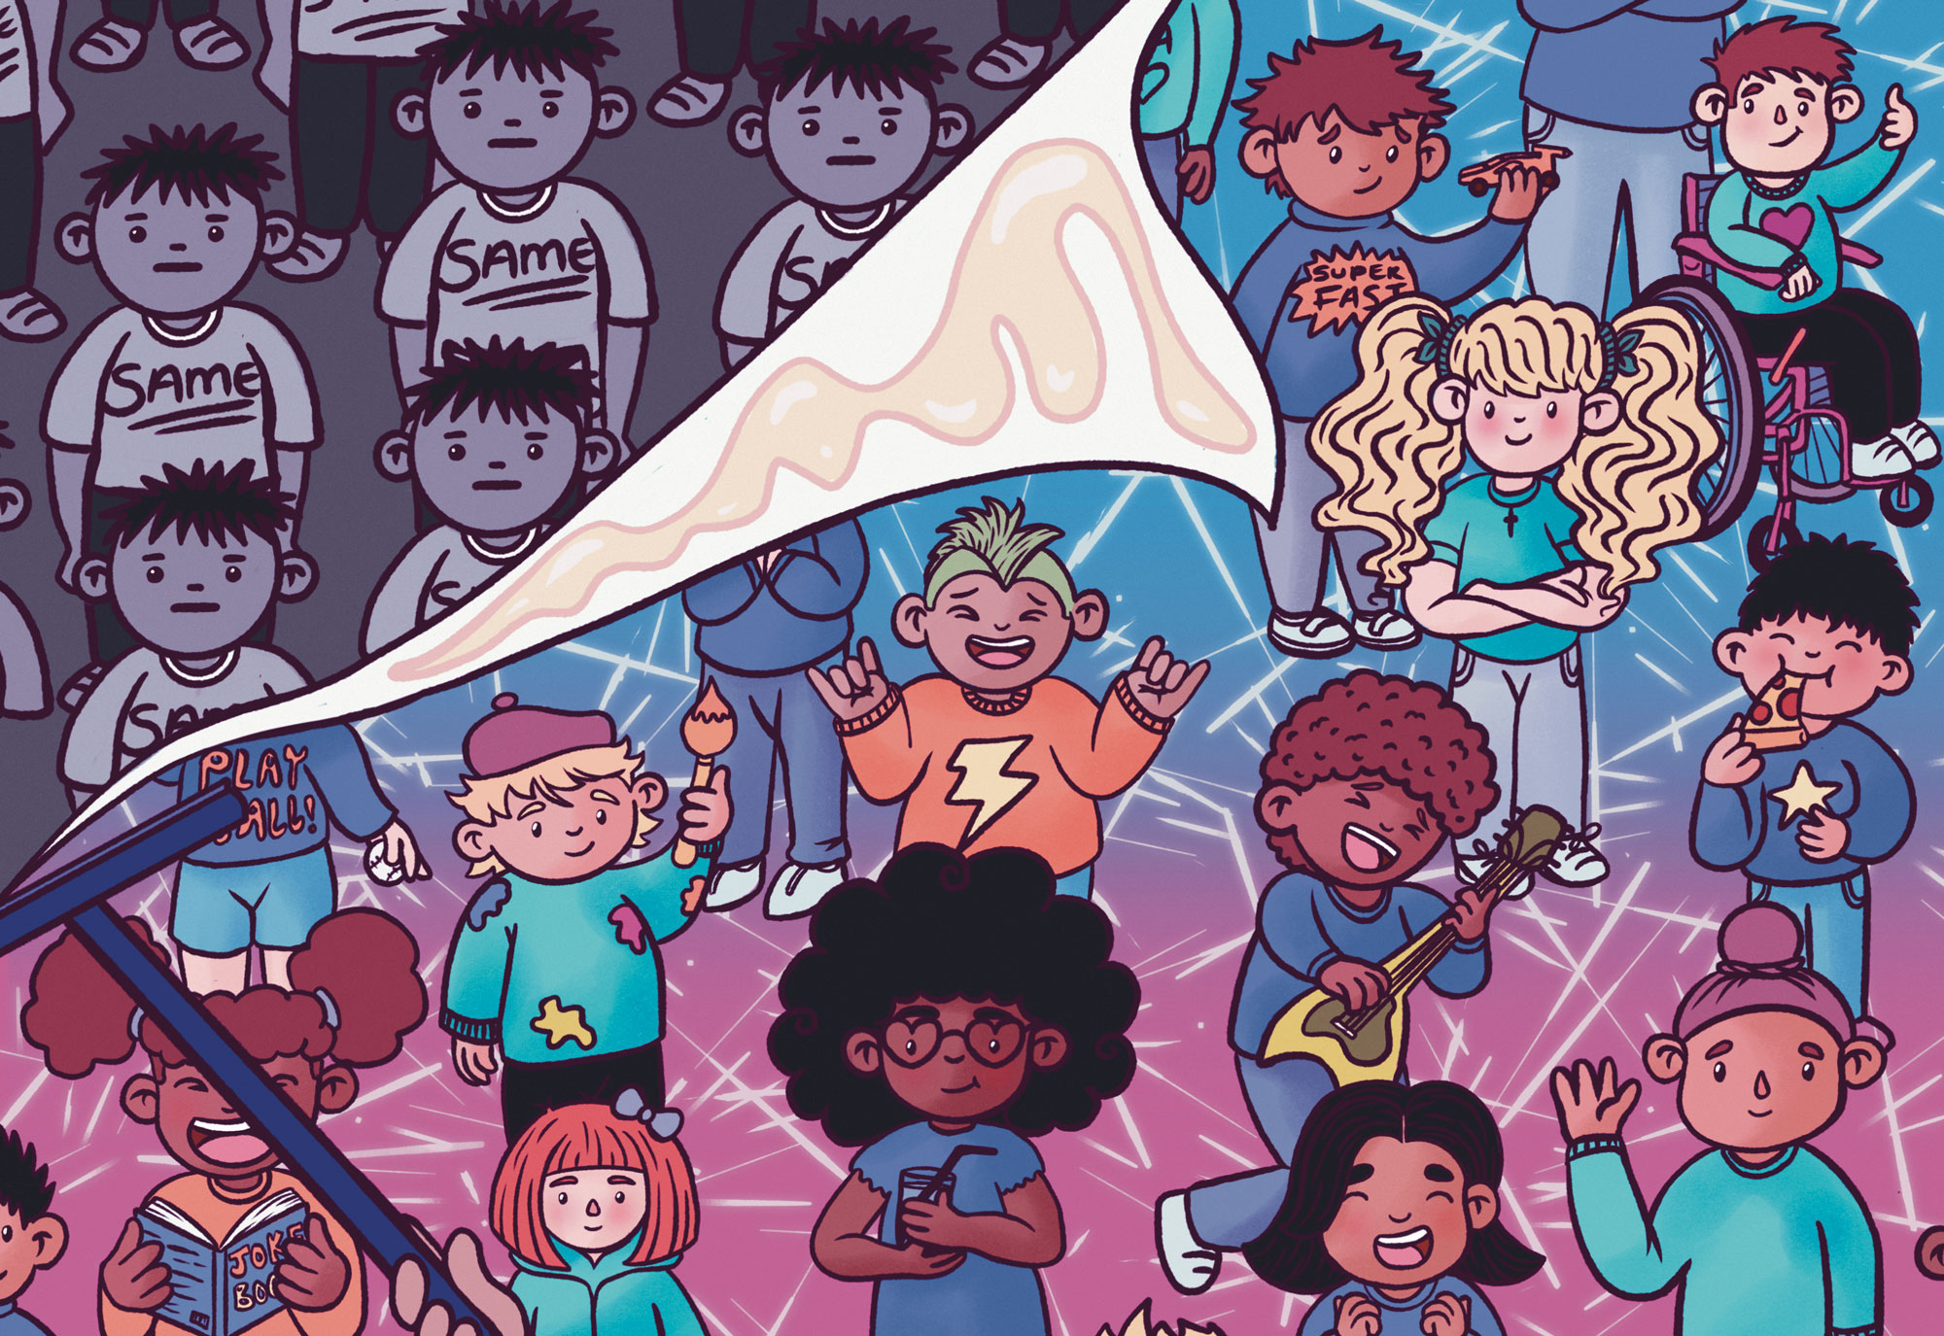
Different is Better
What the artist had to say about the piece:
“In a world where you are asked to fit in, stand out and do it proudly. Our differences make us unique, they should be celebrated and acknowledged. This artwork depicts a dull, grey billboard being pasted over with a vibrant portrait of a very happy bunch of people.”
What do you think about when you look at this piece of art?
How does this piece of art make you feel?
What is the theme of this piece?
Different is Better
by: Chanelle Lloyd (from Leeds, England)

Slide 5
Different is Better
Be You

Slide 6
Different is Better
Be You

Slide 7
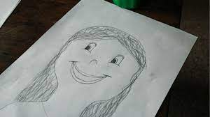
Flip over your paper and sketch a quick self- portrait. When you are done, you will use your drawing to compare yourself to a friend.
Zoe Fred

