Slide 1
Dear Social Media
How does social media influence teens?
By Jasmine Persaud

Slide 2
Agenda
Examine graphs with a peer
O.D.I.E. artwork analysis
Complete graphic organizer and share understanding with a peer

Slide 3
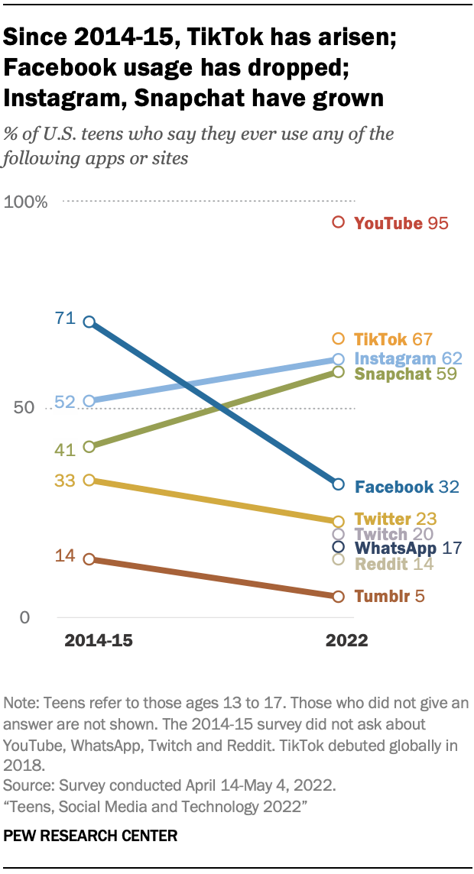
Why do you believe Snap Chat has become so popular?
How do you believe that changed how teens behave?
Share your understanding with a peer.
Peer A shares first for 30 seconds while peer B actively listens. Then reverse roles.

Slide 4
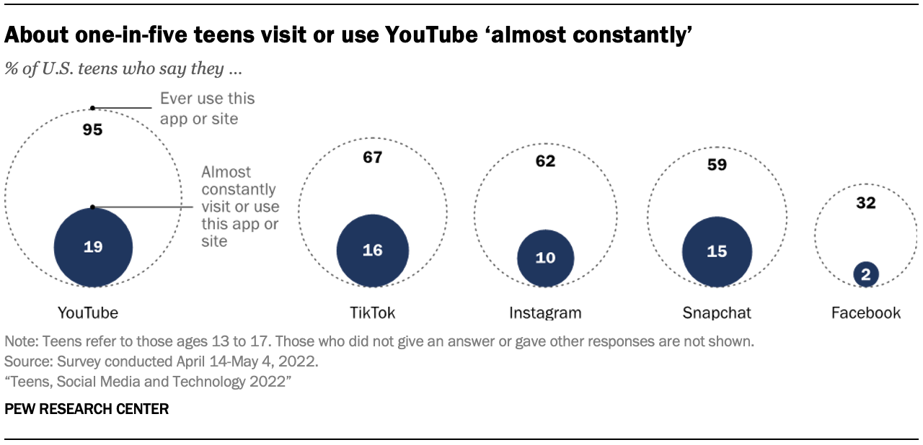
How do you use YouTube?
Do you think this data is accurate?
Share your understanding with a peer.
Peer A shares first for 30 seconds while peer B actively listens. Then reverse roles.

Slide 5
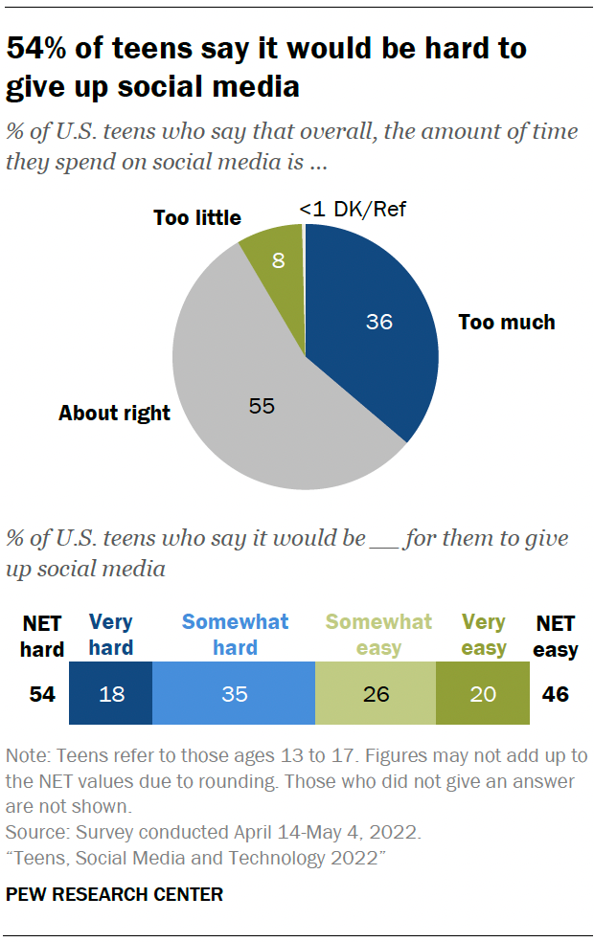
Why do they believe giving up social media is so difficult?
Write your answers on a post it note and put your note on the whiteboard.

Slide 6
ODIE Process
Today we will analyze art with the steps below.
Use the graphic organizer to show your thinking.
Observe
Describe
Infer
Evaluate

Slide 7
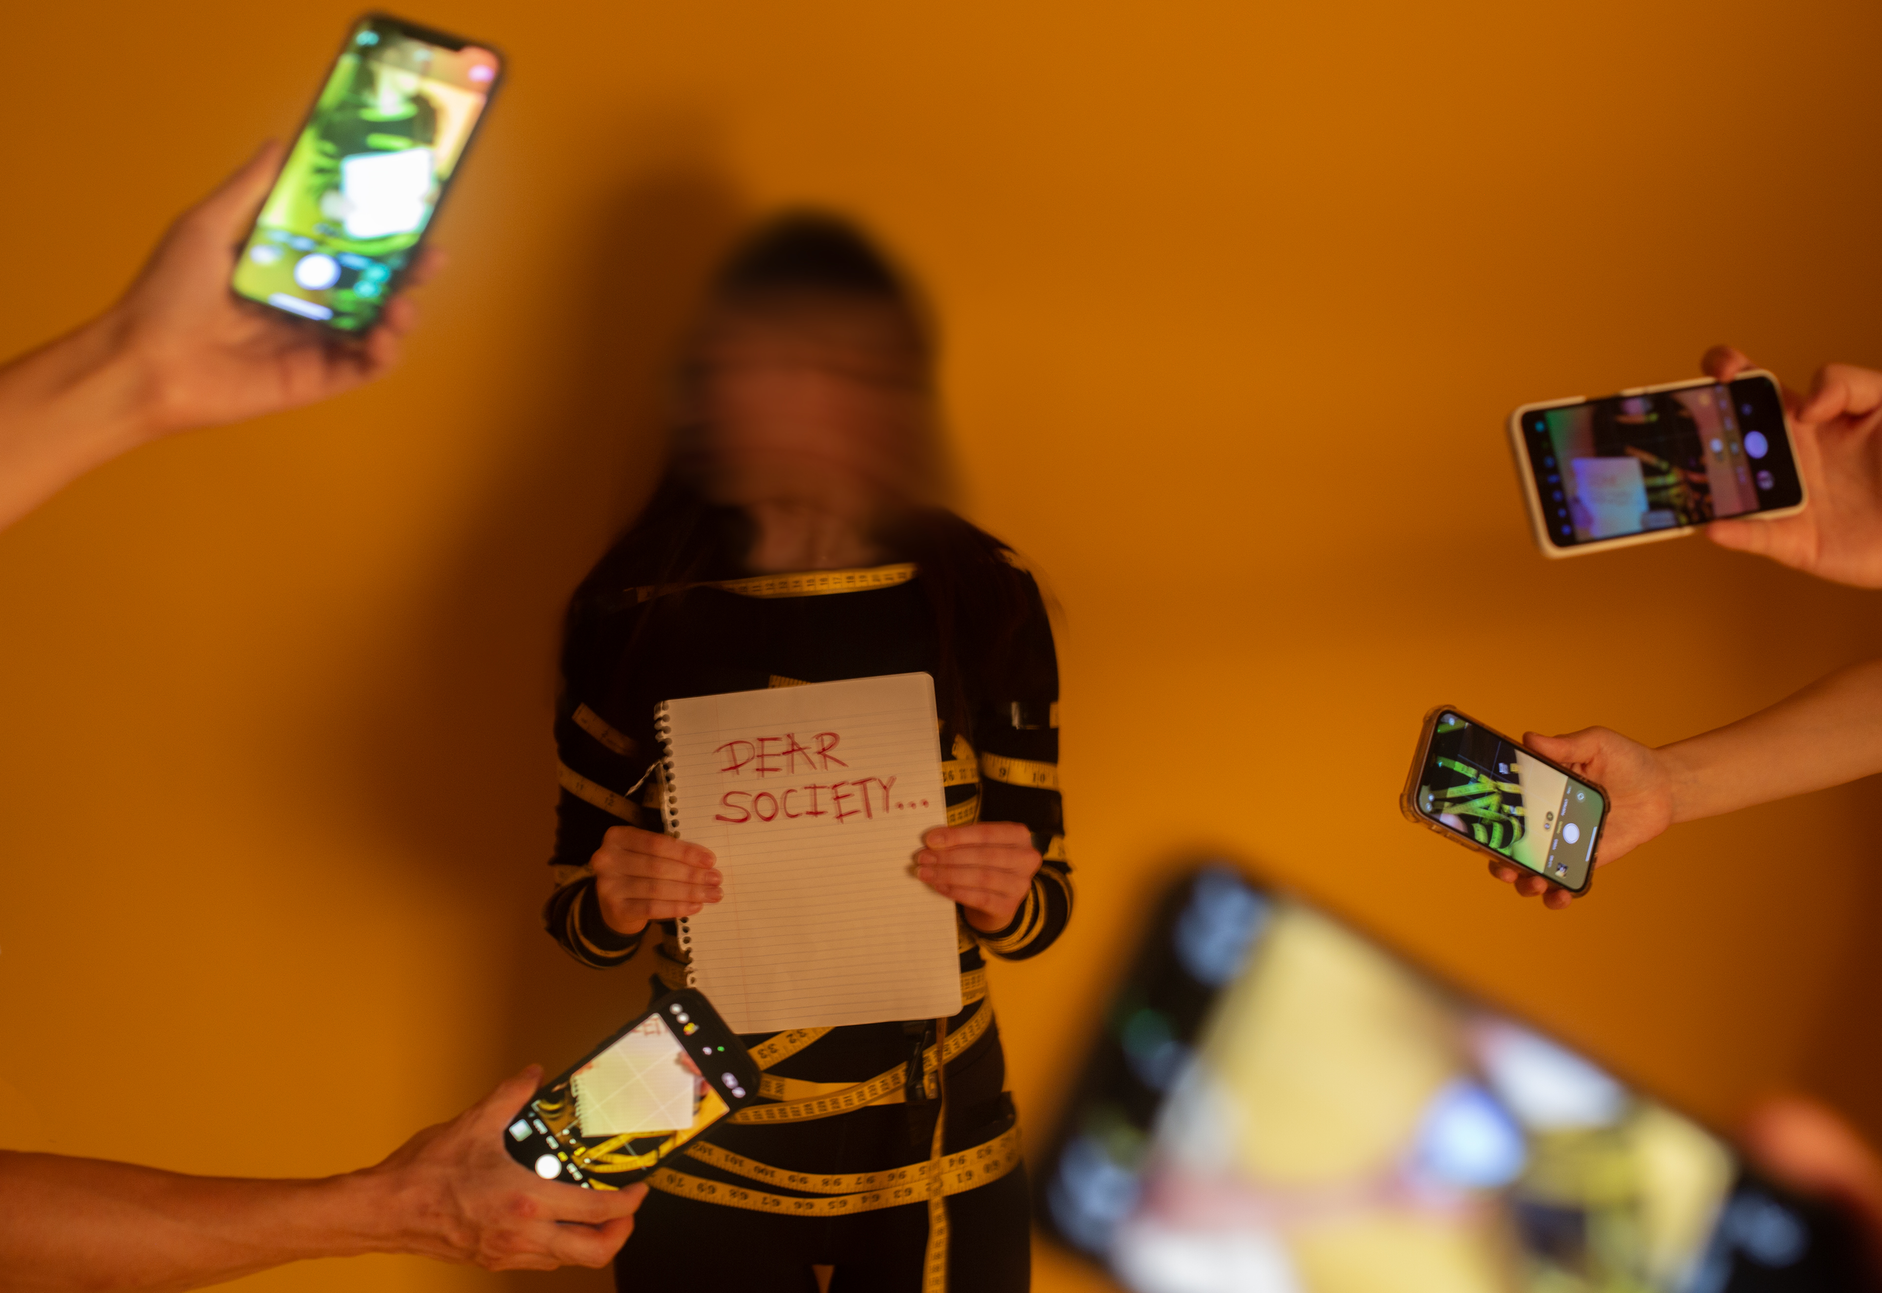
Observe
Under “Observe” write three things you see in the image.
Turn and Talk (30 seconds each)
Wrapped in Standards Yeobin Park, 10th Grade
Seuol, South Koreo | Teacher – Jai Won Lee

Slide 8
Describe
Write descriptive details, consider location, position, colors, etc.
Turn and Talk (30 seconds each)
Wrapped in Standards Yeobin Park, 10th Grade
Seuol, South Koreo | Teacher – Jai Won Lee

Slide 9
Infer
How does the artwork reflect the impact of technology on our daily lives?
In box one for“infer”, write your claim
In the two other boxes, cite evidence.
Turn and Talk (30 seconds each)
Wrapped in Standards Yeobin Park, 10th Grade
Seuol, South Koreo | Teacher – Jai Won Lee

Slide 10
Evaluate
How engaging is the artwork in capturing the viewer's attention and maintaining interest, especially in the context of technology?
In box one for “evaluate”, write your claim
in the two other boxes, cite text evidence.
Complete Turn and Talk (30 sec. each)
Wrapped in Standards Yeobin Park, 10th Grade
Seuol, South Koreo | Teacher – Jai Won Lee

