Slide 1
What is going on in this picture?
What do you see that makes you say that?
What more can you find?
Accept, Adjust, Flow!
Kata Kakuszi | Sao Paulo, Brazil

Slide 2
If the penguin had a speech bubble beside it, what do you think it would be saying?
Accept, Adjust, Flow!
Kata Kakuszi | Sao Paulo, Brazil

Slide 3
Our Classroom Map

Slide 4
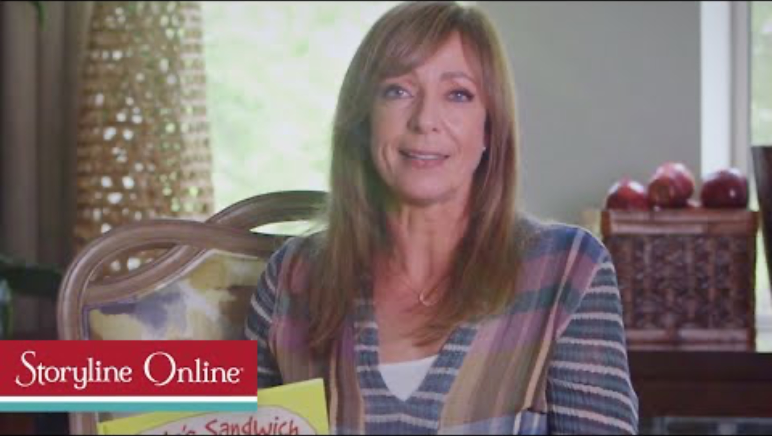
We are better together!

Slide 5
I can be part of our classroom family by…

