Slide 1
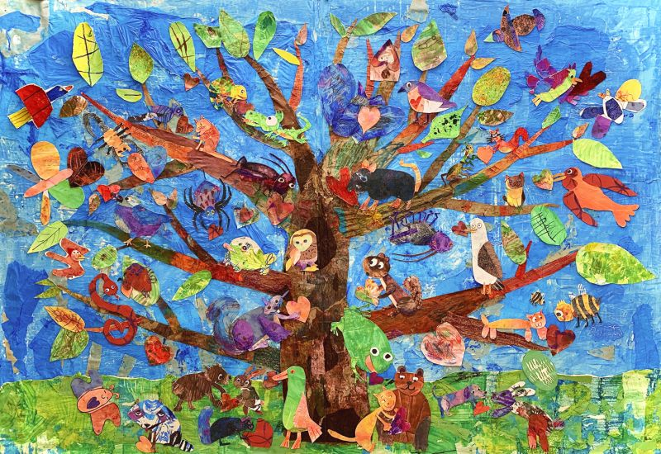
How many animals can you count in and around the tree?
Tree of Harmony
Kindergarten - 12th Grade Students Easterseals Academy, Sarasota, Florida Teacher: Chris Leverett

Slide 2
Is our classroom better together?

Slide 3

Our Class is a Family

Slide 4
I can be part of our classroom family by…

