Slide 1
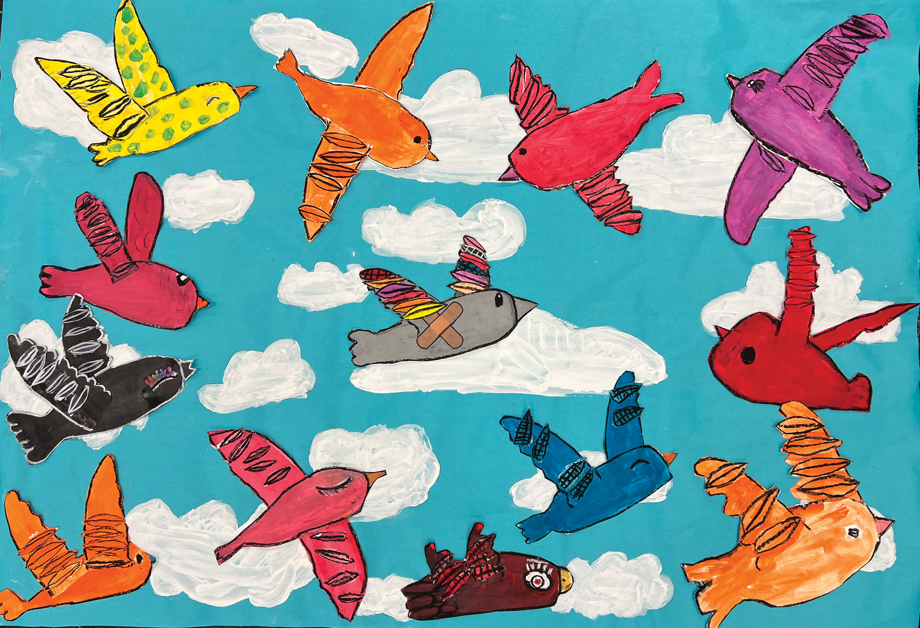
What do you notice and wonder about this painting?

Slide 2
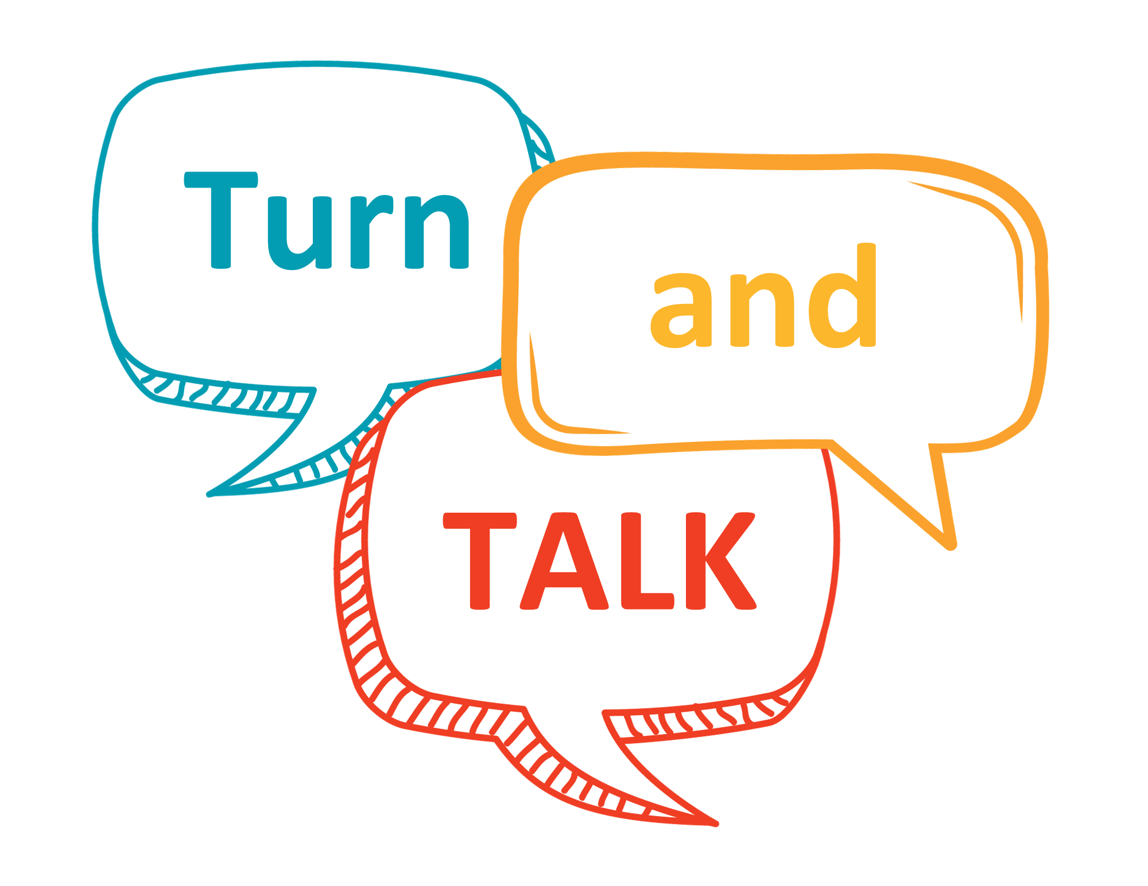
How are the birds alike,
and how are they different?

Slide 3
Lending a Feather
What do you think happened to the gray bird’s wing?
Why do you think the artists titled their painting, Lending a Feather?
Lending A Feather
By Mr. Rodkey's 3rd Grade Class Emma E. Booker Elementary, Sarasota, Florida | Teacher: Melissa Shaw

Slide 4
Artist Statement
Before creating this collaborative artwork, our class learned about empathy. In our class project, we wanted to convey how important it is to show compassion for others when they are hurting by finding ways to help.
The gray bird in our image was injured and couldn’t fly until all the other birds came together, each lending a feather so they could all take flight again.
Lending A Feather
By Mr. Rodkey's 3rd Grade Class Emma E. Booker Elementary, Sarasota, Florida | Teacher: Melissa Shaw

Slide 5
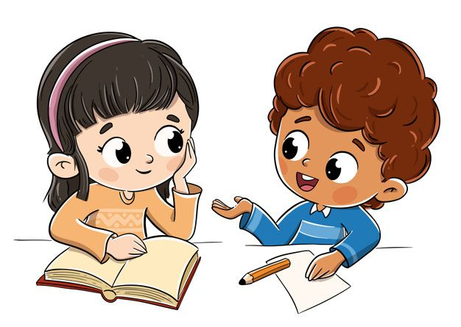
Vocabulary
Define and discuss some words you will hear in the story:
shimmering
dazzling
special
admire
wavered

Slide 6
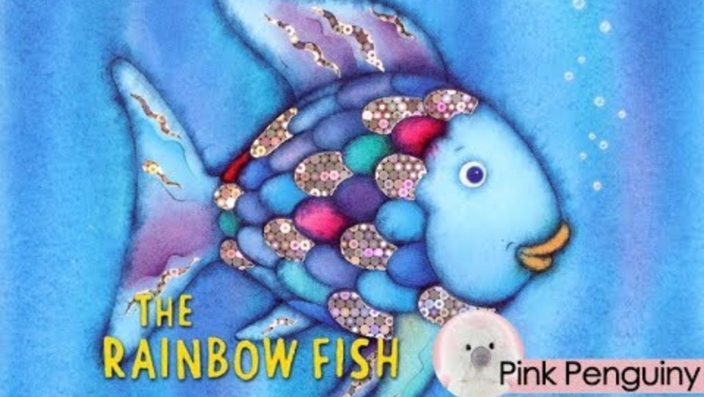
The Rainbow Fish by Marcus Pfister

Slide 7
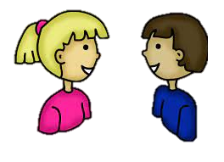
Compare and Contrast
Rally Robin:
You and your partner describe the qualities of rainbow fish.
Next, describe the qualities of the birds in the painting.
How are actions of the colorful birds and rainbow fish alike? How are they different?

Slide 8
Discussion
Define selfish and unselfish.
Discuss the qualities of being selfish vs. being unselfish
(K-1st): Discuss: When was the rainbow fish selfish and unselfish?
(K-1st): Discuss: Were any of the birds selfish? How do you know?
(K-1st): Writing Prompt: I was unselfish when ______.
(2nd): Discuss – How did the rainbow fish change from the beginning to the end of the story?
(2nd): Write Answer in Journal – Who do you think was more unselfish: the rainbow fish or the colorful birds and why?

