Slide 1
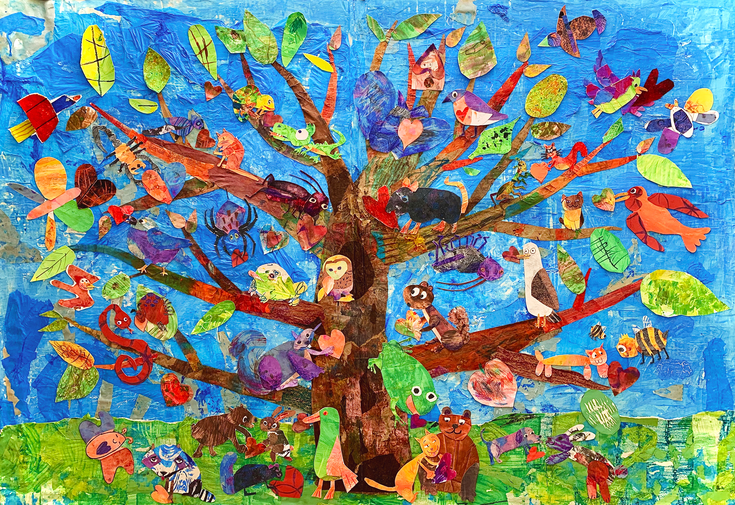
What do you notice and wonder about this painting?

Slide 2
Artist Statement
Though we all may come from separate branches, we all share the same tree. In our Tree of Harmony mixed media collaborative collage, all levels of our K-12 academy got to take part throughout the process, and also demonstrate their ability to work with one another, just like our animals. We found that, even though we may differ in a number of ways, we all have our own special gifts to offer, and we’re even stronger when we support each other and work together.
Tree of Harmony
School Collaboration - Sarasota, Florida, United States
(Kindergarten through 12th Grade, Easterseals Academy, Teacher - Chris Leverett)

Slide 3

How can all those different animals live harmoniously in one tree?
Tree of Harmony
School Collaboration - Sarasota, Florida, United States
(Kindergarten through 12th Grade, Easterseals Academy, Teacher - Chris Leverett)

Slide 4
Vocabulary
Define and discuss:
generations
ancestors
depend
harmony

Slide 5
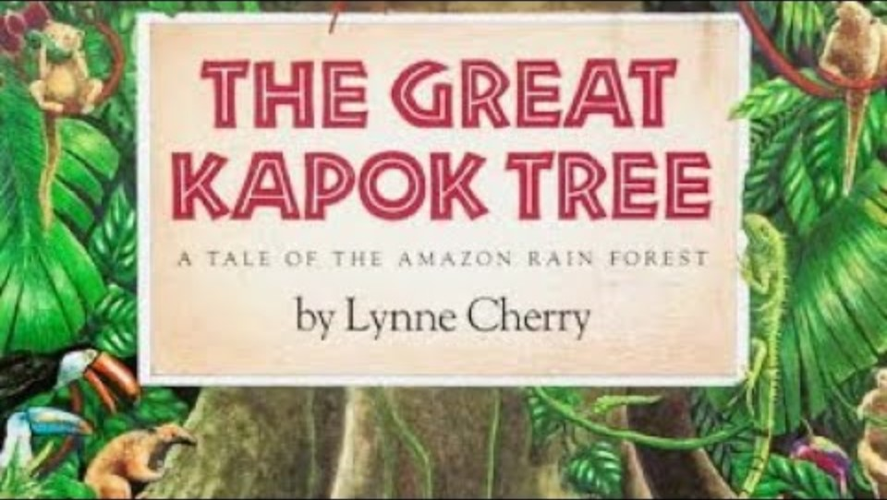
The Great Kapok Tree by Lynne Cherry

Slide 6
Book Discussion
How would cutting down one tree impact the animals?
Why are so many different species of animals able to live in the great Kapok tree?
Why are the trees so important to the rainforest’s survival?

Slide 7
Compare and Contrast
What similarities and differences do you notice about The Great Kapok Tree and the tree in the painting?
Tree of Harmony
School Collaboration - Sarasota, Florida, United States
(Kindergarten through 12th Grade, Easterseals Academy, Teacher - Chris Leverett)

Slide 8
Artist Statement
Though we all may come from separate branches, we all share the same tree. In our Tree of Harmony mixed media collaborative collage, all levels of our K-12 academy got to take part throughout the process, and also demonstrate their ability to work with one another, just like our animals. We found that, even though we may differ in a number of ways, we all have our own special gifts to offer, and we’re even stronger when we support each other and work together.
Tree of Harmony
School Collaboration - Sarasota, Florida, United States
(Kindergarten through 12th Grade, Easterseals Academy, Teacher - Chris Leverett)

Slide 9
Interview Your Classmates
Think about the book and artwork.
Think about what the artists said in their statement about their artwork.
Interview 10 classmates about where they are from, one strength, and one area/trait they would like to improve about themselves.
Discuss your findings as a class.
What things do you have in common with each other?
Did the same person give different answers to different interviewers?
Can someone else’s strength help another person’s area to improve?
What did you learn about your classmates?
How can this information help your teacher when assigning group projects?

Slide 10
Write About It: Our Class Tree
Think about your class being a tree and each branch is one of the traits listed as strengths or areas of improvement from the interview activity.
Choose on of the following prompts to write about:
How is each branch contributing to your class (tree) as whole?
What if one branch broke off in a storm? How would this affect your class (tree)?
What new branch could your class tree really use?
How could you help support someone’s area of improvement and/or how could someone support you to strengthen your area of improvement?

