Slide 1
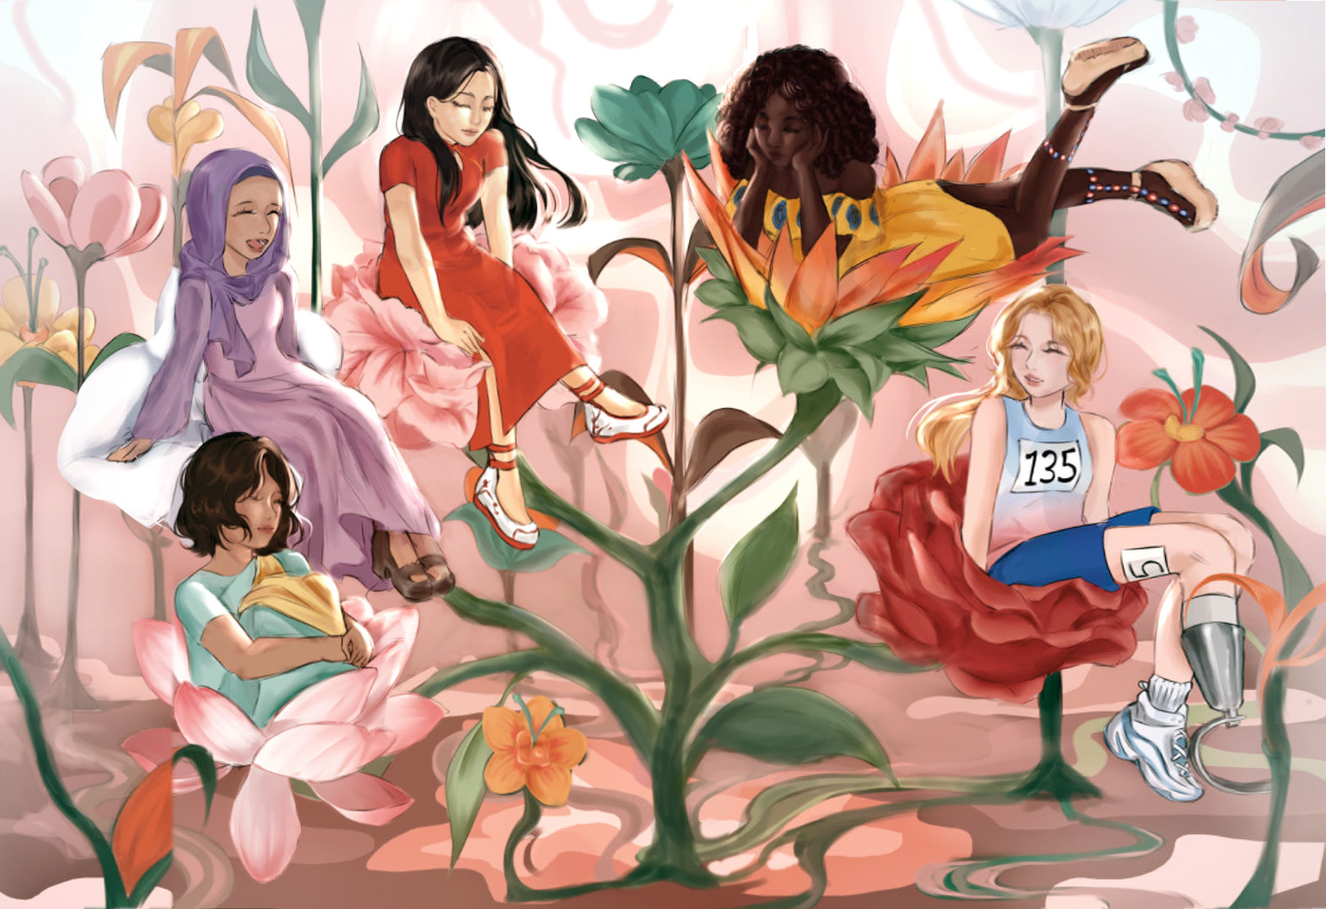
Children Raised by the Same Earth Sofia Huang, 9th Grade, SFK International Art Education Beijing, China | Teacher: Ruilin Meng & Amanda Meng

Slide 2
Artist Statement
There is a classic old saying in China called Fifty-six nationalities fifty-six flowers, fifty-six brothers and sisters are one family.
My country has so many cultures, and so much inclusiveness. I grew up in this environment. In my opinion, every country, every race, and every person in the world are also many different flowers. These flowers can be the same family. So I used flowers as the elements of my creation.
I made these flowers grow from one root and collected several representative races with their national flowers. I also wanted to include people with disabilities, so I drew a beautiful girl with a prosthetic leg in the bottom left corner.
We are the children raised by the same earth.

Slide 4
“You are not extra.
You are not ordinary.
You are extraordinary.”
Robert Arroyos, 7th Grade
Pine View School – Osprey, FL (Teacher – Susy Grandusky)

Slide 5
