Slide 1
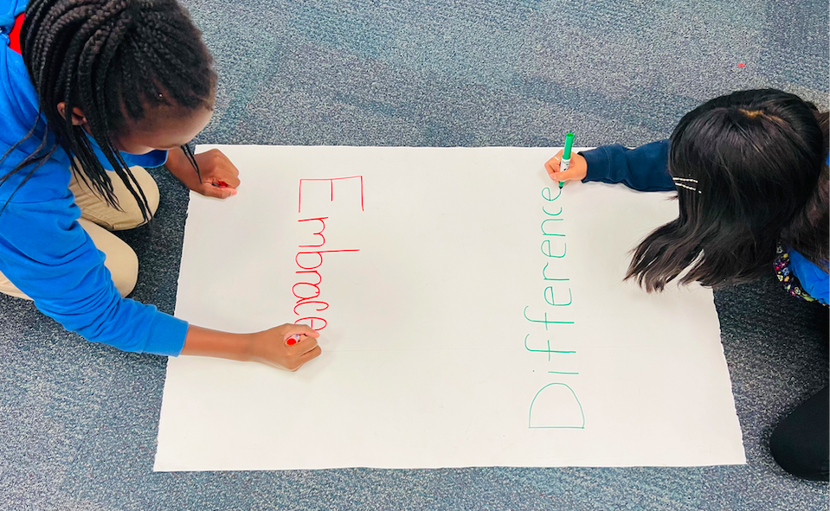
Embracing Our Differences Introduction and Brainstorming
A Beginning Guide to Embracing Our Differences
By Brittany Braniger
Notes:
Teacher instructions:
First, begin with stating that today students will be learning about an amazing contest and exhibit opportunity called, Embracing Our Differences. (Want to tell students more about what Embracing Our Differences is?
Visit https://www.embracingourdifferences.org/exhibit/ for more EOD information and photos of the event)
Then, pass out large paper (bulletin board paper) or poster board for each table/group and a different colored material for each individual (I recommend markers).
Have 2 students from each group write the word Embrace and the word Difference on the large paper.

Slide 2
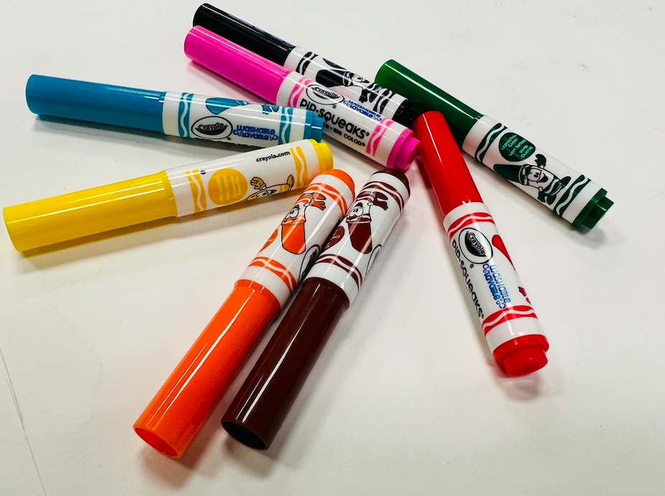
Round One of Brainstorming:
-
- .
Using your color marker, write notes and examples of the word Embrace and the word Difference for each of the large group papers. This can be words, pictures, sentences or both.
Notes:
Teacher instructions:
Group papers can be passed around or students can be walking around to groups to add new thoughts that may be inspired by what other groups have listed. Repeat this process until everyone from every group has added their color to each of the displays.
Teacher tip: if students are having difficulty coming up with different ideas, presenting topics as questions can help. For example: What are differences with food? Can you think of differences in fashion? Are there differences with emotions?

Slide 3
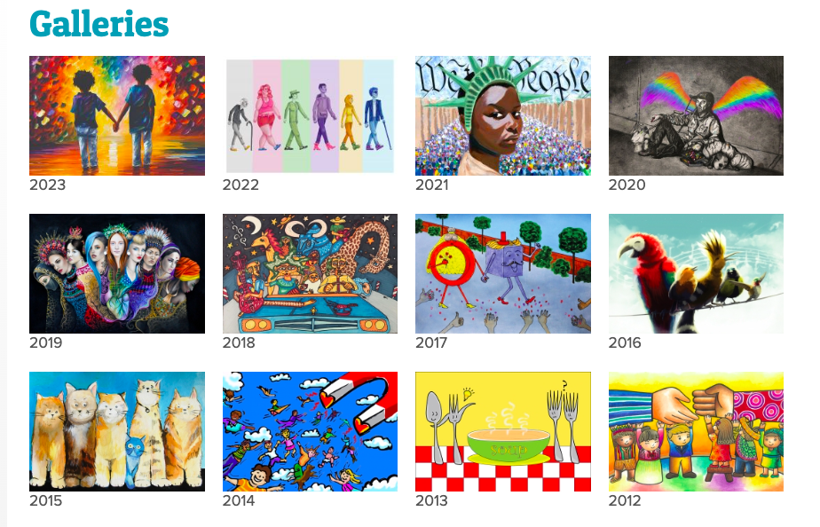

Round Two of the Brainstorming Process
Explore the Embracing Our Differences exhibit catalog books
or
online gallery at
https://www.embracingourdifferences.org/galleries/
Notes:
Teacher instructions:
Hand out sticky notes to each group (different colored sticky notes makes it easy to see each groups participation but not essential to the lesson). Students will draw/write/symbolize their favorite artworks from past EOD exhibits using books or the gallery on the website. Students should select art that is visually pleasing, that speaks to them, and that has a clear vision.
Students draw a simple rendition or write a short description on the sticky note and then add these to the brainstorming board. I recommend a minimum of three sticky notes per student.
Students will then find a connection with another groups poster and add their sticky notes.
*At the end of both brainstorming sessions, all of the group boards should be filled with different colored marker comments, drawings, and sticky notes that represent each individual students’ opinions and connections.

Slide 4
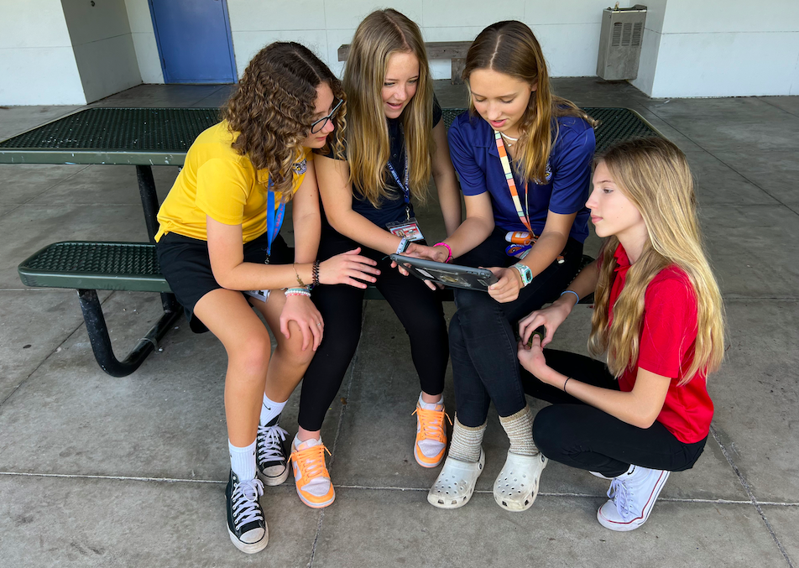
Discussion of favorite works and connections
Introduce yourself
Share your favorite artworks and tell why you like them
Participate in the conversation
Everyone’s opinion is important
Be courteous of others as they speak
Notes:
Teacher Notes:
Back in groups, give time to discuss what they see and share their favorite artworks. The best part about these brainstorming rounds are that there are no wrong answers.
*Teacher tip: remind students to be open, understanding, empathetic, and non-judgmental of others opinions during this discussion time.
*Students often find idea inspiration for their own project development. For example, student chose all black and white photography, or are drawn to compositions that include animals etc.

Slide 5
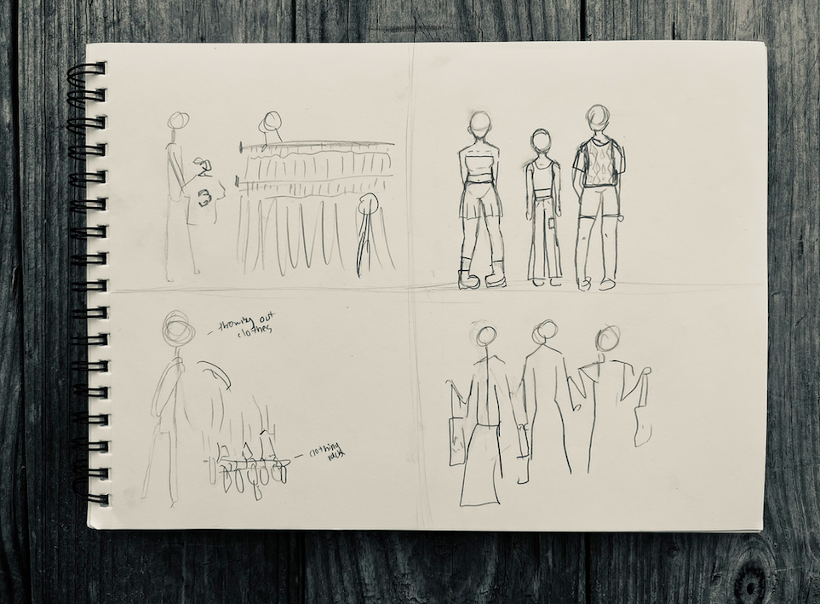
Sketches Set Up and Words Discussion
Before You Begin
Sketching
- 4 sections for sketches
- Orientation must be horizontal
- Plan interesting compositions
- Are words necessary in your design? Check out the next two slides for help with this decision
- Think of what compelling and instructive title you will give your art that helps complete your idea
Notes:
Teacher Notes:
Fold printer paper into 4 sections. Students create 4 sketches with different compositions on one sheet of paper.
Make sure that they are horizontal orientation.
Remind students of the importance of interesting composition (how do you want the viewers eyes to move around the art?)
Effective and impactful titling of an artwork lends to a successful understanding of a piece.

Slide 6

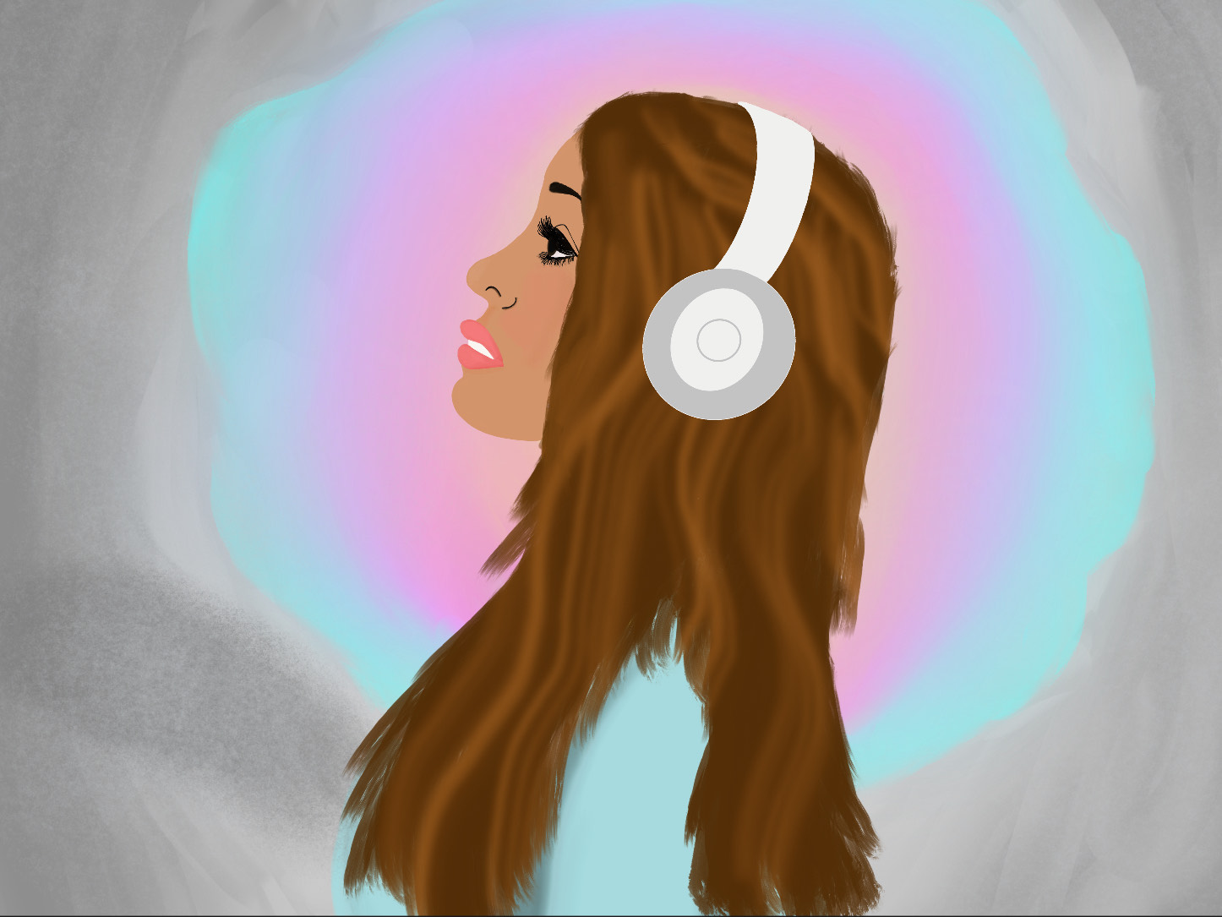
How do words add to the idea of Mazie’s art?
“Tuned Out” by: Mazie Zoller, 7th Grade, Rowlett Middle Academy, Bradenton, Florida
Why is “Tuned Out” a great title for this artwork?
Notes:
Teacher notes:
The words in Mazie Zoller’s “Tuned Out” help the viewer better recognize the artist’s idea when making the artwork.
The title, “Tuned Out” is effective because it enhances the understanding and consolidates the ideas behind the theme.

Slide 7
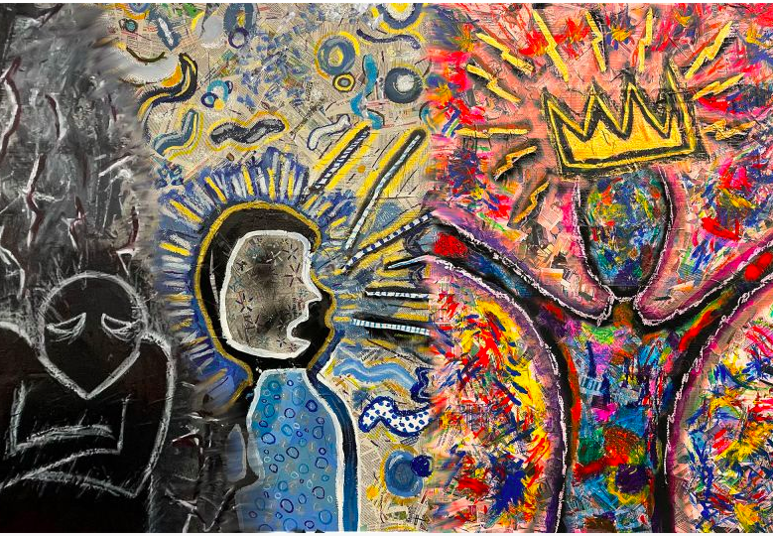
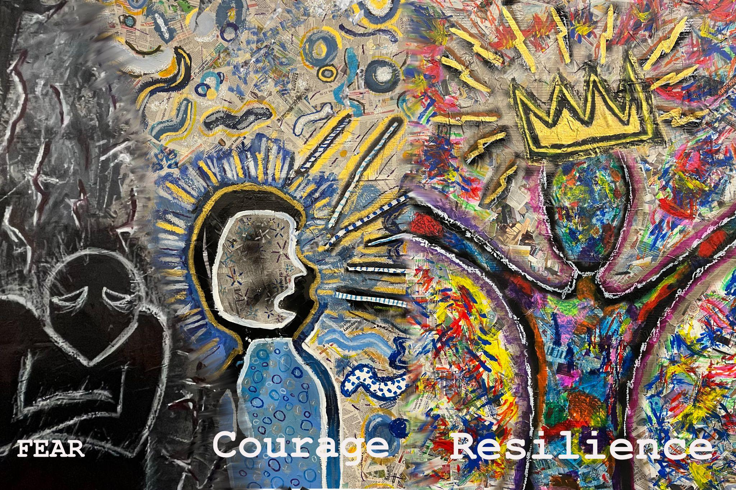
Why are words not essential for
“Life Doesn’t Frighten Me”?
“Life Doesn’t Frighten Me” by: Rowlett Middle Academy Visual Arts Students, 8th Grade, Rowlett Middle Academy, Bradenton, Florida
Notes:
Teacher notes:
Adding words to “Life Doesn’t Frighten Me” is not helpful to the understanding of the theme of the art. The words distract from the visuals instead of add to the visual story of the artwork.

Slide 8
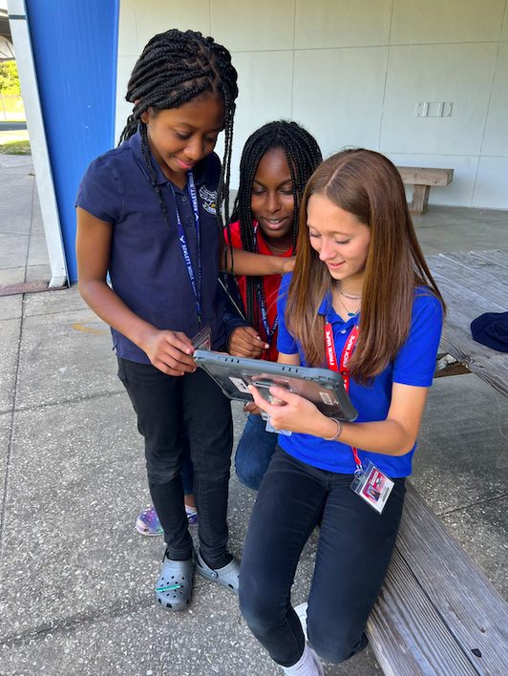
Discuss In 3’s
Show, Share, and Take turns giving 3:
- Give 1 detailed complement about their sketch
- Ask 1 thoughtful question
- Give 1 recommendation that could be helpful
Notes:
Teacher notes:
Students partner up to talk through their designs with 3 different peers.
Artists show all four sketches, share the title ideas, then the group discusses in 3’s:
Taking turns giving 3: give 1 detailed complement about their sketch, give 1 thoughtful question, and give 1 recommendation that could make the design better.
*It is recommended that students create a final sketch incorporating changes of your 3 reviews before beginning the final project.

Slide 9

Write your artist statement in complete sentences (150 Word Maximum)
1. State the title of your art and explain what you made
2. Explain your creative process
(what you used or will use to create your artwork)
3. Tell how you included the theme embracing our differences
4. Tell what the theme means to you.
5. Enjoy each of the steps when creating your own EOD Design!
Notes:
Essential Question:
Create a work of art that embraces our differences and clearly shows the perspective on a current topic of interest while being thoughtful of the viewing audience. This artwork must be horizontal orientation.
*Students can use, large brainstorming posters, slide experiences, and discussions to assist in creating the art and artist statement.

