Slide 1
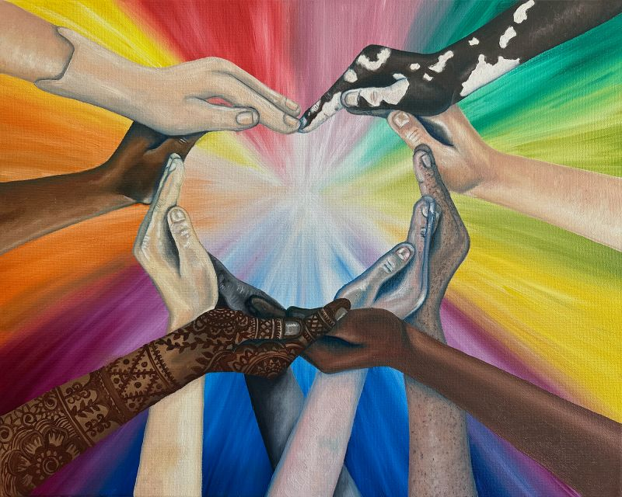
Silently look at this image.
What’s going on in this picture?
Notes:
Give students time to silently look at the image. Then ask, “What’s going on in this picture?” As students answer, gesture to the parts of the image that the student is referring to. Teacher can paraphrase what the student noticed. Then, follow up with, “What do you see that makes you say…?”
Ask students, “What more can we find?”

Slide 2
‘Hand’le with Care
By: Samantha Dennis
Do you think the message of this image would change if all the hands were the same? Why or why not?

Slide 3
Words to FOCUS ON
Inclusion
Empathy
Inclusion: to be included or made part of a group
Empathy: being aware of and sharing another person’s feelings, experiences and emotions
‘Hand’le with Care (2024)
by: Samantha Dennis, Woodbridge, Canada
Notes:
Teacher’s note: If you feel comfortable, this is a good time to give an example from your own life of a time when you felt excluded. Ask your students how they would have felt if they were in your same situation and what someone could have done to make you feel more included.

Slide 4
“An inclusive society is one where people are not judged by their individual differences but by the differences they make.”
Quote by: Dele Oye,
Mowe, Nigeria
What does this quote mean to you?
‘Hand’le with Care (2024)
by: Samantha Dennis, Woodbridge, Canada

Slide 5

Just Ask! by Sonia Sotomayor
  Like the variety of plants that grow in a garden, people are different, too. Do you think our differences are important? Why or why not?
  In what ways can we learn from people who are different from us?
  Sometimes, it is easy to overlook someone who doesn’t fit in with the group. How can we include others who are different or left out?
Notes:
Control + click the image of the book to play the story.

Slide 6

Turn and Talk
With a neighbor, finish these two statements:
One time I felt left out was when _______________________.
Being left out made me feel ____________________________ because ____________________________________________.
Listen carefully to your neighbor’s story.
Can you understand what they were feeling when they were left out? You are showing empathy.
Notes:
Give students think time before asking them to share.

Slide 7

Let’s Brainstorm
In small groups, we are going to brainstorm situations in which someone might feel left out because they are different.
Divide your poster paper into two columns.
Column 1 | Column 2
List situations in which someone might feel left out because they are different.
Notes:
Divide the class into small groups. Explain that each group is going to brainstorm a list of different situations in which someone might feel left out because they are different. Tell students that they will use this list later to inspire ideas for their artwork.
Ask each group to choose a person to record the group’s ideas. Have the groups fold their poster paper in half vertically, so it has two columns. Tell the students that in column 1 they will think of situations in which a person might feel left out because they are different.

Slide 8

How can we include others?
Column 2: Next to each situation listed in column 1, think of a way that we can help the person feel included.
Column 1 | Column 2
List situations in which someone might feel left out because they are different. | List ways that we can help someone in this situation feel included.
Notes:
The teacher can get group discussions going by giving an example for the class: A new student in your class doesn’t speak English. We all can help by using hand gestures or pictures when we are speaking and by learning to say hello in the other student’s language.
After brainstorming is finished, the teacher can tape each group’s poster to the wall. Then, ask one person from each group to present their group’s ideas to the class.

Slide 9





How can we turn our ideas into art?
Artists can use symbols to help represent complex ideas that would be hard to show in a picture.
A symbol is something that stands for something else.
What do the symbols below represent?

Slide 10
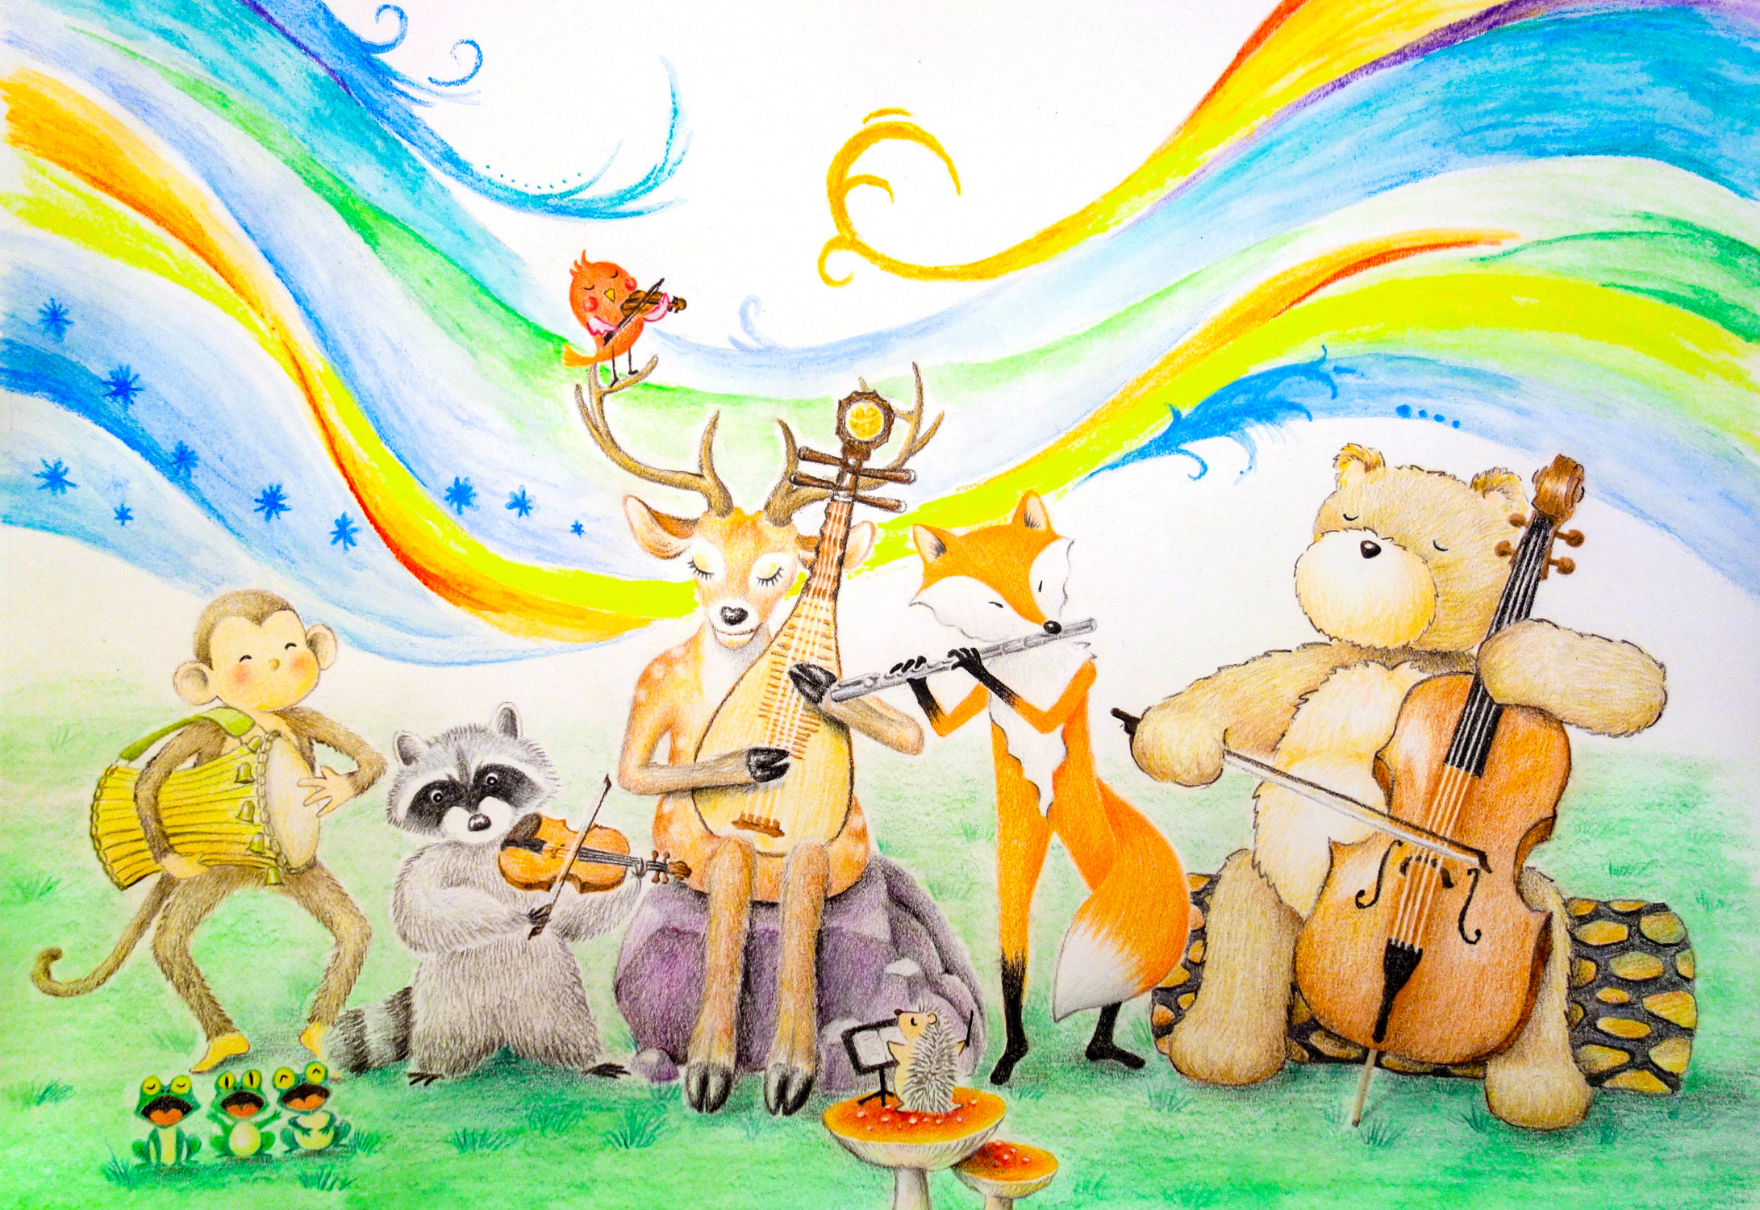
What do you think the animals playing music together is a symbol for?
What do you think this artwork would look like if it was realistic, or literal, instead of symbolic?
Harmony (2020)
by: Chiapei Chang, San Diego, California

Slide 11

Making thumbnail sketches
A thumbnail sketch is a small, quick drawing that artists make to help plan out how their artwork will look. It is like a rough draft.
Notes:
Teacher’s note: Demonstrate making a quick thumbnail sketch of ‘Hand’le with Care for students.

Slide 12

Let’s start sketching!
Select one idea from our inclusion brainstorming list that inspires you. Fold a blank piece of copy paper in half horizontally and label it sketch #1 and sketch #2.
Sketch #1 should use symbols to represent the message.
Sketch #2 should be realistic, or literal.

Slide 13

Gallery Walk: I like, I wonder, next steps
Divide into small groups and look at each of your group’s sketches. Next to each student’s art, write what you like about the sketches, what you wonder and what the artist could do next or improve.
Notes:
Use a Gallery Walk format for students to get feedback on their two sketches and decide which sketch to use for their final artwork. Number each student 1 through 5. Tell each student to bring both of their sketches with them to meet the other students with the same number for a Gallery Walk. Give each group a stack of notecards.
Ask students to look at all the sketches in their group and write feedback on a notecard for every artist. Students should divide their notecards into three columns: I Like, I Wonder and Next Steps. Each student will be required to write one thing they like about the sketches displayed, one thing they wonder about them, and one thing the artist could do next or improve. This process could also be done orally.
Students may then use their classmates’ feedback to improve their sketches and ultimately decide which sketch to turn into their final artwork.

Slide 14
Artist Statement
Write an artist statement when your final artwork is finished. Use complete sentences.
What is the title of your artwork?
How did you create your artwork? (What tools, supplies and techniques did you use?)
What does this piece of art mean to you? (You can use “I” statements and talk about what inspired you.)

