Slide 1
EOD Artist Statement
Why do you write an artist statement?
Artist Statements give the viewer some background on the work, you as the artist, and why you created the piece. A quality piece of artwork will always pique the interest of viewers on its own. However, providing an artist's statement for your work grounds the piece in the context you provide.

Slide 2
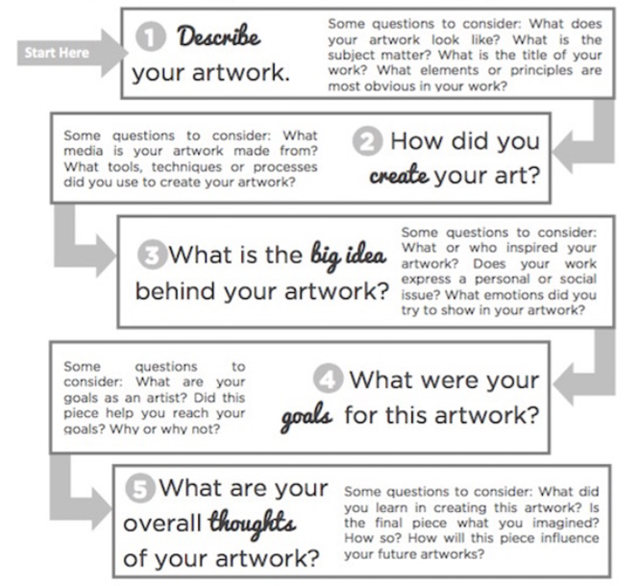
What should you include?
Edit your Statement
Use correct spelling & grammar – no text slang
Reread before you pass it in

Slide 3

Words
2012
Notes:
Excerpt from the Artist Statement
At one time in every person’s life, he or she has been made fun of, picked on or abused. Whether it’s because one is the new kid in school, or for believing in a different religion, or countless other reasons, it has happened to every single one of us. While the saying goes, “sticks and stones may break my bones, but words will never hurt me,” that does not apply to everyone. Words DO hurt. Cyber-bullying hurts as much as it does in person. Always remember that what you say could mark a person’s life forever.

Slide 4

State of Mind
2013
Notes:
Excerpt from the Artist Statement
“State of Mind” shows viewers that mental illness frequently goes unheard. Many people cannot deal or understand mental disorders because they fear it. When an individual suffers from a mental illness, they feel lost, different, and worthless compared to everyone else. These individuals need to be heard and express themselves. Having a mental illness doesn’t make anyone different; it makes that person a unique individual who expresses his or her differences differently.

Slide 5


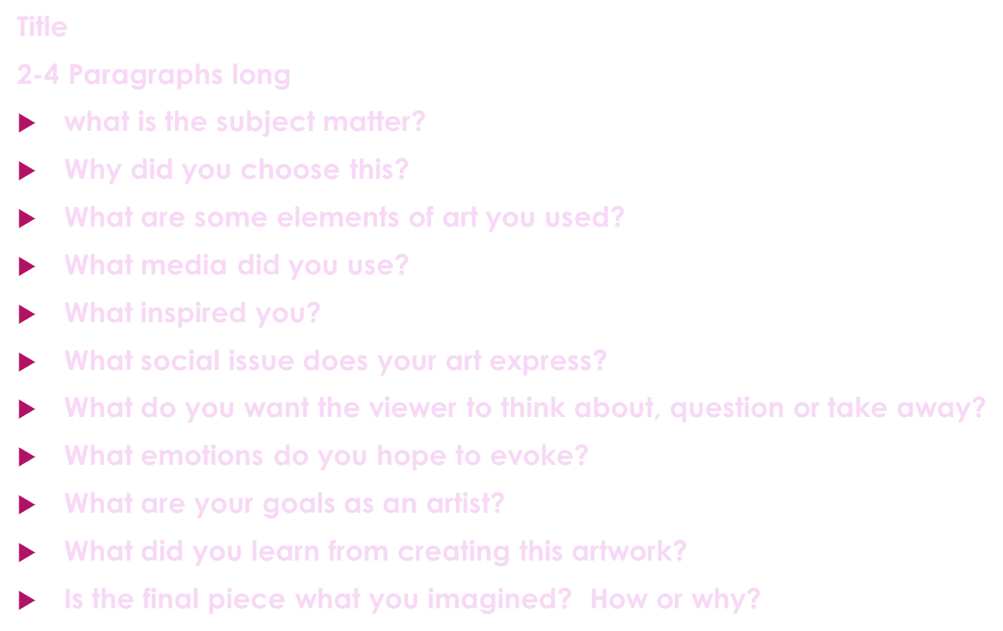


Pass in through blackboard
*Due Thursday, March 11th *

