Slide 1
We will LOOK, THINK, & TALK about art
to help us answer the questions:
What is the artist trying to teach me?
What is the artist’s message?
What is the artwork mainly about?

Slide 2
GATHER CLUES AND
EVIDENCE TO BACK UP OUR
THOUGHTS

Slide 3
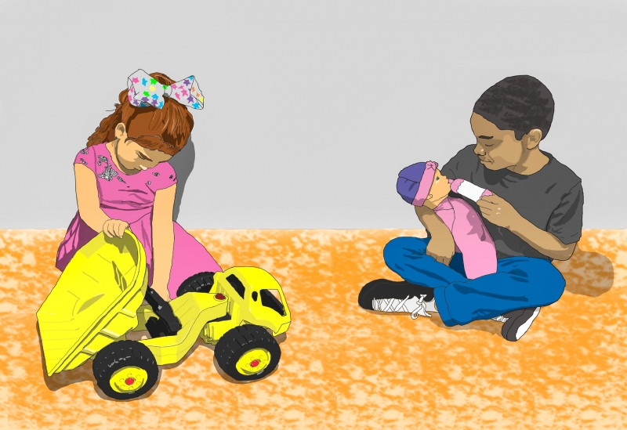
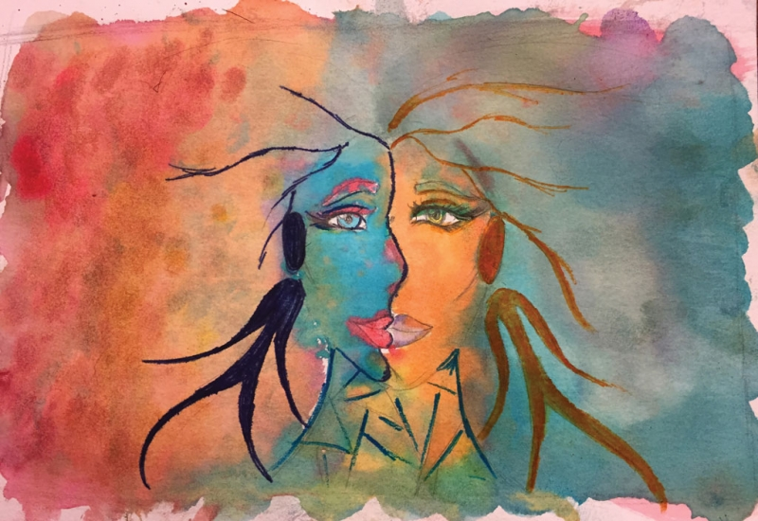
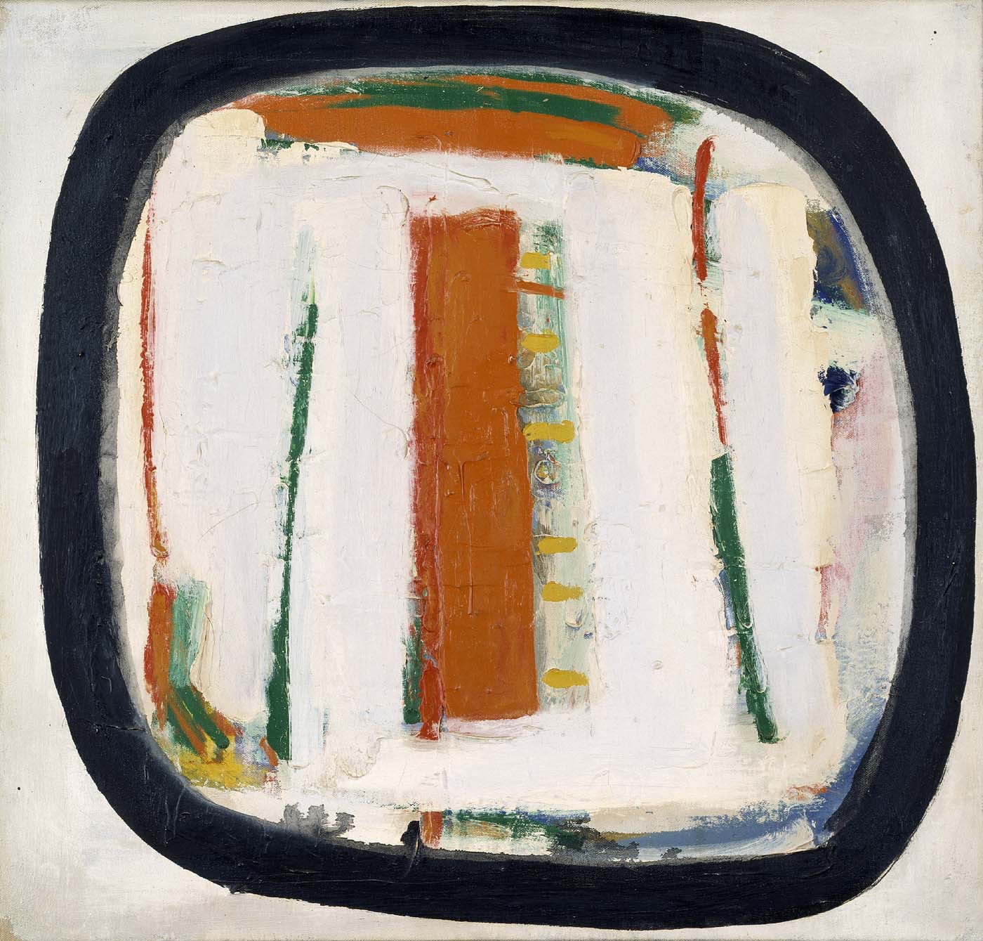
Classifying Art
Abstract
Representational
Nonrepresentational
Notes:
See pages in handout about the next few slides.
Compare different book genres to different art genres.
Representational art- realistic art.
Non representational art- formality of lines, shapes and colors, not depicting reality
Abstract- based on reality but abstracted line, colors and shapes.

Slide 4

Among the Sierra Nevada, California
1868
Albert Bierstadt
oil on canvas
72 x 120 1/8 in. (183 x 305 cm)
Smithsonian American Art Museum
Notes:
2020
Pink is for Girls
by: Napoleon Stewart, Edwardsville, Kansas
Artist Statement
My work addresses gender-specific roles and which toys are meant for which gender. We see a young boy playing with a doll—something that goes against societal norms. We also see a young girl playing with a toy that society would classify is for boys only. I created this because I have a daughter, and, too often, I see kids being told what types of toys they should or shouldn’t wear or play with, based on their gender. Toys are toys and should be viewed as such.

Slide 5
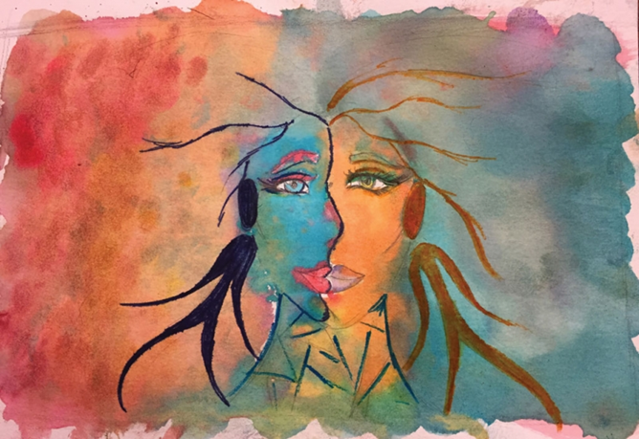
Kenneth Noland’s ‘Untitled’
Evening Tones
1911-1917
Oscar Bluemner
oil on canvas
15 1/4 x 20 in. (38.7 x 50.8 cm)
Smithsonian American Art Museum
Notes:
2017
Beauty in Opposites
by: Caecie D., 11th Grade, Ronald N. Davies High School - Fargo, North Dakota
Artist Statement
There is beauty in the harmony of opposites. Through the use of complementary colors my hope is to express this ideal, showing that each piece of diverse and different color serves a purpose. If we fail to embrace these differences, then we fail to see what the bigger picture is really about.

Slide 6
Untitled
1958
Kenneth Noland
acrylic on canvas
24 1/4 x 25 in. (61.6 x 63.5 cm.)
Smithsonian American Art Museum
Kenneth Noland’s ‘Untitled’

Slide 7
Classifying Art
Abstract
Representational
Nonrepresentational
Notes:
Compare different book genres to different art genres.
Representational art- realistic art.
Non representational art- formality of lines, shapes and colors, not depicting reality
Abstract- based on reality but abstracted line, colors and shapes.
Sometimes its hard to tell if its abstract or non representational. Without context about art and artist it might be difficult to tell. Its not to create an arguement but to categorize how our eye perceives it.

Slide 8
FACIAL EXPRESSION
Notes:
FACIAL EXPRESSION
2019
Bullies
by: Vince Gray, Cincinnati, Ohio
Artist Statement
I used the pointillism style for this painting, which shows that we all deal with bullies in our life. I meant this to not sadden - but to open the eyes and make us aware of the pain we cause when we bully others.
2019
Beyond the Burqa
by: Pranab Basak, Kolkata, India
Artist Statement
A burqa is an enveloping outer garment worn by women in some Islamic traditions. Some women choose to wear it proudly; others have no choice. Is this garment a means of oppressing women, or an assertion of religious and cultural identity? I hope the image of this little girl sparks these questions in the mind of the viewer. The burqa doesn’t hide her face—her deep, soulful life force shines through. I hope the sight inspires the viewer to see beyond the burqa.
2019
Thumbs Up
by: Judith Carlin, New York, New York
Artist Statement
“Thumbs Up” is my invitation for people to explore the world, experience new adventures, meet new people and celebrate our differences. The more we travel, the more people we meet, the more cultures we see up close, the more we will realize we’re not that different. We have to stop seeing people unfamiliar to us as the other. We may look different, eat different food, have different passions, but we are all the same in many ways. We want to be loved. We want our loved ones to have a roof over their heads, enough food to eat, to be safe, to be healthy and to be happy. “Thumbs Up” is a celebratory painting about what it means to be human.

Slide 9
FOCAL POINT
Notes:
FOCAL POINT
2019
Pressure
by: Lindsay W., 12th Grade, Saint Stephen's Episcopal School, Bradenton, Florida
teacher: Mollie Grady
Artist Statement
This piece represents the struggle that many young girls go through every day. Eating disorders affect many young girls, yet they are not talked about as openly as they should be. This work depicts the pressure many girls feel to fit the beauty standards set by society. Many times, girls feel they need to choose between eating and not eating to maintain a certain size. By encouraging conversations about this, I can help people become more open and expressive about their feelings.
2019
Internet Security
by: Sudipta D., 8th Grade, Cambridge School Noida, Dehli, India
teacher: Sandip Kr Deb
Artist Statement
Social media can be dangerous when it adversely affects us, causing depression, suicide, violence, addiction and more. We are not always aware of what is good for us. We might even think that our parents are our biggest enemies. We can get so addicted to this nonsense and propaganda that we don't know what the world is beyond our screen—how beautiful it can be. My artwork represents how we can live safely in this diverse, beautiful world so that it doesn’t kill us.
2019
Consumed
by: Kaley R., 11th Grade, Booker High School, Sarasota, Florida
teacher: Jeffery Cornwell
Artist Statement
My intention was to capture a literal sense of consumerism. I portrayed monster-like makeup products as a representation of the way companies tend to eat away at consumers’ insecurities or manipulate their needs to sell more products. By using labels such as “You NEED me!” or “EVERYBODY has this!” companies manipulate customers into believing they truly need a certain product when, in retrospect, they can survive without it. I chose this topic because the topic is not often discussed among young people. The younger generation has become desensitized to consumerism—especially when the media portrays “perfection” as a standard you can buy at a store. It’s important that younger people know that perfection is self-defined and doesn’t come in packages or have a price. Don’t let yourself be eaten alive by consumerism or societal pressures to be “perfect.”

Slide 10
GESTURE
Notes:
GESTURE
2019
Internet Security
by: Sudipta D., 8th Grade, Cambridge School Noida, Dehli, India
teacher: Sandip Kr Deb
Artist Statement
Social media can be dangerous when it adversely affects us, causing depression, suicide, violence, addiction and more. We are not always aware of what is good for us. We might even think that our parents are our biggest enemies. We can get so addicted to this nonsense and propaganda that we don't know what the world is beyond our screen—how beautiful it can be. My artwork represents how we can live safely in this diverse, beautiful world so that it doesn’t kill us.
2019
Thumbs Up
by: Judith Carlin, New York, New York
Artist Statement
“Thumbs Up” is my invitation for people to explore the world, experience new adventures, meet new people and celebrate our differences. The more we travel, the more people we meet, the more cultures we see up close, the more we will realize we’re not that different. We have to stop seeing people unfamiliar to us as the other. We may look different, eat different food, have different passions, but we are all the same in many ways. We want to be loved. We want our loved ones to have a roof over their heads, enough food to eat, to be safe, to be healthy and to be happy. “Thumbs Up” is a celebratory painting about what it means to be human.
2019
An Act of Kindness
by: Chalita Amornchaipiriyakul, Bangyai, Thailand
Artist Statement
Not every life is born lucky. It is the reality of this cruel world. Like stray animals born without decent food or shelter, some have been abandoned and left behind to defend themselves. But every life is equal. We can make the world a better place with just a small act of kindness. My artwork illustrates a little girl who found an abandoned puppy on the verge of death sitting alone in a pile of garbage. Being a kind-hearted girl, she took the puppy under her care. By passing her love forward, the girl got a loyal friend with whom she shares an unbreakable bond. The sky has never shone brighter.

Slide 11
CLOTHING
Notes:
CLOTHING
2019
Internet Security
by: Sudipta D., 8th Grade, Cambridge School Noida, Dehli, India
teacher: Sandip Kr Deb
Artist Statement
Social media can be dangerous when it adversely affects us, causing depression, suicide, violence, addiction and more. We are not always aware of what is good for us. We might even think that our parents are our biggest enemies. We can get so addicted to this nonsense and propaganda that we don't know what the world is beyond our screen—how beautiful it can be. My artwork represents how we can live safely in this diverse, beautiful world so that it doesn’t kill us.

Slide 12
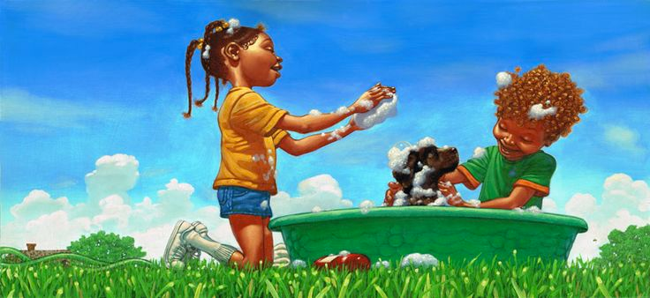
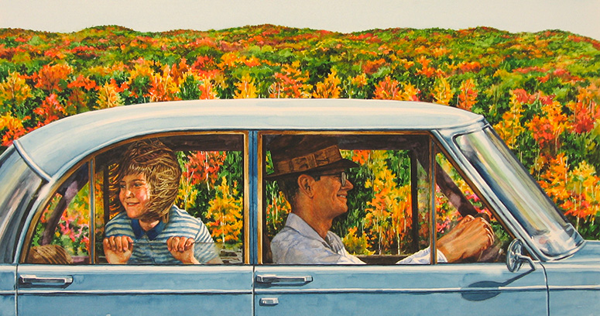
SETTING
Notes:
SETTING
2019
We Are All One in Our Struggle
by: Kathryn De Young, Manatee Technical College, Lakewood Ranch, Florida
teacher: Marina Proskurina
Artist Statement
This piece represents to me the embodiment of the quote "We are all one in our struggle...only egos, beliefs, and fears separate us." I wanted to show with this piece that there is no difference between us, the struggles are real for us all.
2019
Only Slightly Touched
By: Lucy Hsiung, 9th Grade, Taipei, Taiwan
Artist Statement
The media doesn't always show everything. They censor what they think are "flaws" and "imperfections." This piece represents the “touch-up” that can change the whole image; often whitewashing it to conform to artificial beauty standards. This is what people end up seeing in various media formats—missing the real beauty, the real person, behind all the digital work. No matter race, body type, or gender, people often feel less worthy than the figure projected on a flat, lifeless surface.
Kadir Nelson from Please Puppy Please
And Then It’s Spring by Julie Fogliano and Erin E. Stead

Slide 13
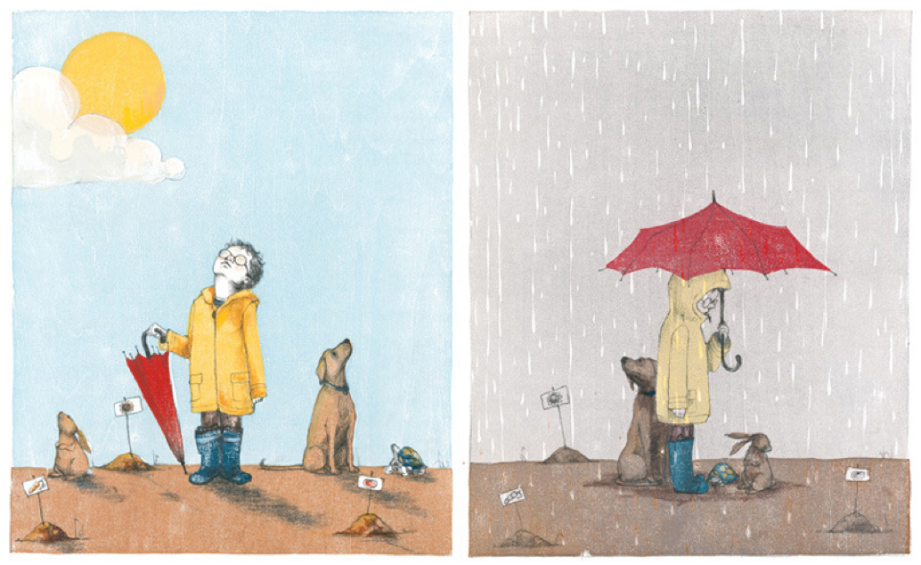

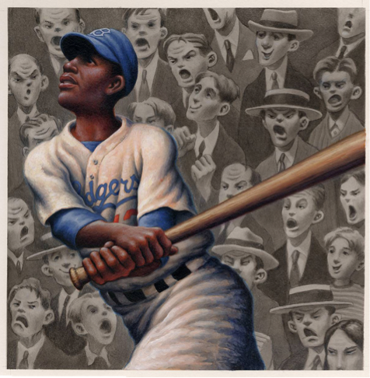
OBJECTS
Notes:
OBJECTS
Compare and contrast the objects
Kadir Nelson from Please Puppy Please
Rafael Lopez: http://rafaellopez.com/2013/02/11/the-king-of-mambo-arrives-on-marc/
And Then It’s Spring by Julie Fogliano and Erin E. Stead
A Sign by Georgia Ella Lyon and Chris Soentpiet
Loren Long—Jackie Robinson from Of Thee I Sing by Barack Obama

Slide 14
MORE CLUES!
For abstract art and works of art that don’t have people or recognizable places, look for these clues.
Quantity
1, 2, 3, 4...
many/few
equal/nonequal
Size
big/small
tall/short
wide/narrow
Value
light/dark
saturated/diluted
Color
primary/secondary
warm/cool
complementary/
analogous
neutral
Lines
straight/curved
horizontal/vertical
parallel/intersecting
moving/still
Shape/Form
2-D 3-D
round/angular
measured/irregular
convex/concave
geometric/organic
Texture
smooth/rough
hard/soft
shiny/dull
coarse/fine
dry/wet
Callers
ca. 1926
Walter Ufer
oil on canvas
Smithsonian American Art Museum

Slide 15
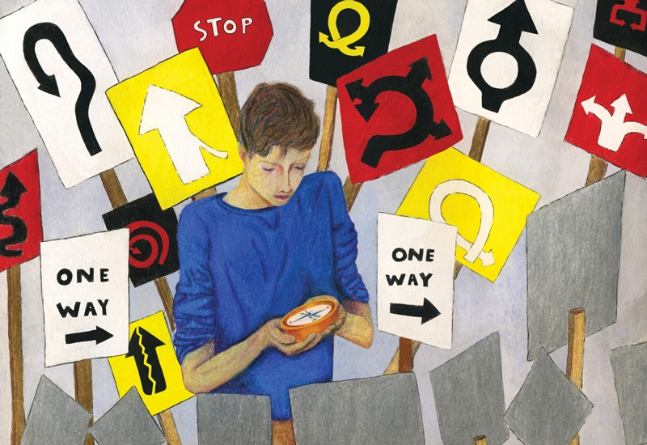
LOOK
(gather evidence silently for 1 min)
Facial expression
Focal point
Gesture
Clothing
Setting
Objects/ Lines/shapes
Quantity
Size
Colors
Textures
And more
Notes:
2016
Which Will You Follow?
by: Maya N., 10th Grade, Booker High School, Sarasota, Florida
teacher: Jeffery Cornwell
Artist Statement
My piece represents the chronic dilemma between staying faithful to your moral compass and not yielding to the pressure of society’s standards—whether from peers, authority figures, or the unsaid code. As human beings we constantly contend with wanting to be loved by others and yet yearning to love ourselves. Our futures are determined by how we navigate through every decision in this tug-of-war called life. Similar to the character in this piece, we a ttempt to keep our compass close to our hearts, reflecting our desire to protect clarity during the journey. We must embrace such a lesson’s truth with optimism to find balance in the end. https://youtu.be/faD2RfmPNaU?list=PLTYIqUIsA25Kz02Y6KmYPHRno1mG9eZIA

Slide 16
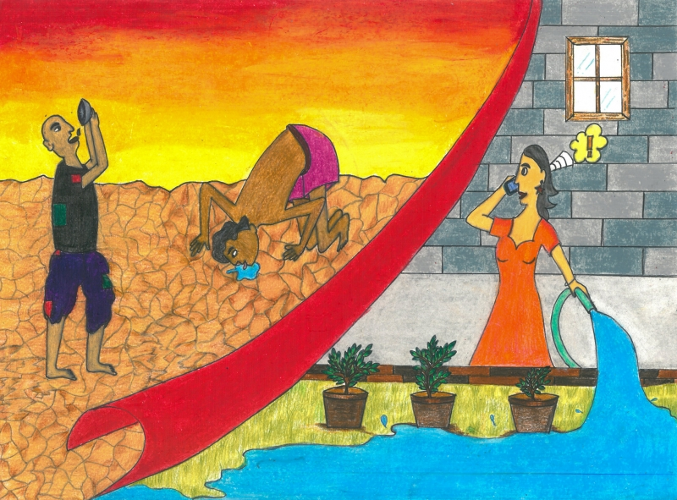
LOOK
(gather evidence silently for 1 min)
Facial expression
Focal point
Gesture
Clothing
Setting
Objects/ Lines/shapes
Quantity
Size
Colors
Textures
And more
Notes:
2020
Each Drop Counts by Sakina Mandsaurwalla, 5th Grade, Mumbai, India
Artist Statement
This topic highlights the growing scarcity of water in rural India. I hope to inspire people in urban India to become aware of how easily resources are available to them—and to think twice before wasting such precious resources. I think it is time for us to open our eyes to the suffering of those around us and value what is available to us. A little caution everyday will go a long way in quenching the thirst of all human beings.

Slide 17

LOOK
(gather evidence silently for 1 min)
Facial expression
Focal point
Gesture
Clothing
Setting
Objects/ Lines/shapes
Quantity
Size
Colors
Textures
And more
Notes:
2017
Beauty in Opposites
by: Caecie D., 11th Grade, Ronald N. Davies High School - Fargo, North Dakota
Artist Statement
There is beauty in the harmony of opposites. Through the use of complementary colors my hope is to express this ideal, showing that each piece of diverse and different color serves a purpose. If we fail to embrace these differences, then we fail to see what the bigger picture is really about.

Slide 18
LOOK, THINK, and TALK about ART
LOOK
(gather evidence silently for 1 min)
Facial expression
Focal point
Gesture
Clothing
Setting
Objects
Lines/shapes
Colors
Textures
And more
THINK
(silently for 1 min)
What is the artist
trying to teach me?
What is the
artist’s message?
What is the artwork
mainly about?
TALK
(with a partner for 1 min)
I think________
because I see______
When I see_______
it makes me think______
Only One
Georgia O'Keeffe
oil on canvas
36 x 30 1/8 in. (91.5 x 76.4 cm.)
Smithsonian American Art Museum

Slide 19
LOOK
(gather evidence silently for 1 min)
Facial expression
Focal point
Gesture
Clothing
Setting
Objects/ Lines/shapes
Quantity
Size
Colors
Textures
And more
Notes:
2016
Which Will You Follow?
by: Maya N., 10th Grade, Booker High School, Sarasota, Florida
teacher: Jeffery Cornwell
Artist Statement
My piece represents the chronic dilemma between staying faithful to your moral compass and not yielding to the pressure of society’s standards—whether from peers, authority figures, or the unsaid code. As human beings we constantly contend with wanting to be loved by others and yet yearning to love ourselves. Our futures are determined by how we navigate through every decision in this tug-of-war called life. Similar to the character in this piece, we a ttempt to keep our compass close to our hearts, reflecting our desire to protect clarity during the journey. We must embrace such a lesson’s truth with optimism to find balance in the end. https://youtu.be/faD2RfmPNaU?list=PLTYIqUIsA25Kz02Y6KmYPHRno1mG9eZIA

Slide 20
THINK
(silently for 1 min)
What is the artist
trying to teach me?
What is the
artist’s message?
What is the artwork
mainly about?
Notes:
2016
Which Will You Follow?
by: Maya N., 10th Grade, Booker High School, Sarasota, Florida
teacher: Jeffery Cornwell
Artist Statement
My piece represents the chronic dilemma between staying faithful to your moral compass and not yielding to the pressure of society’s standards—whether from peers, authority figures, or the unsaid code. As human beings we constantly contend with wanting to be loved by others and yet yearning to love ourselves. Our futures are determined by how we navigate through every decision in this tug-of-war called life. Similar to the character in this piece, we a ttempt to keep our compass close to our hearts, reflecting our desire to protect clarity during the journey. We must embrace such a lesson’s truth with optimism to find balance in the end. https://youtu.be/faD2RfmPNaU?list=PLTYIqUIsA25Kz02Y6KmYPHRno1mG9eZIA

Slide 21
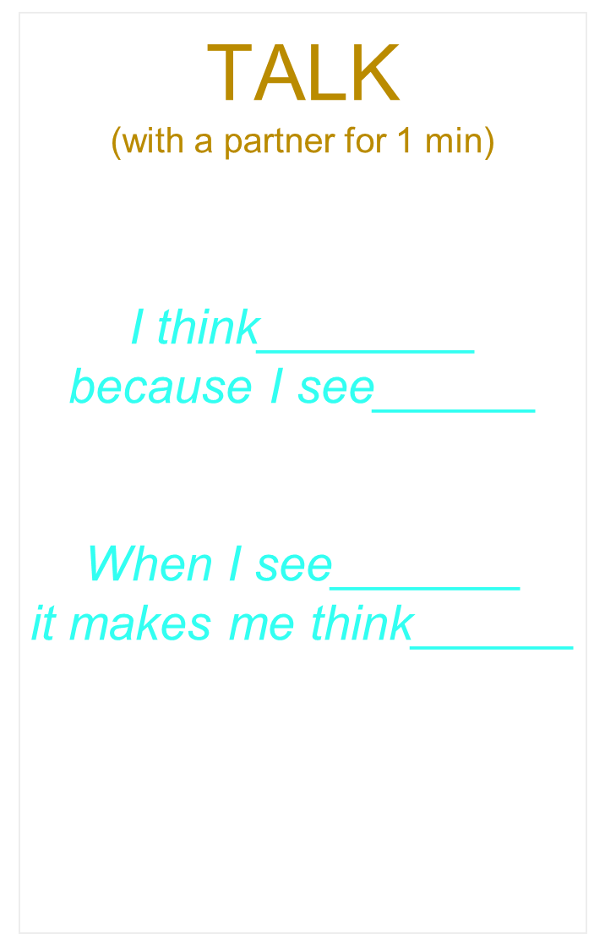
Notes:
2016
Which Will You Follow?
by: Maya N., 10th Grade, Booker High School, Sarasota, Florida
teacher: Jeffery Cornwell
Artist Statement
My piece represents the chronic dilemma between staying faithful to your moral compass and not yielding to the pressure of society’s standards—whether from peers, authority figures, or the unsaid code. As human beings we constantly contend with wanting to be loved by others and yet yearning to love ourselves. Our futures are determined by how we navigate through every decision in this tug-of-war called life. Similar to the character in this piece, we a ttempt to keep our compass close to our hearts, reflecting our desire to protect clarity during the journey. We must embrace such a lesson’s truth with optimism to find balance in the end. https://youtu.be/faD2RfmPNaU?list=PLTYIqUIsA25Kz02Y6KmYPHRno1mG9eZIA

Slide 22
LOOK, THINK, and TALK about ART
LOOK
(gather evidence silently for 1 min)
Facial expression
Focal point
Gesture
Clothing
Setting
Objects
Lines/shapes
Colors
Textures
And more
THINK
(silently for 1 min)
What is the artist
trying to teach me?
What is the
artist’s message?
What is the artwork
mainly about?
TALK
(with a partner for 1 min)
I think________
because I see______
When I see_______
it makes me think______
Only One
Georgia O'Keeffe
oil on canvas
36 x 30 1/8 in. (91.5 x 76.4 cm.)
Smithsonian American Art Museum

Slide 23
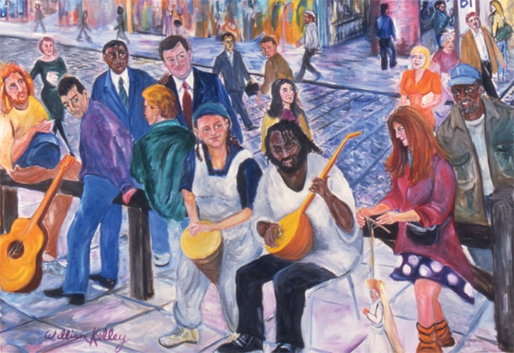
LOOK
(gather evidence silently for 1 min)
Facial expression
Focal point
Gesture
Clothing
Setting
Objects/ Lines/shapes
Quantity
Size
Colors
Textures
And more
Notes:
2007
Coby: William Kelley, Sarasota, Florida
vent Garden, London
Artist Statement
A socially conscious painting, Covent Garden celebrates unity and diversity by depicting a street full of different races enjoying a band of street musicians.

Slide 24
THINK
(silently for 1 min)
What is the artist
trying to teach me?
What is the
artist’s message?
What is the artwork
mainly about?
Notes:
2007
Coby: William Kelley, Sarasota, Florida
vent Garden, London
Artist Statement
A socially conscious painting, Covent Garden celebrates unity and diversity by depicting a street full of different races enjoying a band of street musicians.

Slide 25
Notes:
2007
Coby: William Kelley, Sarasota, Florida
vent Garden, London
Artist Statement
A socially conscious painting, Covent Garden celebrates unity and diversity by depicting a street full of different races enjoying a band of street musicians.

Slide 26
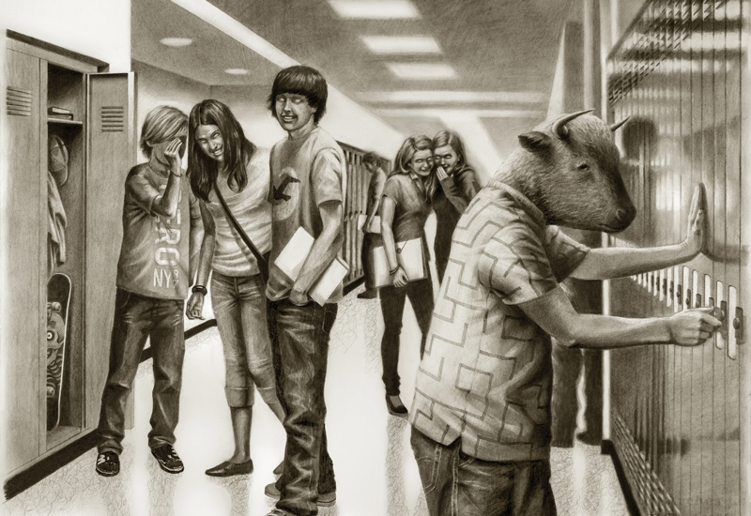
LOOK
(gather evidence silently for 1 min)
Facial expression
Focal point
Gesture
Clothing
Setting
Objects/ Lines/shapes
Quantity
Size
Colors
Textures
And more
Notes:
2016
Friends Forever
By: Sammy Chong, Chestnut Hill, Massachusetts
Artist Statement
Societies strive for the establishment of stability and order. Those who do not fit in and are deemed as different are consigned and silenced. Myths often portray them as monsters, like the Greek Minotaur. His alienation is rooted in the fact that he is reviled by others. It is not the essence of his being, it is imposed upon him by the mainstream. My drawing juxtaposes the conventional and the grotesque. By featuring the instability and disorder implicit in the monster concept, I introduce an inquiry into societal paradigms. This entails a consideration through contrast of a reality that embraces what is different at cultural, political, racial, economic, and sexual levels.

Slide 27
THINK
(silently for 1 min)
What is the artist
trying to teach me?
What is the
artist’s message?
What is the artwork
mainly about?
Notes:
2016
Friends Forever
By: Sammy Chong, Chestnut Hill, Massachusetts
Artist Statement
Societies strive for the establishment of stability and order. Those who do not fit in and are deemed as different are consigned and silenced. Myths often portray them as monsters, like the Greek Minotaur. His alienation is rooted in the fact that he is reviled by others. It is not the essence of his being, it is imposed upon him by the mainstream. My drawing juxtaposes the conventional and the grotesque. By featuring the instability and disorder implicit in the monster concept, I introduce an inquiry into societal paradigms. This entails a consideration through contrast of a reality that embraces what is different at cultural, political, racial, economic, and sexual levels.

Slide 28
Notes:
2016
Friends Forever
By: Sammy Chong, Chestnut Hill, Massachusetts
Artist Statement
Societies strive for the establishment of stability and order. Those who do not fit in and are deemed as different are consigned and silenced. Myths often portray them as monsters, like the Greek Minotaur. His alienation is rooted in the fact that he is reviled by others. It is not the essence of his being, it is imposed upon him by the mainstream. My drawing juxtaposes the conventional and the grotesque. By featuring the instability and disorder implicit in the monster concept, I introduce an inquiry into societal paradigms. This entails a consideration through contrast of a reality that embraces what is different at cultural, political, racial, economic, and sexual levels.

Slide 29
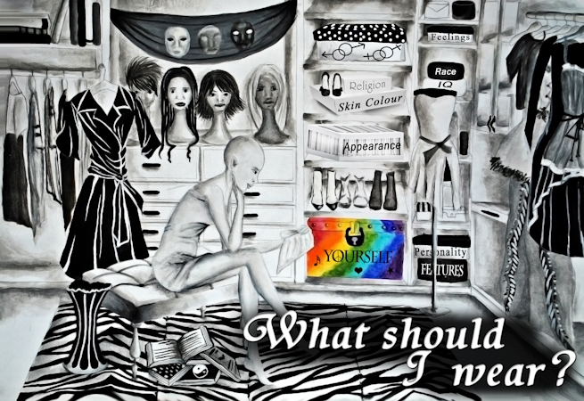
LOOK
(gather evidence silently for 1 min)
Facial expression
Focal point
Gesture
Clothing
Setting
Objects/ Lines/shapes
Quantity
Size
Colors
Textures
And more
Notes:
2012
Yourself
Best in Show Student
by: Alina C., 10th Grade, Alexandru Ioan Cuza National College - Galati, Romania
teacher: Silvia Rapiteanu
Artist Statement
My love for fashion influenced the creation of my artwork as a “closet in one’s mind” which, unfortunately, exists in many of us who seek acceptance and understanding. We try to hide who we really are, keeping our differences in “boxes.” But why - why do we do hide when being one’s self is the most beautiful thing? Everyone is different like trees or snowflakes. To me different means special and we should all find the key to open that special, colorful box inside each of us. Being yourself and understanding yourself is the first and most important step to accepting other people’s differences. I feel sorry for those who live in a black and white universe and see only with their eyes. When people begin to look with their hearts and minds, the world will finally be the place we can call “Home” – with colors bursting, people smiling and embracing one another.

Slide 30
THINK
(silently for 1 min)
What is the artist
trying to teach me?
What is the
artist’s message?
What is the artwork
mainly about?
Notes:
2012
Yourself
Best in Show Student
by: Alina C., 10th Grade, Alexandru Ioan Cuza National College - Galati, Romania
teacher: Silvia Rapiteanu
Artist Statement
My love for fashion influenced the creation of my artwork as a “closet in one’s mind” which, unfortunately, exists in many of us who seek acceptance and understanding. We try to hide who we really are, keeping our differences in “boxes.” But why - why do we do hide when being one’s self is the most beautiful thing? Everyone is different like trees or snowflakes. To me different means special and we should all find the key to open that special, colorful box inside each of us. Being yourself and understanding yourself is the first and most important step to accepting other people’s differences. I feel sorry for those who live in a black and white universe and see only with their eyes. When people begin to look with their hearts and minds, the world will finally be the place we can call “Home” – with colors bursting, people smiling and embracing one another.

Slide 31
Notes:
2012
Yourself
Best in Show Student
by: Alina C., 10th Grade, Alexandru Ioan Cuza National College - Galati, Romania
teacher: Silvia Rapiteanu
Artist Statement
My love for fashion influenced the creation of my artwork as a “closet in one’s mind” which, unfortunately, exists in many of us who seek acceptance and understanding. We try to hide who we really are, keeping our differences in “boxes.” But why - why do we do hide when being one’s self is the most beautiful thing? Everyone is different like trees or snowflakes. To me different means special and we should all find the key to open that special, colorful box inside each of us. Being yourself and understanding yourself is the first and most important step to accepting other people’s differences. I feel sorry for those who live in a black and white universe and see only with their eyes. When people begin to look with their hearts and minds, the world will finally be the place we can call “Home” – with colors bursting, people smiling and embracing one another.

Slide 32
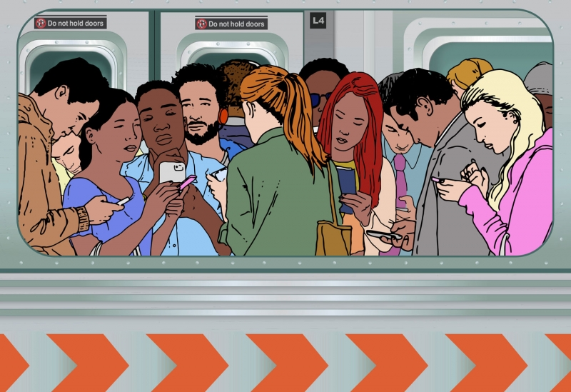
LOOK
(gather evidence silently for 1 min)
Facial expression
Focal point
Gesture
Clothing
Setting
Objects/ Lines/shapes
Quantity
Size
Colors
Textures
And more
Notes:
2018
Family
by: Jordi Sabate, Collingswood, New Jersey
Artist Statement
We live in a world of diversity and we interact with diverse groups of people in our daily lives. Our streets, subways, malls, and parks are rich with diversity. In this new age of social media, we not only interact in person with people across all cultures, races, and religions, but we also communicate with diverse groups beyond our borders. Technology can connect us with the whole world, but it can also isolate us from the people nearest us.

Slide 33
THINK
(silently for 1 min)
What is the artist
trying to teach me?
What is the
artist’s message?
What is the artwork
mainly about?
Notes:
2018
Family
by: Jordi Sabate, Collingswood, New Jersey
Artist Statement
We live in a world of diversity and we interact with diverse groups of people in our daily lives. Our streets, subways, malls, and parks are rich with diversity. In this new age of social media, we not only interact in person with people across all cultures, races, and religions, but we also communicate with diverse groups beyond our borders. Technology can connect us with the whole world, but it can also isolate us from the people nearest us.

Slide 34
Notes:
2018
Family
by: Jordi Sabate, Collingswood, New Jersey
Artist Statement
We live in a world of diversity and we interact with diverse groups of people in our daily lives. Our streets, subways, malls, and parks are rich with diversity. In this new age of social media, we not only interact in person with people across all cultures, races, and religions, but we also communicate with diverse groups beyond our borders. Technology can connect us with the whole world, but it can also isolate us from the people nearest us.

Slide 35
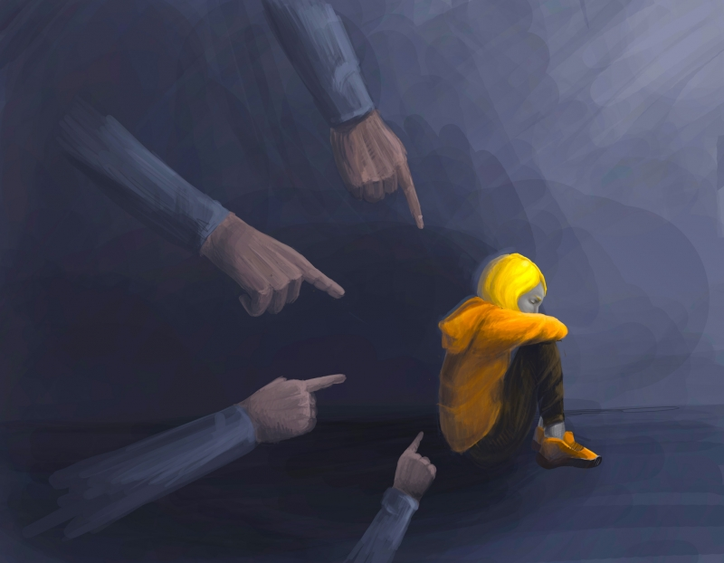
LOOK
(gather evidence silently for 1 min)
Facial expression
Focal point
Gesture
Clothing
Setting
Objects/ Lines/shapes
Quantity
Size
Colors
Textures
And more
Notes:
2020
Alienation
by: Maryana Oliynyk, Lviv College of Civil Engineering, Architecture & Design, Lviv, Ukraine
teacher: Alina Mulyk
Artist Statement
Remember that you can always grow in this position, but no one wants to feel alone.

Slide 36
THINK
(silently for 1 min)
What is the artist
trying to teach me?
What is the
artist’s message?
What is the artwork
mainly about?
Notes:
2020
Alienation
by: Maryana Oliynyk, Lviv College of Civil Engineering, Architecture & Design, Lviv, Ukraine
teacher: Alina Mulyk
Artist Statement
Remember that you can always grow in this position, but no one wants to feel alone.

Slide 37
Notes:
2020
Alienation
by: Maryana Oliynyk, Lviv College of Civil Engineering, Architecture & Design, Lviv, Ukraine
teacher: Alina Mulyk
Artist Statement
Remember that you can always grow in this position, but no one wants to feel alone.

Slide 38
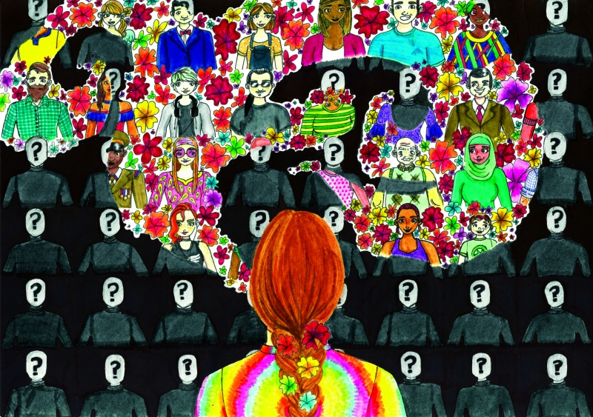
LOOK
(gather evidence silently for 1 min)
Facial expression
Focal point
Gesture
Clothing
Setting
Objects/ Lines/shapes
Quantity
Size
Colors
Textures
And more
Notes:
2020
Be a Voice, Not an Echo
by: Mackenzie A., 9th Grade, Saint Kentigern College, Auckland, New Zealand
Artist Statement
I want to represent how we sometimes feel forced to suppress our true identities as we fear society's judgment, but all that it takes for us to unlock who we are is the words of one person who is not afraid to speak up. I believe we can all be that person if we abandon our fear and learn how to use our power to change. Once we are able to do this, we can inspire others to do the same and take giant strides toward world peace. As Albert Einstein said, “Be a voice, not an echo."

Slide 39
THINK
(silently for 1 min)
What is the artist
trying to teach me?
What is the
artist’s message?
What is the artwork
mainly about?
Notes:
2020
Be a Voice, Not an Echo
by: Mackenzie A., 9th Grade, Saint Kentigern College, Auckland, New Zealand
Artist Statement
I want to represent how we sometimes feel forced to suppress our true identities as we fear society's judgment, but all that it takes for us to unlock who we are is the words of one person who is not afraid to speak up. I believe we can all be that person if we abandon our fear and learn how to use our power to change. Once we are able to do this, we can inspire others to do the same and take giant strides toward world peace. As Albert Einstein said, “Be a voice, not an echo."

Slide 40
Notes:
2020
Be a Voice, Not an Echo
by: Mackenzie A., 9th Grade, Saint Kentigern College, Auckland, New Zealand
Artist Statement
I want to represent how we sometimes feel forced to suppress our true identities as we fear society's judgment, but all that it takes for us to unlock who we are is the words of one person who is not afraid to speak up. I believe we can all be that person if we abandon our fear and learn how to use our power to change. Once we are able to do this, we can inspire others to do the same and take giant strides toward world peace. As Albert Einstein said, “Be a voice, not an echo."

Slide 41
Today we
LOOKED, THOUGHT, AND TALKED
about art
to help us answer the questions:
What is the artist trying to teach me?
What is the artist’s message?
What is the artwork mainly about?

Slide 42
WE GATHERED CLUES AND
EVIDENCE TO BACK UP OUR
THOUGHTS

Slide 43
How has the way you
look, think, and talk about
ART
changed?

